Slide 1
NAT: Two Purposes for Transition
Share IPv4 addresses: NAT44
Connect IPvX hosts to IPvY hosts: NAT64

Slide 2
1. Share IPv4 Addresses
Still lots of IPv4 content
  School websites, day care websites, ...
Still lots of IPv4 applications
  Skype, IP televisions
Not enough IPv4 addresses
  dual stack consumes IPv4 address at the same rate
NAT is not perfect. NAT at edge to minimize impact.
NAT Purpose 1: share IPv4 addresses among hosts
IPv4-only long tail

Slide 3
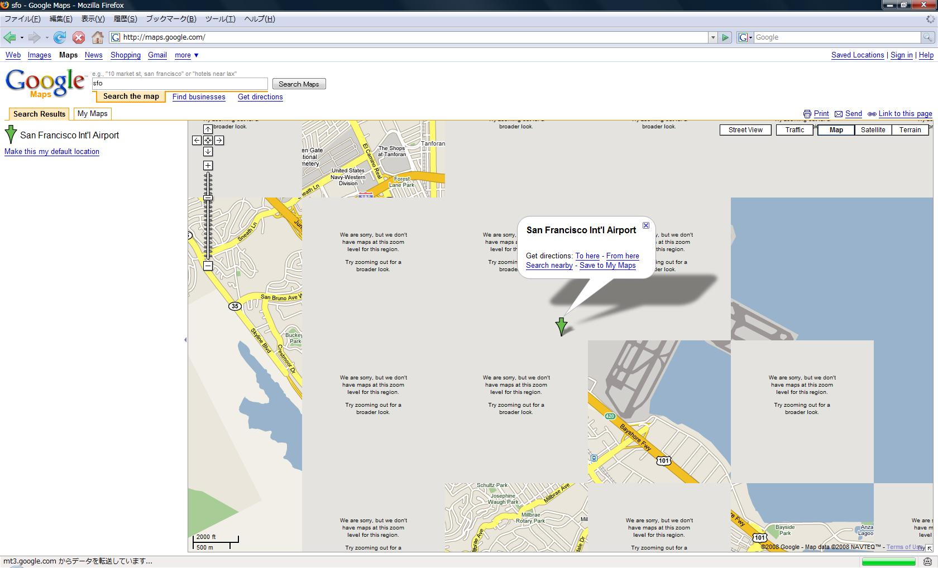
Address Sharing Gone Bad
Source: Shin Miyakawa, NTT Communications

Slide 4
IPv4 Address Sharing Technologies
IPv4 Address
Run-Out
Obtain IPv4 Addresses (RIR, address broker)
IPv4
IPv4 Address Sharing
CGN, NAT44,
SD-NAT
6rd
+
CGN
Dual
Stack
Lite
4rd/
dIVI
IPv6
native
6rd

Slide 5

2. Connect IPvX to IPvY
NAT Purpose 2: connect IPv6 to IPv4
IPv4
IPv6
NAT64
IPv4-only hosts
IPv6-only hosts

Slide 6
Connecting IPvX hosts to IPvY hosts
NAT64 is not perfect
IPv6 and IPv4 are not compatible
  Fragmentation (IPv4: network fragments, IPv6: hosts fragment)
  minimum MTU (IPv4: 576, IPv6: 1280)
  IPv4 options versus IPv6 extensions
Like NAT44:
  NAT64 can also bring Application Layer Gateway (ALG) issues
  Complicates troubleshooting and abuse handling

Slide 7
IPv6 Transition: Tunnel or Translate?
translate
tunnel
native routing
worst
best

Slide 8
Conclusion
IPv4 address sharing (NAT, A+P, other)
  Necessary to keep business running
  Necessary to keep users happy (long tail IPv4)
  But is never ideal
Native IPv6 > tunneling > NAT
Focus on mechanisms that move towards IPv6
Simple to operate
Stateless

