Slide 1
IEEE OmniRAN for Heterogeneous Networks
24 July 2012
Roger Marks
Juan Carlos Zuniga
Charlie Perkins

Slide 2
Introduction
OmniRAN Tutorial presented at the last IEEE 802 Plenary meeting
Heterogeneous Networking among the IEEE 802 Family: http://www.ieee802.org/Tutorials.shtml
Discussion currently in HetNet Study Group
Proposal:
new IEEE 802 WG (e.g. IEEE 802.25) to specify access network abstraction layer above IEEE 802 (and possibly other) access technologies

Slide 3
OmniRAN Expectations
Use existing IEEE 802 access specifications
Use existing IETF RFCs
Relate to some IETF working groups:
DMM
MIF
NETEXT
Other?

Slide 4
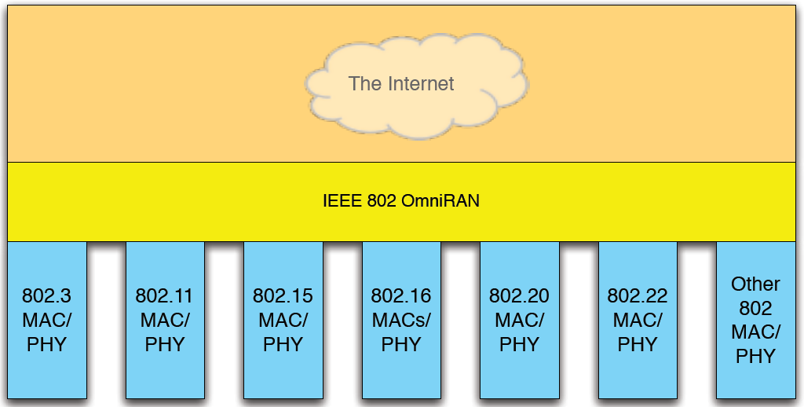
IEEE 802 OmniRAN fills a gap

Slide 5
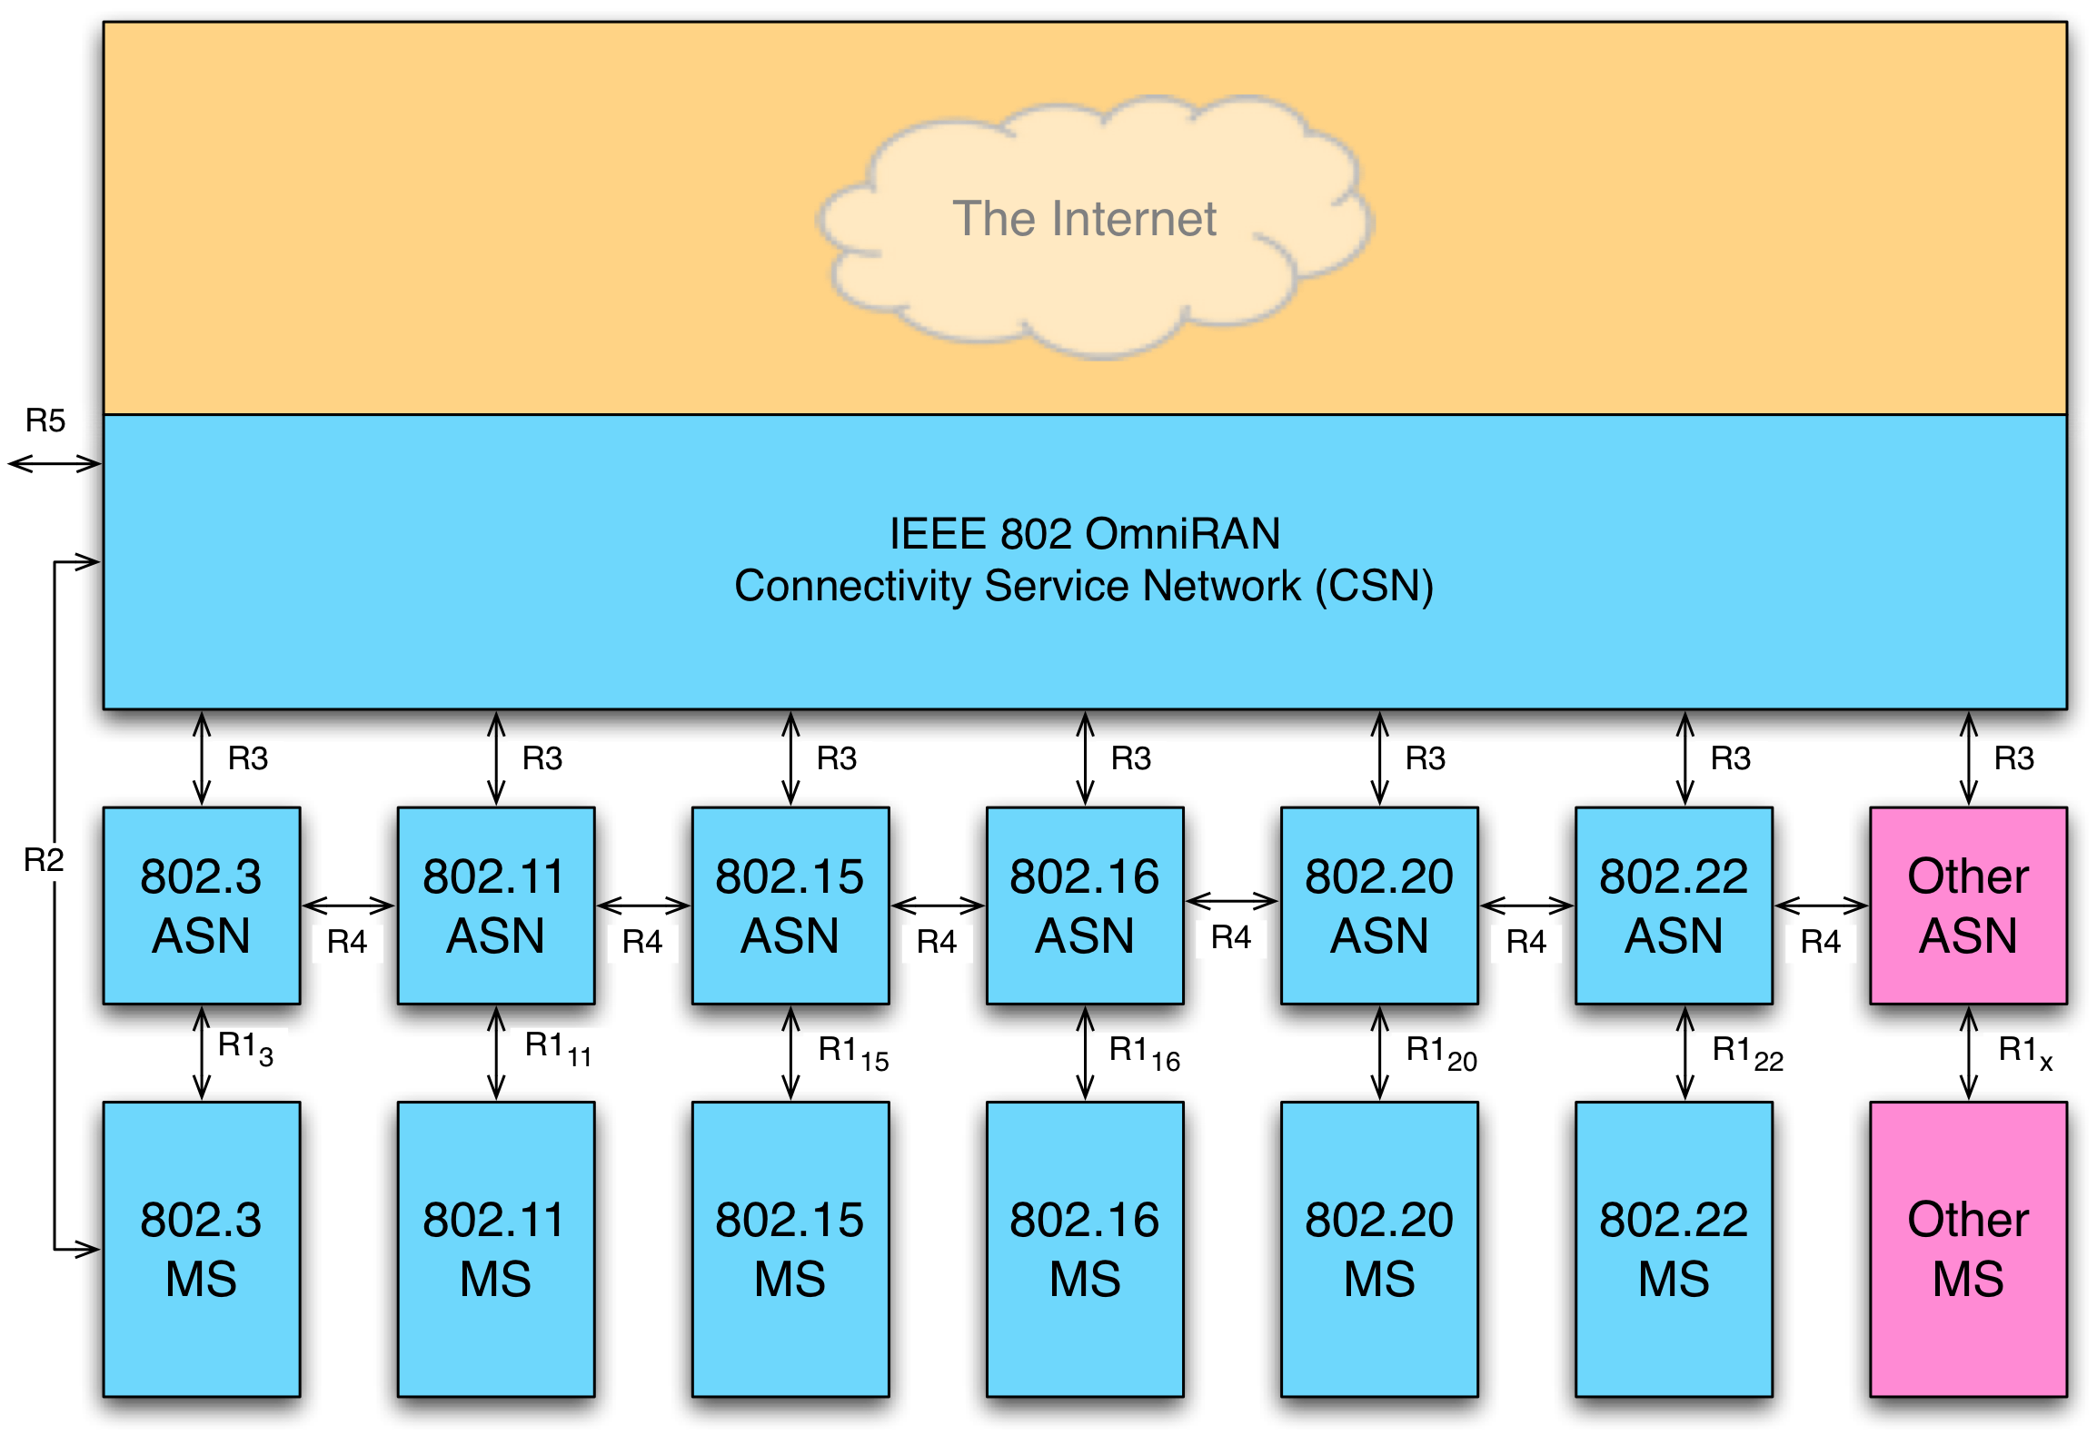
OmniRAN Architecture

Slide 6
OmniRAN Functionality Menu
Network Discovery and Selection
Authentication & Security
Provisioning
Accounting, Charging, and Settlement
Connection Management
QoS, Admission Control and Service Flow
Power Management
Interworking and Roaming
Radio Resource Management
Operation, Administration, Maintenance and Provisioning
Lawful Interception
Location Services
Emergency Telecommunications Service
VoIP

Slide 7
OmniRAN and IP Mobility
Heterogeneous devices require integrated solutions for inter-RAT mobility
IETF – LIF informational / recommended practices
IETF – DMM not addressing issues below L3
IEEE 802.21 offers partial solution to mobility
IEEE 802.3, 802.11, 802.15, 802.16, etc, & 3GPP: out of scope
OmniRAN can fill the gap

Slide 8
Conclusions / Recommendations
IEEE 802 OmniRAN can close the gap and tie 802 devices into a family of standards within a heterogeneous IP network supporting evolving IETF standards
IEEE 802 and IETF should…
leverage each other’s expertise
plan communications
identify commonalities
link solutions
organize a team to coordinate milestones and progress

Slide 9
Backup slides

Slide 10
IETF NETEXT Logical Interface (Data Plane)
Allows hiding L2/L1 changes to IP stack and maintaining session bindings active
Permits forwarding traffic to different access networks / interfaces regardless of the original IP address assignment
TCP/UDP
Session to IP address binding
IP
IP to logical interface binding
Logical Interface
Logical to physical interface binding
L2 (IF#1)
L2 (IF#2)
L2 (IF#n)
…
L1
L1
L1

Slide 11
IEEE 802.21 MIHS (Control Plane)
Provides predictive signaling that can proactively trigger handovers or flow mobility and hence enhance QoE (ES)
Allows a better control of lower layers to enforce Operator and User’s policies (CS)
Provides information about available access networks (IS)
MIH User
(MIP, Policy Control, Conn Mgr)
MIH_SAP (API)
MIHF
MIH_Link_SAP (API)
L2 (IF#1)
L2 (IF#2)
L2 (IF#n)
…
L1
L1
L1

