Slide 1
Supercharged Forward Error Correction Codes
draft-stauffer-rmt-bb-fec-supercharged-00
(update to this soon to be submitted officially)
IETF #84 – Vancouver
July 29 – August 3 2012
Stephanie Pereira and Erik Stauffer

Slide 2
Outline
Broadcom Proposal for Supercharged Codes
Case for Supercharged Codes: Performance, Plug & Play
Plug & Play into protocol stack
Description of Supercharged Code
Performance Results
Recommendation to adopt as working draft

Slide 3
Proposal
Supercharged codes should be adopted as an alternative technology to RFC 5053 and RFC 6330

Slide 4
Supercharged Codes: Improved Performance
Larger block sizes:
Optimal Maximum Distance Separable performance for smaller block sizes, N<257, others do not come close
Error probability orders of magnitude less than RFC 5053 for same received overhead
Code | Supercharged | RFC 5053 | RFC 6330
Block Size [Symbols] | 61617 | 8192 | 56403

Slide 5
Supercharged Codes are “Plug & Play!”
Works with existing stack
No change needed to TCP/IP, UDP, LCT, ALC and Flute protocols
Retains key benefits of RFC 5053 and RFC 6330
Systematic
Flexibility in assignment and size of source symbols in transmit block:
10 to 61617 source symbols per transmit block
1 to 65536 bytes per symbol
Encoder supports wide variety of decoder cache sizes (down to kB)
Supports a range of code rates from near zero (e.g. 1/128) to 1
Decoding time linear in number of transmit symbols

Slide 6
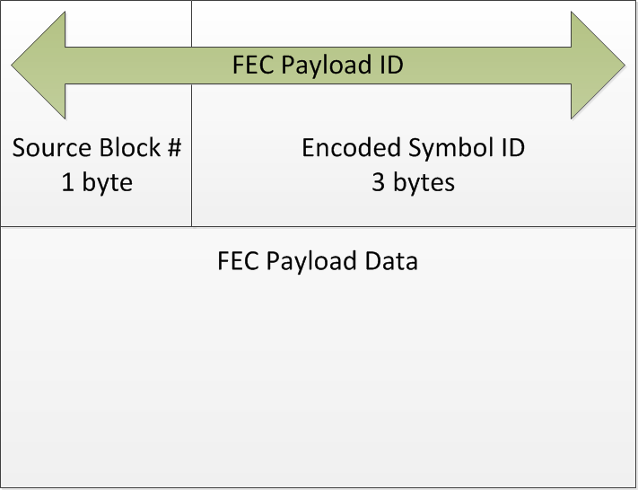
Plug Into Protocol Stack
Same setup as RFC 5053
FEC Payload unchanged:
FEC Object Transmission Information:
F, T, Z, N parameters unchanged
LSB of Al parameter changed to be a flag to enable performance enhancing optimizations for small block sizes

Slide 7
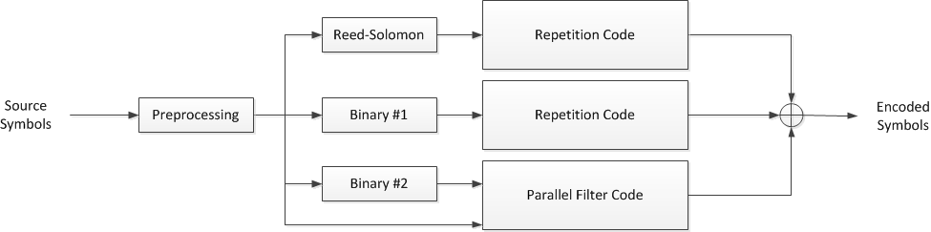
Supercharged Code Description
Mixture of Random coding theory and Block coding theory
Three block codes:
Reed-Solomon
Binary #1
Binary #2
Repetition codes
Parallel filter code: Random interleavers and FIR filters
Preprocessing of source symbols to guarantee systematic code

Slide 8
Reed-Solomon Code
Block Code 1:
Non-systematic Reed-Solomon Code, i.e. a Vandermonde matrix

Slide 9
Parallel Filter Code
Parallel Filter Code:
Random interleaver followed by a FIR filter
Multiplexer selects the output of the FIR filters randomly

Slide 10
Combining the Codes
Block code outputs are informative but complex to decode
Parallel filter output are easily decoded by not as informative
Hence, repeat block code outputs and XOR with parallel filter output to produce the Supercharged encoded symbols

Slide 11
Error Probability vs Received Overhead
K=# source symbols, N=#transmitted symbols
Received Overhead = # symbols needed to decode- # source symbols
Each line is 3GPP SA4 test case
Number | K | N | Channel
CP1 | 32 | 39 | IID P_{e}=5%
CP2 | 128 | 154 | IID P_{e}=5%
CP3 | 256 | 282 | IID P_{e}=5%
CP4 | 1024 | 1127 | IID P_{e}=5%
CP5 | 8192 | 9012 | IID P_{e}=5%
CP6 | 32 | 45 | IID P_{e}=10%
CP7 | 128 | 180 | IID P_{e}=10%
CP8 | 256 | 308 | IID P_{e}=10%
CP9 | 1024 | 1229 | IID P_{e}=10%
CP10 | 8192 | 9831 | IID P_{e}=10%

Slide 12
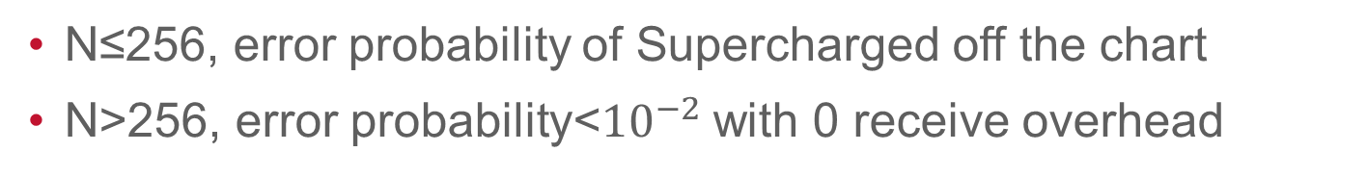
Error Probability vs Received Overhead
N≤256, error probability of Supercharged off the chart
N>256, error probability<${10}^{−2}$ with 0 receive overhead
Number | K | N | Channel
CP11 | 32 | 34 | N/A, rand shuffle
CP12 | 32 | 38 | N/A, rand shuffle
CP13 | 32 | 128 | N/A, rand shuffle
CP14 | 256 | 269 | N/A, rand shuffle
CP15 | 256 | 307 | N/A, rand shuffle
CP16 | 256 | 1024 | N/A, rand shuffle
CP17 | 1024 | 1075 | N/A, rand shuffle
CP18 | 1024 | 1229 | N/A, rand shuffle
CP19 | 1024 | 3072 | N/A, rand shuffle
CP20 | 8192 | 8601 | N/A, rand shuffle
CP21 | 8192 | 9830 | N/A, rand shuffle
CP22 | 8192 | 30000 | N/A, rand shuffle

Slide 13
Recommendation
Adopt as a Reliable Multicast Transport working group draft

Slide 14
Appendix: Compare with RFC 6330
Better support for small blocks, i.e. N≤256
Useful for streaming applications
Better support for large blocks sizes (~20% larger)
Comparable performance elsewhere

