Slide 1

NeMo - Network Modeling for Applications
---- An Application API for Intent Driven Networking

Slide 2
Context for Nemo
Nemo
Application API
Open Innovation
Software
Defined
Networking
NFV

Slide 3
Topics
Why NeMo?
Status
State machine
Demo Description

Slide 4
Why Intent-Driven NeMo?
Application needs Intent-Driven not prescriptive Control
Applications need a Simple API
Request Virtual network path through specific functions with network services at flow rate,
When applications can aid control of network, storage, compute – can reach 95% utilization of net, storage, compute
NeMo has 3 primitive groups, 15 sentences, and 36 key words
Application to state:
  A connection between two sites with flows
  Network Function flow
  A customer network service chain
Intent Driven: What I want not how to do it
  Let network layers figure out how to accomplish intent
High level
  Yang is low-level specific to device
App 2
App 1
Node or
Function

Slide 5
Path through logical funcitons

Slide 6
NeMo can enable
Multi-service NFV Controller
MultiService NFV controller
NeMo’s API uses REST/RPC to talk to Nemo Language Engine
Problem
  It’s hard to support multiple, independently developed SDN applications or services without resource conflicts
State of the Art
  ODL Helium has not solved this problem which prevents competing flow writers that can’t be run simultaneously.
  It is not possible to run e.g. NetVirt and SFC services in the same controller domain.
  Commercial controllers have not solved this problem either
Nemo API
Set of Network Functions
NetVirt + SFC-Ctl

Slide 8
NeMo API at App layer rather than ODL Policy Groups
OPL Group Policy
Policy Groups architecture
Purpose:
  “higher” than neutron policy storage and control
Benefits:
  Intent based
  Use PCIM concepts (RFC3060, 3460, 3644) that combine policy rules into policy groups (aka contracts)
Problem:
  Only Flow behavior, no create node or specify network service so cannot handle NFV devices or TE channels
  Need Network flows, NFV, SFC, TE plus compute and storage placement
CLI
Heat
Horizon
Neutron
Policy Manager
Legacy
Policy driver
ODL
Policy
Driver
others

Slide 9
Status
Completed: (July – Nov)
API presented at network forums
IETF drafts + technical Manual specify language State Machine
Proof of Concept demo created
Possible Next Steps:
Work with Telefonica on the Nemo interface to IDE
Create Open Daylight Project
Add Security level to API
We welcome feedback on NEMO, proof of concept demo, and our next steps.

Slide 10
The NetIDE Architecture

Slide 11
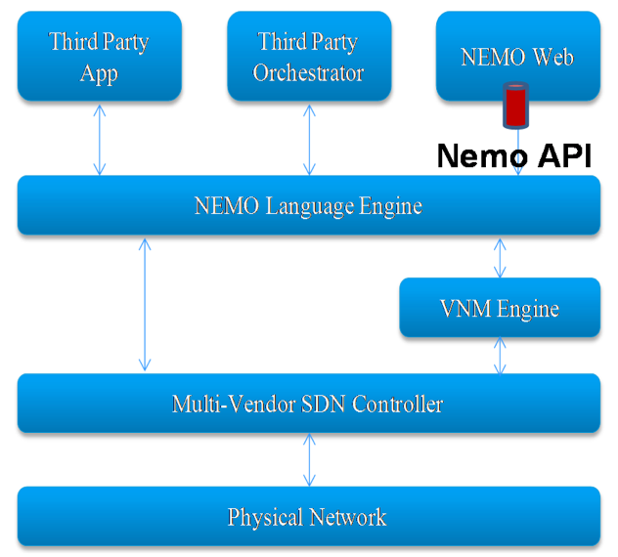
Matching NeMo and NetIDE
NeMo can provide the support for the NetIDE IRF
NetIDE can act as the NeMo Virtual Network Engine
No overlap, clear synergies
Align IPR policies

Slide 12
NEMO Language - 3 Primitive Groups
NEMO Language: Concise and Flexible
Resource Access
Entity Model | node | Node/UnNode entity_id Type {FN|PN|LN} Owner node_id Properties key1 ,value1
 | link | Link/UnLink entity_id Endnodes (node1_id,node2_id) SLA key,value Properties key1 ,value1 ….
 | flow | Flow/UnFlow entity_id Match/UnMatch key1, value1|Range(value, value) |Mask(value, value) Properties key1 ,value1
Policy and Event Handling
Capability Model | Query | Query key Value {value} From entity_id
 | Policy | Policy/UnPolicy policy_id Appliesto entity_id Condition {expression} Action { “forwardto” | “drop” | “gothrough” | “bypass” | “guaranteeSLA” | “Set” |“Packetout“| Node | UnNode | Link | Unlink} Commit / Withdraw
 | Notifica-tion | Notification entity_id On key Every period RegisterListener callbackfunc
Model Definition and Transactions Control
Connect Transaction | Connect <conn-id> Address <ip-prefix> Port <integer> Disconnect <conn_id> Transaction …. Commit
Node definition | NodeModel <node_type> Property { <data_type> : <property_name> }
Link definition | LinkModel <Link_type> Property { <data_type> : <property_name> }
Action definition | ActionModel <Action_Name> parameter { <data_type> : <property_name> }

Slide 13
NeMo Language Engine

Slide 14
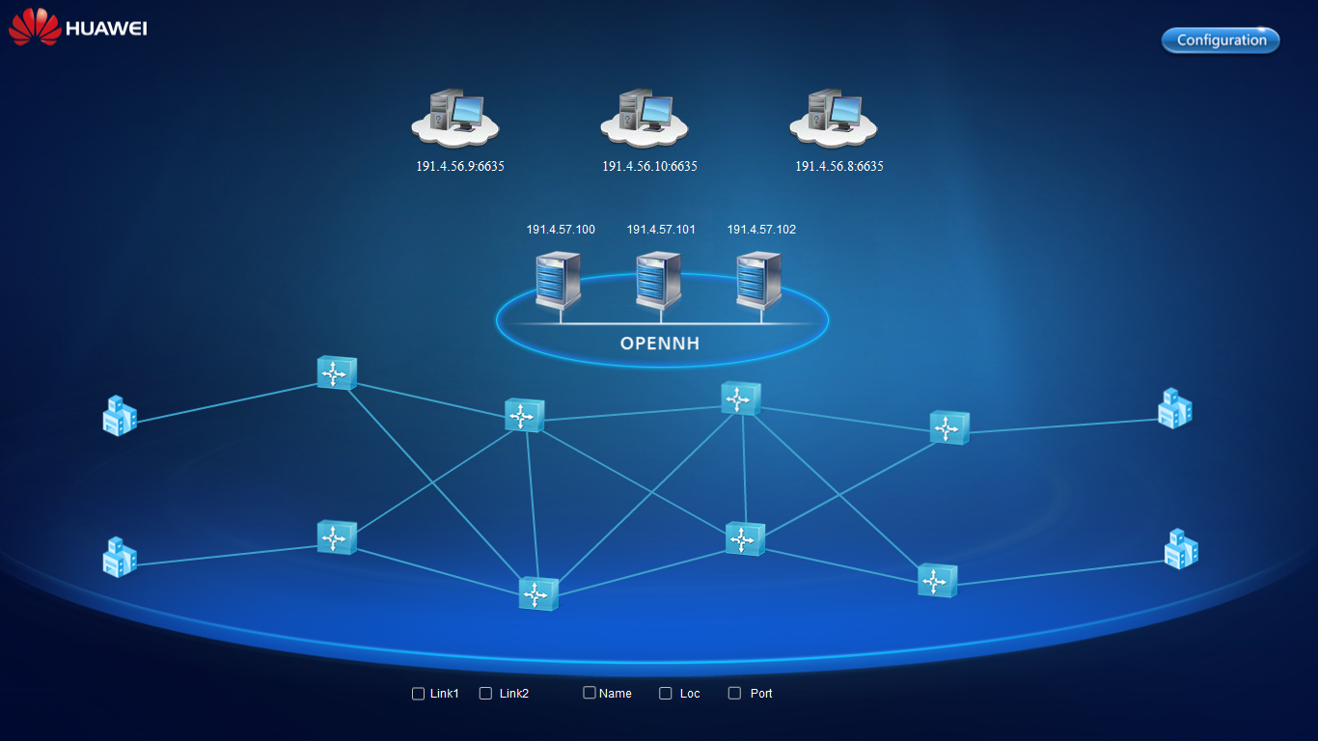
Demo
Virtual sites
Three controllers
Mininet on Vbox

Slide 15
Demos and Documents
Demos – After SDNRG and NFVRG
IETF Drafts:
draft-xia-sdnrg-service-description-language-01
draft-xia-sdnrg-nemo-language-01
All Project documentation
Technical Reference
5 page summary
Status of Code
Presentations

Slide 16
Q & A

Slide 17
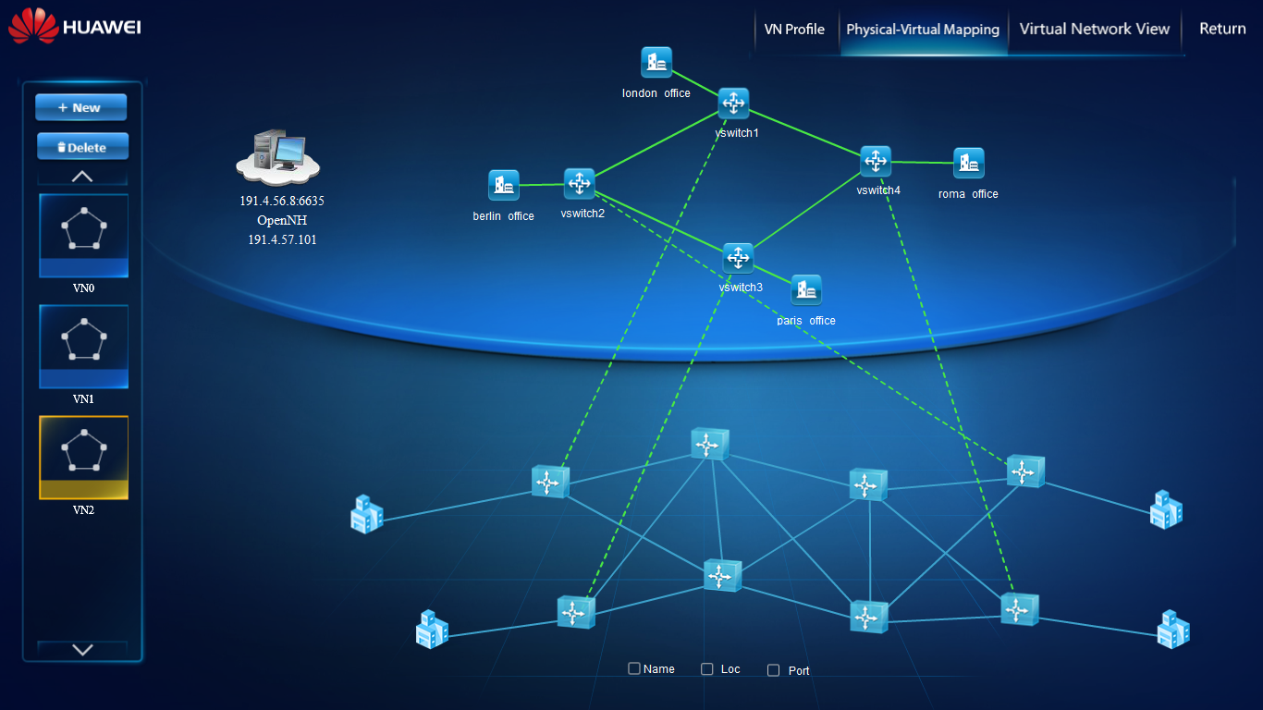
Apps V-Net
Overlay to Mininet

Slide 18

Example of Service Programming by NEMO
App use NEMO language to programming their service:
Flow sitea2siteb Match srcip:10.0.0.1 dstip:10.0.1.1;
Policy day applyto flow sitea2siteb condition 0800<time<2000 action gothrough {R1,R2,R4};
Policy night applyto flow sitea2siteb condition 2000<time<0800 action gothrough {R1,R3,R4};
APP
Text
in here
NEMO
Path daytime
site a
site b
Path at night
Network Hypervisor
OF1.X/Forwarding Instruction
Compiler resolver NEMO code to southbound instruction and maintain a state machine for each app.
At daytime go through path1;

Slide 19
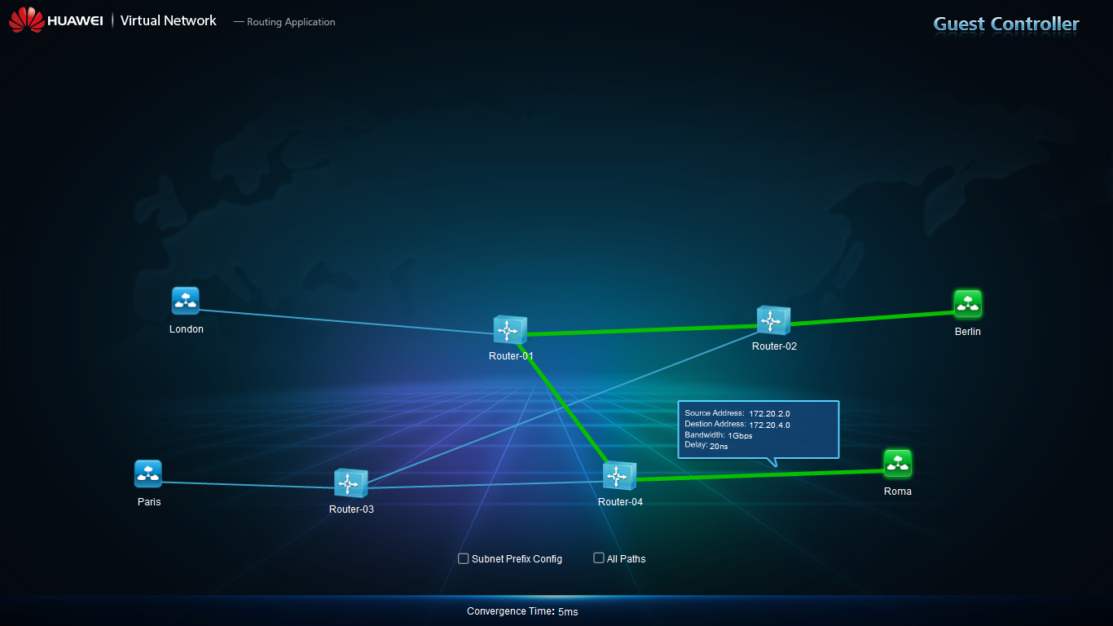
Flows in Apps Virtual Network

