Slide 1
Recursive Internet Architecture EC-Funded projects IRATI, GN3+ OC.IRINA and PRISTINE
Dimitri Staessens – Ghent Uni. iMinds (BE)

Slide 2
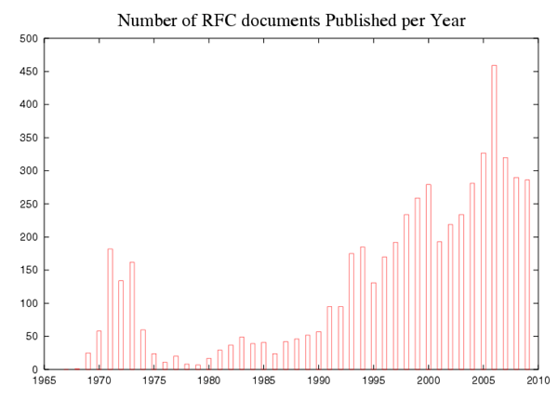

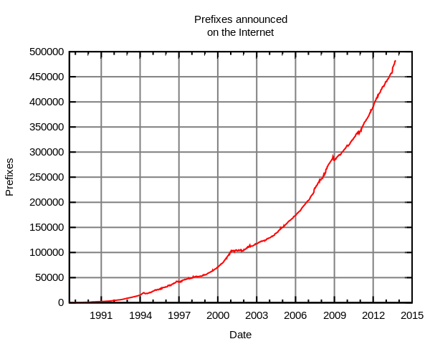
Current challenges
explosion in the complexity of the overall system (hundreds of protocols and thousands of standards documents)
security
scalability issues with the routing system
(IPv6/BGP multihoming)
Mobile end-users
Application mobility

Slide 3
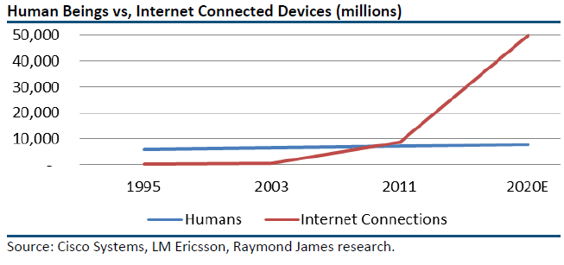

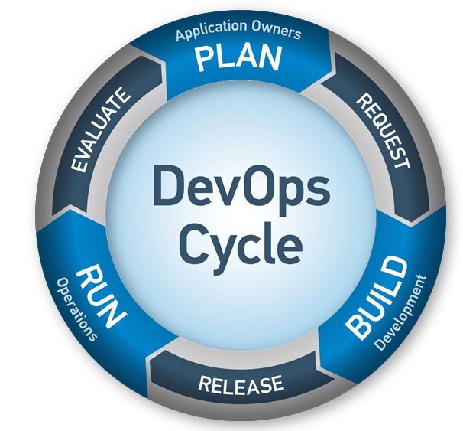

Production environment
ever growing customer base
ever growing number of devices
new and more demanding services
“worse is better”
RAD of services
fast deployment

Slide 4

RINA
A brief introduction to the Recursive Internet Architecture

Slide 5
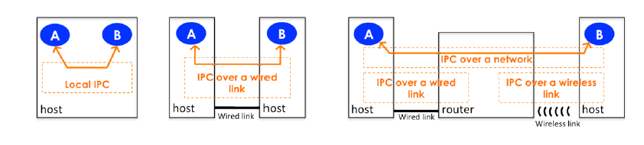
Extending the IPC model

Slide 6
Providing IPC services (with different characteristics) over different scopes
Everyday practice
Applications
UDP (L4)
RINA
Theory
IP (L3)
VXLAN(L2)
Applications
Applications
UDP (L4)
IPC
TCP/UDP (L4)
IP (L3)
IPC
IP (L3)
IP (L3)
IPC
Ethernet (L2)
IEEE 802.3 (L2)
IPC
Physical Media (L1)
MPLS (L2.5)
Physical Media
IEEE 802.1Q (L2)
IEEE 802.1ah (L2)
10GBASE-ER (L1)

Slide 7
IPC API
APs communicate using a port, identified by a portId
6 operations:
int _registerApp(appName, List<difName>)
portId _allocateFlow(destAppName, List<QoSParams>)
int _write(portId, sdu)
sdu _read(portId)
int _deallocate(portId)
int _unregisterApp(appName, List<difName>)
QoSParams are defined in a technology-agnostic way
Bandwidth-related, delay, jitter, in-order-delivery, loss rates, …

Slide 8
Distributed Applications Provide IPC services
host
Edge router
Internal AS router
Edge router
host
X
Y
F3
F1
F2
F4
C2
C1
D2
D1
D3
E1
E2
A1
A2
B1
B2

Slide 9
Architectural Model
Application Specific Tasks
System (Host)
System
(Host)
System
(Router)
Appl.
Process
Other Mgt. Tasks
Appl.
Process
Mgmt
Agent
IPC Mgt. Tasks
DIF
Multiplexing
IPC Resource Mgt.
IPC Process
IPC Process
IPC Process
Mgmt
Agent
Mgmt
Agent
SDU Protection
DIF Allocator
Shim DIF
over TCP/UDP
Shim DIF
over Ethernet
Shim IPC Process
Shim IPC Process
Shim IPC Process
Shim IPC Process
IPC API
Data Transfer
Data Transfer Control
Layer Management
SDU Delimiting
Transmission Control
CACEP
Transmission Control
Enrollment
Transmission Control
RIB Daemon
Data Transfer
State Vector
Authentication
Flow Allocation
Data Transfer
State Vector
Data Transfer
State Vector
Retransmission Control
Retransmission Control
Retransmission Control
RIB
Relaying and Multiplexing
Resource Allocation
Flow Control
CDAP Parser/Generator
Flow Control
Flow Control
Forwarding Table Generator
SDU Protection
Increasing timescale (functions performed less often) and complexity

Slide 10
FP7 IRATI – overview

Slide 11




IRATI - Introduction
FP7 Project – Jan 2013 to Dec 2014 (2 years)
5 partners
[Research] Fundació Privada i2CAT (Spain)
[Research] iMinds VZW(Belgium)
[SME] Nextworks s.r.l. (Italy)
[Industry] Interoute (UK/Italy)
[Academia] Boston University (US)

Slide 12
IRATI
Validation of RINA concepts
FOSS implementation of core functionalities
IPC Process / IPC Manager daemons
Transport and management tasks
Stack publicly available on GitHub ~ 11/2014

Slide 13
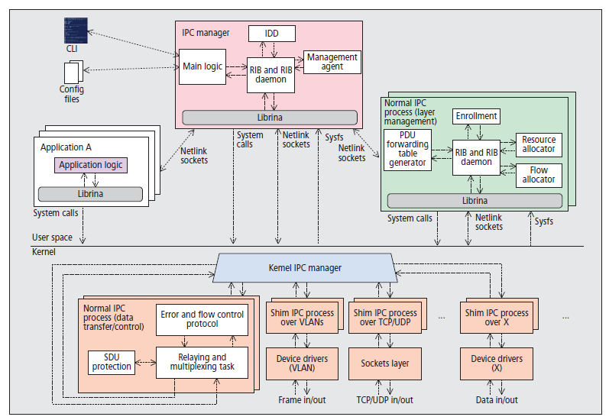
IRATI OS/Linux implementation
Source: S. Vrijders, F. Salvestrini, E.Grasa, M. Tarzan, L. Bergesio, D. Staessens, D. Colle “ Prototyping [RINA], the IRATI project approach”, IEEE Network, March 2014

Slide 14
IRATI Prototype initial tests
Source: S. Vrijders et al. “Experimental evaluation of RINA Prototype”, IEEE Globecom, Dec 2014

Slide 15
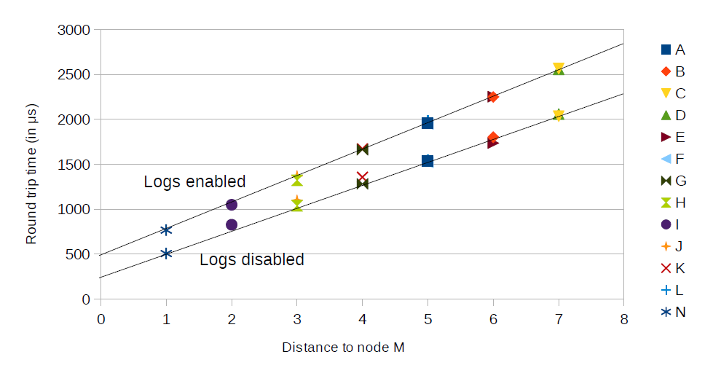
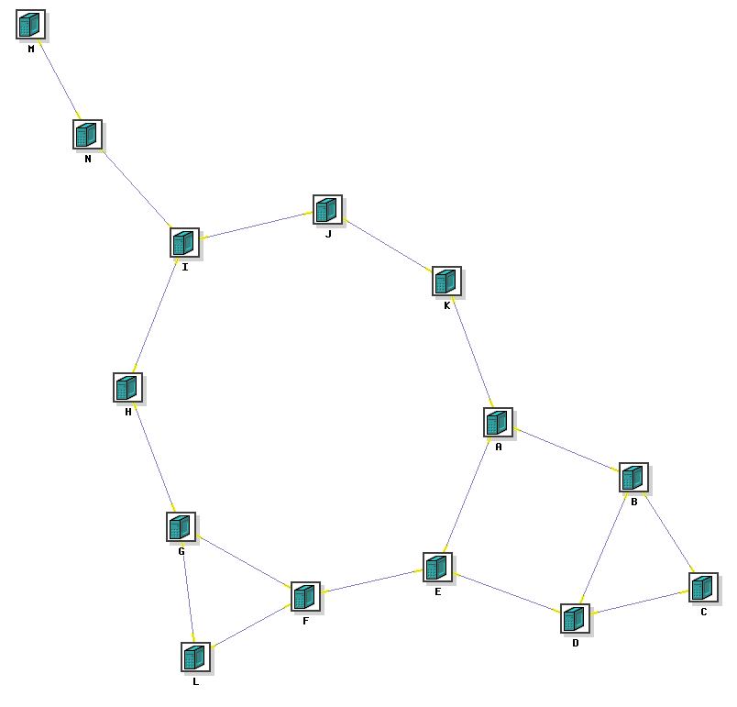
Link-state routing test (IS-IS based)

Slide 16
GEANT3+ IRINA – overview

Slide 17

IRINA - Intro
Investigating RINA as the next generation GEANT and NREN network architecture (IRINA)
GEANT3+ project
Starts Oct 2013, ends March 2015 (18 months)
4 Partners:
[Research] iMinds VZW(Belgium)
[Research] Fundació Privada i2CAT (Spain)
[Research] Waterford Institute of Technology – Telecommunications Software & Systems Group (Ireland)
[SME] Nextworks s.r.l. (Italy)

Slide 18
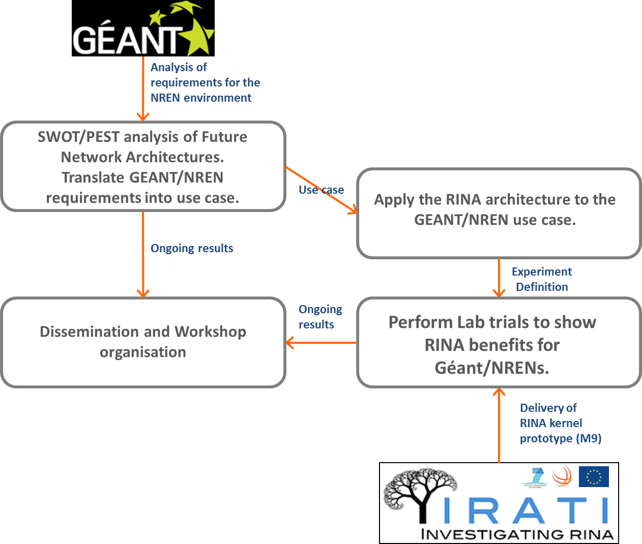
IRINA – Overview/Objectives

Slide 19
FP7 PRISTINE – overview
Programmability in RINA

Slide 20












PRISTINE - Intro
FP7 Project
Starts Jan 2014, ends Jun 2016 (30 months)
15 Partners (Research, SMEs and Industry)

Slide 21
PRISTINE - Objectives
IRATI provides basic core packet transport functions
PRISTINE designs some advanced functions:
security of content and application processes,
congestion control
protection and resilience,
efficient topological routing
multi-layer management
Three use-cases
Datacenter
Distributed cloud
Carrier network

Slide 22

PRISTINE Focus
System (Host)
System
(Host)
VNF
System
(Router)
Appl.
Process
Appl.
Process
Mgmt
Agemt
DIF
SDK: Policies and policy sets
IPC Process
IPC Process
IPC Process
Mgmt
Agemt
Mgmt
Agemt
Shim DIF
over TCP/UDP
Shim DIF
over Ethernet
Shim IPC Process
Shim IPC Process
Shim IPC Process
Shim IPC Process
LL
Cong. Ctrl.
HL
IPC API
Data Transfer
Data Transfer Control
Layer Management
SDU Delimiting
Transmission Control
CACEP
Transmission Control
Enrollment
Transmission Control
RIB Daemon
Data Transfer
State Vector
Authentication
Flow Allocation
Data Transfer
State Vector
Data Transfer
State Vector
Retransmission Control
Retransmission Control
Retransmission Control
RIB
Relaying and Multiplexing
Resource Allocation
Flow Control
CDAP Parser/Generator
Flow Control
Flow Control
Forwarding Table Generator
SDU Protection
Increasing timescale (functions performed less often) and complexity

