Slide 1
IETF 80
Prague, Czech Republic
NOC Report
Morgan Sackett
msackett@verilan.com

Slide 2
General Status
NOC is staffed by Verilan and volunteers.
All public areas in the Hilton Prague have wireless. Guest rooms also have wired access, as does the terminal room.
Network has been very stable, with a few minor route propagation issues.

Slide 3
Upstream Connectivity
Two 1Gb uplinks, provided by CZ.NIC (AS 25192) and Dial Telecom (AS 29208)
IPv6 native on both circuits
Peak outbound traffic of 150 Mbps
Running BGP over both links
Announcing 130.129.0.0/16 and 2001:df8::/32 from AS 290

Slide 4
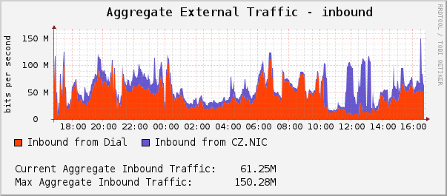
Inbound Aggregate Traffic

Slide 5
Wireless
53 802.11a/b/g/n Cisco Access Points
Wireless service available all areas of the Hilton Prague, guestroom access provided by hotel equipment via “hilton” SSID
Back to old IETF SSIDs
Supporting the NAT64 experiment
No longer running a portal, no special logins required
Continuing to provide eduroam access

Slide 6
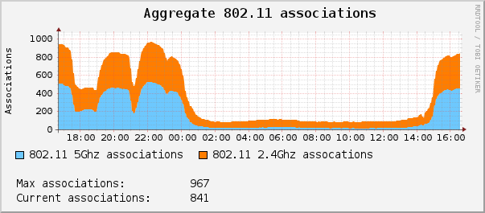
802.11 Associations
(minus “hilton” APs)

Slide 7
Verilan staff
Brandon Height
James Dishongh
Morgan Sackett
Nick Kukich
Noah Weis
Rick Alfvin
  Volunteers
Aman Anand
Bill Jensen
Bjoern Zeeb
Brian Taylor
Christopher Arnold
Chris Elliott
Jaromir Talir
Joel Jaeggli
Jim Martin
Karen O'Donoghue
Lucy Lynch
Michal Krsek
Warren Kumari
Providers
CZ.NIC
  Jaromír Talíř
  Anna Filínová
  Adam Mikulic
  Marian Kadziolka
Dial Telecom
  Zbynek Pospichal
Equipment Donations
Cisco
Juniper

Slide 8
Any questions?

