Slide 1
Mapping of Address and Port
Stateless IPv4 over IPv6
draft-mdt-softwire-mapping-address-and-port
Congxiao Bao, Mohamed Boucadair, Gang Chen, Maoke Chen, Wojciech
Dec, Xiaohong Deng, Remi Despres, Jouni Korhonen, Xing Li, Satoru
Matsushima, Tomasz Mrugalski, Tetsuya Murakami, Jacni Qin, Qiong
Sun, Ole Troan, Tina Tsou, Dan Wing, Leaf Yeh, Jan Zorz

Slide 2
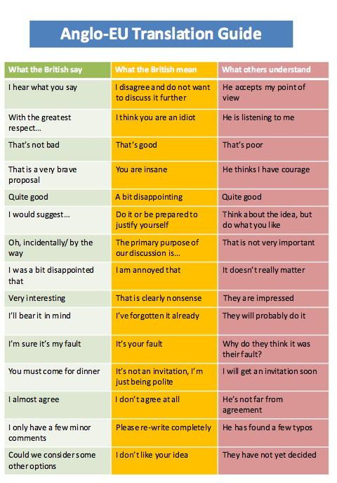

Slide 3
MAP is:
a building block. Describes how to map between an IPv4 address, prefix or IPv4 address and port into and IPv6 address.
Used by various protocol mechanisms (4rd-{E,T,U}, dIVI-PD, stateless 4over6...)
Provisioned by the MAP DHCPv6 option

Slide 5









Dual Stack Lite (DS-Lite)
Private IPv4
IPv6
IPv4 in IPv6 Tunnel
Private IPv4
IPv6
IPv6
IPv6
IPv4
IPv4
IPv4 in IPv6 Tunnel
Private IPv4
IPv6
Subscribers
Providers
Internet

Slide 6


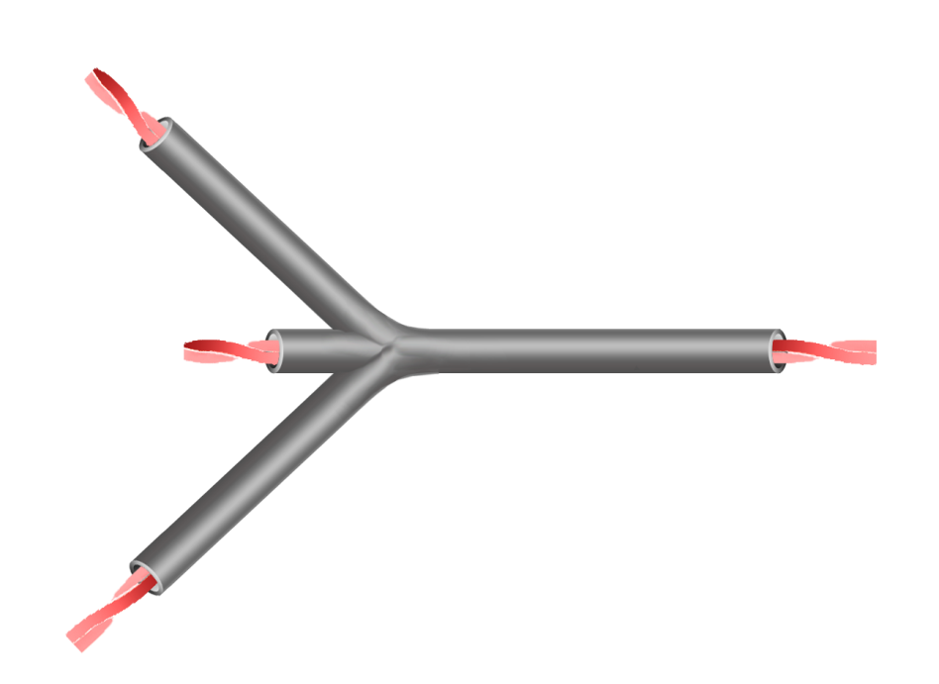


IPv6 Dual IVI (dIVI)
IPv6 Residual Deployment (4rd)
Private IPv4
IPv6
Private IPv4
IPv6
IPv6
IPv6
IPv4
IPv4
Private IPv4
IPv6
Subscribers
Providers
Internet

Slide 7
IPv6 → IPv4 + Port Mapping
IPv6 Delegated Prefix (e.g., /X)
Size = X bits (provisioned)
Y - Z = a
2001:0DB8:00 /X
01010101 111000
Subnet-ID
Interface ID
0
Mapping Domain Prefix
/X
“EA Bits”
/Y
64 (fixed)
Z bits (provisioned)
32 – Z = b
6 (fixed)
a - b = c
10-c
130.67.1 /Z
01010101
+
> 0
111000
XXXX
0
IPv4 Prefix
/Z
IPv4 Suffix
32
0
6
6+c
16
Port Set ID
+
IPv4 Address
Port

Slide 8
IPv6 → IPv4 + Port Mapping
IPv6 Delegated Prefix (e.g., /56)
Size = 42 bits (provisioned)
56-42 = 14
2001:0DB8:00 /42
01010101 111000
Subnet-ID
Interface ID
0
Mapping Domain Prefix
42
“EA Bits”
/56
64 (fixed)
For this Example…
24 bits (provisioned)
32-24 = 8
6 (fixed)
14-8 = 6
10-6 = 4
130.67.1 /24
01010101
+
> 0
111000
XXXX
2⁶=64 port sets
per IPv4 Address
0
IPv4 Prefix
24
IPv4 Suffix
32
0
6
12
16
Port Set ID
Ports 0-1023 skipped,
each CPE gets
2¹⁶/2⁶ - 2⁴ = 1008 ports
+
IPv4 Address
Port
One IPv4 /24 serves
2⁽⁶⁺⁸⁾ ≈ 16,384 (vs.≈256)
subscribers
130.67.1.85/38

Slide 9
MAP consensus:
Choice of port mapping algorithm. “infix” / generalized modulus algorithm and bit representation.
IPv6 prefix format and encoding of IPv4 address, prefix or shared IPv4 address bits.
A MAP domain can have multiple mapping rules (accommodate multiple IPv4 subnets)

Slide 10
MAP - open issues

Slide 11
#1: Granularity of port set size
If the requirement is: “must support differentiated sharing ratio within a single shared IPv4 address/IPv4 subnet within a single mapping rule”
Solution is Max PSID (see Remi’s slide)
Tradeoff: Destination spray
Alternative: Fixed port set size per IPv4 subnet. One mapping rule == IPv4 subnet and sharing ratio

Slide 12
#2: Checksum (translation)
If the requirement is: “A translator should generate packets with a valid L4 checksum” and “this should be done without modifying the IPv4 packet”
Solution is: Make the IPv6 header checksum neutral by embedding a Checksum Preserver field (16 bits) in the IPv6 addresses
Tradeoff: Destination spray. Source address and destination address will vary depending on changes in IPv6 header
Alternative: Rewrite the L4 checksum

Slide 13
#3: Destination spray
Encapsulated or translated traffic is not anchored to a single “tunnel end-point” address.
How to determine if received traffic is native or MAP?
Solution: Add a V-octet in the Interface-identifier
Tradeoff: Incurs penalty for native IPv6 traffic (V-octet filter), can we be guaranteed that no valid interface-id (or longer prefix) doesn’t overlap with the V-octet?
Alternative: Reserve /64 (for translation with IPv4 prefix, or for BR) or /128 for MAP traffic.

Slide 14
#4: Interface-id
Must include the complete IPv4 DA in the IPv6 address for out of domain translated traffic.
If the requirement is “the interface-id should be globally unique, should be possible to parse (for features / classifiers) without knowing the mapping rule”:
Solution is: include full IPv4 address, PSID and L fields.
Tradeoffs: Must redundant information in prefix and interface-id be enforced?
Alternative: Just include the IPv4 address as specified in RFC6052

Slide 15
#5: Multiple BR prefixes
If the requirement is: “The same MAP DHCPv6 option must be given to MAP CEs”
The solution is: For mapping rules to include the BR IPv6 address, and the CEs do “source based routing” to pick correct exit point.
Tradeoff: More complex mapping rules, more complex CE implementation
Alternative: If CEs are required to use different BR addresses, provision with different DHCPv6 options.

Slide 16
Next steps:
Sense of the room with regards to open issues
Adopt MAP drafts as working group items
Converge the various encapsulation and translation protocol mechanisms and adopt
Drink beer.

