Slide 1
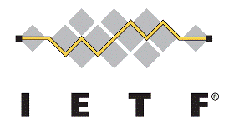
Multicast Routing Optimization
Juan-Carlos Zúñiga
Seil Jeon
Luis M. Contreras
Carlos J. Bernardos
Younghan Kim
MULTIMOB WG, March 2012

Slide 2
Multimob Routing Optimization (1/3)
http://datatracker.ietf.org/doc/draft-ietf-multimob-pmipv6-ropt/
Version 00 of document WG draft
Revised to address comments received on mailing list
Document restructured and multiple editorial corrections made
Solution provides optimal access to content located either in the local (Visited) or in the remote (Home or third party) network

Slide 3
Multimob Routing Optimization (2/3)
MAG can be an MLD Proxy or a Multicast Router
The MAG has the logic/rules to decide whether a multicast subscription should be made in the local network or to the remote (e.g. Home) PMIPv6 domain
Decisions can be based on subscription model, which could be pre-configured or dynamically configured by operator (e.g. draft.gundavelli-netext-pmipv6-sipto-option)
MTMA serves as mobility anchor for remote subscriptions
Typically, the MTMA will be used to get access to multicast content from Home or any third party network

Slide 4
Multimob Routing Optimization (3/3)
Suggested next steps
Organize the document by node instead of by functionality
Provide more details about the solution to dynamically decide on local or remote access

