Slide 1
IPv4-Embedded IPv6 Multicast Address draft-ietf-mboned-64-multicast-address-format
IETF 84
Vancouver

Slide 2
History
December 2010: draft-boucadair-64-multicast-address-format-00 uses the last flag for embedding an IPv4 address.
February 2011: draft-boucadair-behave-64-multicast-address- format-01 abandoned the use of the last flag. The reasons for that choice are listed in the document.
February 2012: draft-ietf-mboned-64-multicast-address-format adopted in mboned WG.
February 2012: mboned WG LC passed
April 2012: IETF LC
April 2012: B. Haberman suggested to use the remaining flag
April 2012: Since that option has been abandoned, a mail has been sent to 6man ML to seek for feedback.
May 2012: An updated version taking into account the comments received during IETF LC was submitted.
May 2012: 6man chairs asked the draft should be developed in 6man.
We are here to present

Slide 3
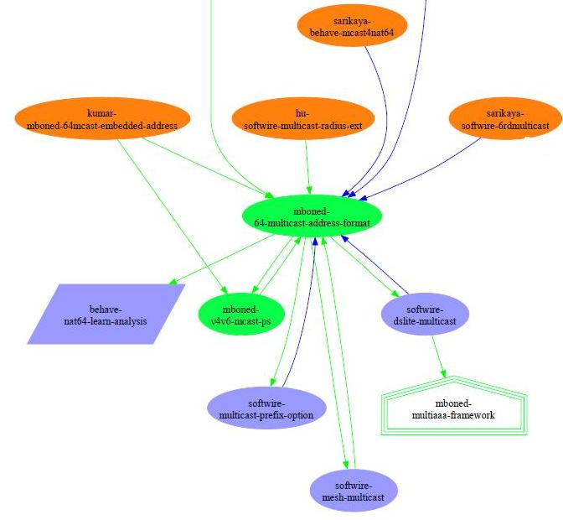
Dependency

Slide 4
Motivations
This address format is used for v4-v6 multicast transition.
Specifies how to build an IPv4-embedded multicast IPv6 address
Specifies how to extract an IPv4 address from an IPv4-embedded multicast IPv6 address
Typical scenarios are
A IPv4 receiver wants to join a multicast group in IPv4 domain via an IPv6-only network (4-6-4).
An IPv6-only receiver wants to receive multicast content from an IPv4-only source (6-4)

Slide 5
Rationale
Be compatible with embedded-RP [RFC3956] and unicast-based prefix [RFC3306] for ASM
Require minimal changes to existing RFCs
Privilege stateless address translation and no coordination between involved functional elements
Embed the multicast IPv4 address in the last 32 of the IPv4-embedded IPv6 multicast address
Use a dedicated flag to uniquely identify an IPv4-embedded multicast address.
5

Slide 6
On IPv4-Embedded IPv6 Multicast Addresses
Embeds a multicast IPv4 address in an IPv6 Multicast one; both ASM and SSM Modes are covered
Flags: 4 flags 0RPT
R (RP-embedded address), P (Unicast-based prefix), T (permanent assignment or not)
Scope: Allowed values are “8” for Organization-Local scope or “E” for Global scope.
64IX field (IPv4-IPv6 interconnection scheme bits): The first bit is the M-bit. When is set to 1, it indicates that an multicast IPv4 address is embedded in the last 32 bits of the multicast IPv6 address. All the remaining bits are reserved and MUST be set to 0.
8
4
4
4
76
32
ASM
11111111
Flg
Scop
64IX
0…0
IPv4@
8
4
4
16
4
68
32
SSM
11111111
0011
Scop
0…0
64IX
0…0
IPv4@
This means: reserve ffxx:8000/17 ASM block and ff3x:0:8000/33 SSM block to embed an IPv4 multicast address in the last 32 bits

Slide 7
On IPv4-Embedded IPv6 Multicast Addresses
IPv4
Receiver
96
32
Stateless IGMP-MLD interworking function
(ASM/SSM) MPrefix64
IPv4@
R
CPE
Stateless IPv4-IPv6 PIM interworking function
IGMP
MLD
PIM IPv6
PIM IPv4
PIM
PIM
UE
S
IPv6
Receiver
Source
IPv4-IPv6
Interconnection
Function
S ➔ S6; G➔ G6
Advertises in the IPv6 realm the IPv4-converted IPv6 address of S
Stateless (local) synthesis of IPv6 address when IPv4 multicast address are embedded in application payload (e.g., SDP)
Stateless IPv4-IPv6 header translation of multicast flows
For SPT mode in ASM, requests will be received by this function
For SSM, requests will be received by this node
No coordination is required between IPv4-IPv6 PIM interworking function, IGMP-MLD interworking function, IPv4-IPv6 Interconnection Function and any ALG in the path
Minimal operational constraints on the multicast address management: IPv6 multicast addresses can be constructed using what has been deployed for IPv4 delivery mode
7

Slide 8
Why Need this Bit?
This bit is used to signal the border multicast router who is in the edge of IPv4-IPv6 domain to perform necessary procedure to translate the address.
An application (app in receiver or ALG north of receiver) may prefer a native multicast address rather than an IPv4 embedded address to avoid unnecessary translation. Without explicit bit in the address this is not possible.

Slide 9
Why not define a Well-Known Prefix?
This implies the RP network prefix must be the same when Embedded RP is used. This adds unnecessary constraint to network design.
This also requires the PIM JOIN using the IPv4-embedded IPv6 address must reach the translator (i.e., RP must be the translator).

Slide 10
Why not each domain uses its own prefix?
This will require each domain to configure the prefix so that the routers knows address using the preconfigured prefix will have an IPv4 address embedded to it.
When we want to use this across domains, this will require coordination between domains to exchange their preconfigured prefixes which may impose operation overhead to manage the network.

Slide 11
Alternative
An alternative method is to include the bit not in the address but in the PIM JOIN and MLDv2 Report Message
It does not help an application to signal an address is native or an IPv4 Embedded IPv6 Address
Details specification is described in draft-kumar-mboned-64mcast-embedded-address-00.txt

Slide 12
Why Not Used the Last Flag Bit?
This is the last bit. If we use it, nothing left.
There are implementations hardcoded FF3X::/32 for SSM and FF7x::/12 for Embedded-RP.
RFC3306 Section 6 says: These settings create an SSM range of FF3x::/32 (where 'x' is any valid scope value).
Implementation(s) may ignore FFBx::/32 as a valid SSM address.
RFC3956 Section 3 says: Without further IETF specification, implementation SHOULD NOT treat FFF0:/12 range as Embedded-RP.
This prohibits to use Embedded RP for v4 address in the “group ID” for translation.

