Slide 1
Telemedical Use Case
Lennard Xiao
Email: lennard.xiao@huawei.com

Slide 2
Introduction
In the Telemedical use case, multiple presentation streams are used for converying different information in parallel to the main video streams from the surgery room.
In the use case, three kinds of endpoints are provided:
Surgery room
Expert endpoints
Education sites

Slide 3

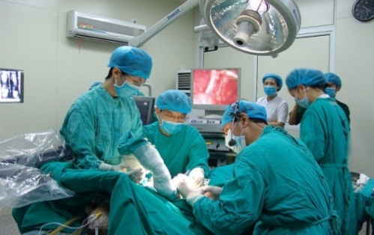
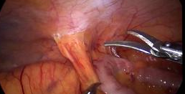
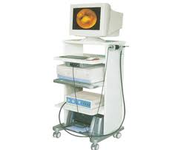



Surgery room
Main cameras
In the surgery room, three main cameras capture the whole room.
Multiple presentation inputs are possible:
a surgery camera which is used to provide to zoomed view of the operation
an endoscopic monitor
an X-ray CT image output device
a B-ultrasonic apparatus
a cardiogram generator
an MRI image instrument, etc.
Surgery camera
– zoomed
endoscopic
B ultrasound
cardiogram

Slide 4
Surgery room (cont.)
Three main screens used to display the remote experts
The presentation screen(s) can be used to display multiple presentation streams from local and remote sites simultaneously.
The surgeon can decide the number, the size and the placement of the presentations to be received and displayed on the local presentation screen(s).
He can also decide to send which send multiple presentation captures to remote sites.

Slide 5
Expert endpoints
A single or dual screen and one camera system with a consulting expert of a particular field.
The presentation screen(s) are provided allowing the experts to see the details of the operation and related data.
Like the main site, the experts can decide the number, the size and the placement of the presentations displayed on the presentation screens.
The experts can also start sending presentation streams, which can carry medical records, pathology data, or their reference and analysis, etc.

Slide 6
Education sites
A typical immersive Telepresence room with three camera/screen pairs.
The teacher and the students are in different rooms.
Students can observe and learn the details of the whole procedure, while the teacher can explain and answer questions during the operation.
The education sites can only send streams among themselves.
All remote education sites can display the surgery room.

Slide 7
Remote sites
All remote sites shall display the zoomed surgery view on their presentation screen. Other dynamic and static data can be optional and up to user's decision.
For all the sites, more presentation screens can be used to enhance visibility.

Slide 8
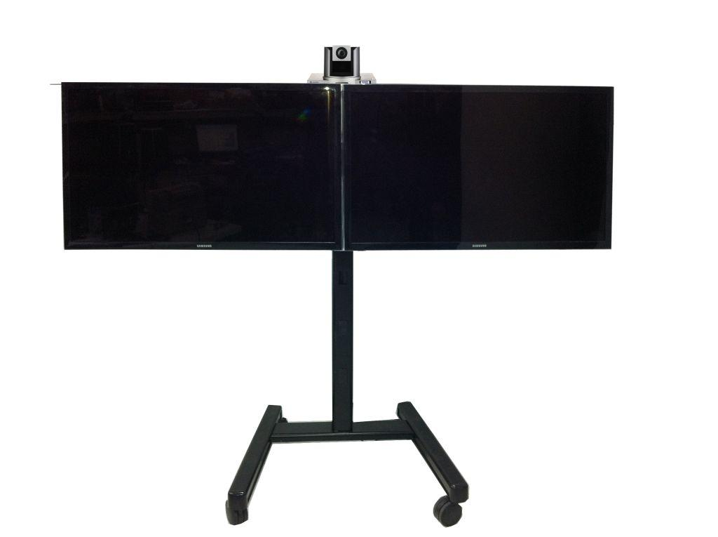

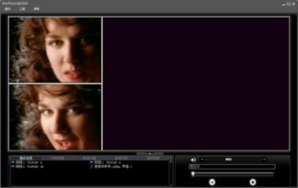
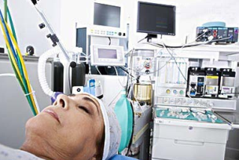


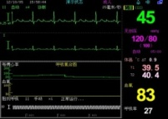


Use case sketch
Expert endpoint
Main cameras
Expert endpoint
Education sites
IP Network
Surgery camera
– zoomed
endoscopic
B ultrasound
Education sites
medical records,
pathology data,
other reference
cardiogram

Slide 9
Related new requirements
The solution must enable an endpoint to send and receive multiple presentation captures.
The solution must support a means to identify presentation captures, including the number, purpose, etc.
The solution must support multiple presentation sources from different endpoints at the same time.
The solution must support means of enabling interoperability between Telepresence endpoints that send and receive different numbers of presentation streams.

