Slide 1
PWE3 Congestion Considerations draft-stein-pwe3-congcons-01.pdf
Yaakov (J) Stein
David Black
Bob Briscoe

Slide 2
PW congestion as seen by PWE3
PWE3 was originally in the transport area
because handling the congestion issue was considered critical
The TDM PW drafts were accepted by the IESG
only after considerable work on their congestion considerations sections
The only draft that devoted entirely to a congestion issue
draft-stein-pwe3-ethpwcong
was extremely limited in scope
and was abandoned due to lack of interest in the WG
PWE3 as a WG has a long-standing commitment
to deal with the congestion problem

Slide 3
PW congestion as seen outside PWE3
The problem is often phrased as follows:
PW traffic may be carried over IP networks
  L2TPv3 PWs
  TDM PWs have native UDP/IP mode
  MPLS PWs can be carried over IP using RFC 4023 (with or without GRE)
Theorem:
If something is allowed by RFCs, then someone is going to do it
Corollary:
Someone is going to place PW traffic
alongside and competing with TCP traffic
Conclusion:
In those cases, PWs MUST behave in a fashion
that does not cause damage to congestion-responsive flows (RFC2914)
Felony:
PW traffic may not be inherently congestion-responsive
and PWE3 has not defined any congestion mechanisms

Slide 4
What has been suggested
Several solutions have been offered:
PWs should never be carried over IP
All PW traffic must be carried over TCP
All PW traffic must be carried over DCCP
PWE3 must design its own
TCP-friendly congestion response mechanism
Note, we adopt TCP friendliness (RFC 5348)
as a safe operational envelope
for the purposes of numerical analysis
In future work we may treat other conditions

Slide 5
What this draft says …
Careful analysis shows that this problem
may be much less serious than commonly imagined
We note that there are two distinct cases:
elastic PWs carrying congestion responsive traffic
e.g., Ethernet PWs carrying mostly TCP traffic
inelastic PWs that can not respond to congestion
e.g., TDM PWs (structure-agnostic or structure-aware)
We discover that
1) elastic PWs are automatically TCP-friendly
and do not require any additional mechanisms
inelastic PWs are often TCP-friendly
and usually do not require any additional mechanisms

Slide 6
Elastic PWs
Analyzed case:
Ethernet PWs carrying TCP traffic
in parallel with
TCP/IP packets
It has been proposed to encapsulate PW packets in TCP/IP
to ensure that the PW does not endanger the TCP flows
However :
there is 1 PW packet per 1 TCP/IP packet
a single dropped packet causes the same back off to the TCP
TCP flow is not rewarded or penalized for being inside PW
PW (as an aggregate of N flow) backs off much less (in percentage)
than a single TCP flow

Slide 7
Inelastic PWs
Analyzed cases:
E1, T1, E3, T3 TDM services
SAToP or structure-aware encapsulations
Main idea
TDM should have relatively low delay (N ms)
SAToP service is valid for very low packet loss (0.5%?)
structure-aware transport valid for higher packet loss (2%)
We can compare constant BW of TDM PW
with TCP’s BW under the same delay and packet loss conditions
If TDM PW consumes same or less BW then it is “friendly”
See figures (from pdf version of draft) for when this condition is obeyed
When condition is not obeyed, PW may cause congestion

Slide 8
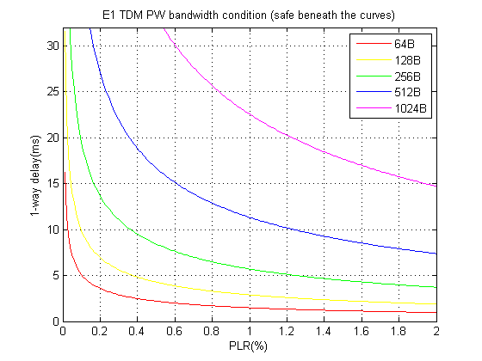
E1 / TCP compatibility regions

Slide 9
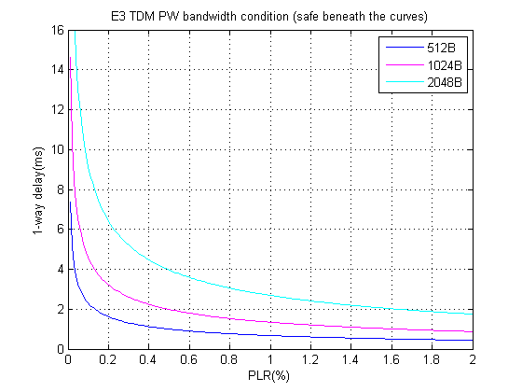
E3 / TCP compatibility regions

Slide 10
Next steps
Explore more TDM cases
Tighten up the argument for inelastic PWs
what happens when compete with short-lived TCP flows ?
treat dynamic cases
how much time to wait until shut-down ?
give specific recommendations
Get more feedback from congestion-control community
Request that PWE3 accept this as a work item
towards an informational RFC

