Slide 1
Trust Router Update
IETF 86, Orlando, FL
ABFAB WG Meeting
Margaret Wasserman
mrw@painless-security.com

Slide 2
Updated Documents
Two documents updated for this meeting
  Trust Router Problem Statement
    draft-howlett-abfab-trust-router-ps-03.txt
    Major update to raise level of requirements
  Trust Router Protocol
    draft-mrw-abfab-trust-router-02.txt
    Several changes to technical approach and terminology
    Motivations from multihop-fed document merged into this document

Slide 3
Major Changes
Communities of Registration (CORs) replaced by Authentication Policy Communities (APCs)
  Purely a terminology change
Change in Operational Model
  Subject no longer traverses the Trust Path, Trust Routers forward requests along the path.
  Eliminated separate Trust Path Query protocol
    Subject sends Temporary Identity Request, which is forwarded by the Trust Routers across the federation to the AAA Server.

Slide 4
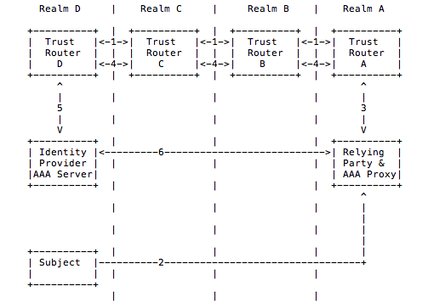
Trust Router Operation

Slide 5
Plans to Move Forward
Looking to continue this work in a separate IETF WG
Mailing list has been created for discussion
  trust-router@ietf.org
Bar BOF will be held during lunch on Thursday in Carribean 7, please join us!
Any feedback on this plan?

