Slide 1
Benchmarking Neighbor Discovery Problems
Bill Cerveny
March 12, 2013

Slide 2
History
Suggested by Ron Bonica at IETF 85 BMWG meeting

Slide 3
Neighbor Discovery (ND) Problem Background
The problem is described and documented in RFC 6583, “Operational Neighbor Discovery Problems.”
An IPv4 subnet is “typically” no larger than 510 addresses and scanning is relatively quick.
Since the default size of any IPv6 user subnet is 2**64, there can be a lot of addresses
Scanning the IPv6 subnet takes a really long time, but one can still start scanning it.

Slide 4
ND Problem con’t
The number of addresses one can scan for is limited only by the available bandwidth.
The DUT (router) needs to perform ND for the addresses being scanned, even if the addresses aren’t “live” in the subnet
This can create a lot of state in the DUT, so much so that the DUT may be unable to complete ND for real, valid nodes in subnet.

Slide 5
Benchmarking ND Problem
Build a network which illustrates ND problem for DUT.
Instrument network to measure DUT behavior under a scan which causes DUT to be overwhelmed by ND triggering events.

Slide 6
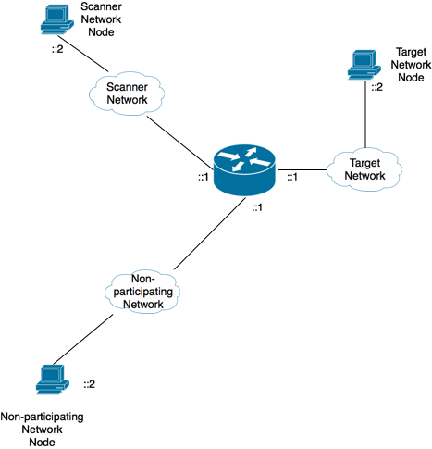
Basic Test Network and Methodology

Slide 7
More comprehensive Test Network

Slide 8
Metrics / Measurements in “00” document
Round trip time across DUT (easy)
Rate DUT add valid node to neighbor cache (medium)
Adherence to NDP activity prioritization described in RFC 6583 (medium)
DUT CPU Utilization (easy to measure, accuracy suspect)
Rate DUT forwards packets(easy)
Rate DUT responds to neighbor solicitations in presence of scanning activity (medium)
Impact on unaffected interfaces/subnets
Maximum number of entries in DUT

Slide 9
Proposed metrics/measurements
Frequency of ND triggering events sufficient for DUT to be impaired (easy) – key to test
Round trip time across DUT (easy)
Rate DUT adds valid node to neighbor cache (medium)
Adherence to NDP activity prioritization described in RFC 6583 (medium) – Relevant but perhaps compliance, not benchmarking
Rate DUT forwards packets(easy) – Is this significant in ND test?
Rate DUT responds to neighbor solicitations in presence of scanning activity (medium)
Impact on unaffected interfaces/subnets
ND latency as determined by monitoring target network (medium)

Slide 10
Questions
Should this document benchmark the neighbor discovery “problems” only or neighbor discovery in general?
Should “unusual” behavior be benchmarked?
  i.e. node in target network responding to all ND solicitations

