Slide 1
CCAMP Working Group
Online Agenda and Slides at:
http://tools.ietf.org/wg/ccamp/agenda?item=agenda86.html
Data tracker: http://datatracker.ietf.org/wg/ccamp/
Tools page: http://tools.ietf.org/wg/ccamp

Slide 2
IETF Note Well
http://www.ietf.org/about/note-well.html:
Any submission to the IETF intended by the Contributor for publication as all or part of an IETF Internet-Draft or RFC and any statement made within the context of an IETF activity is considered an "IETF Contribution". Such statements include oral statements in IETF sessions, as well as written and electronic communications made at any time or place, which are addressed to:
  The IETF plenary session
  The IESG, or any member thereof on behalf of the IESG
  Any IETF mailing list, including the IETF list itself, any working group or design team list, or any other list functioning under IETF auspices
  Any IETF working group or portion thereof
  Any Birds of a Feather (BOF) session
  The IAB or any member thereof on behalf of the IAB
  The RFC Editor or the Internet-Drafts function
All IETF Contributions are subject to the rules of RFC 5378 and RFC 3979 (updated by RFC 4879).
Statements made outside of an IETF session, mailing list or other function, that are clearly not intended to be input to an IETF activity, group or function, are not IETF Contributions in the context of this notice.
Please consult RFC 5378 and RFC 3979 for details.
A participant in any IETF activity is deemed to accept all IETF rules of process, as documented in Best Current Practices RFCs and IESG Statements.
A participant in any IETF activity acknowledges that written, audio and video records of meetings may be made and may be available to the public.

Slide 3
Administrative
Audio Streaming/Recording
  Please speak only using the microphones
  Please state your name before speaking
Minute takers & Etherpad
Jabber
86th IETF CCAMP Working Group
3

Slide 4
Sessions
WEDNESDAY, March 13, 2013
  900 - 1130 Morning Session I
  Room Name: Caribbean 4
FRIDAY, March 15, 2013
  0900-1100 Friday Morning Session I
  1230-1330 Friday Afternoon Session II
  Room Name: Caribbean 4
Details:
  http://tools.ietf.org/wg/ccamp/agenda?item=agenda86.html
86th IETF CCAMP Working Group
4

Slide 5
CCAMP Working Group
Status
Chairs:
Lou Berger <lberger@labn.net>
Deborah Brungard <db3546@att.com>
Secretaries:
Dan King <daniel@olddog.co.uk>
Daniele Ceccarelli <daniele.ceccarelli@ericsson.com>
5

Slide 6
Document Status – RFCs
New Errata:
  RFC6107 – Editorial correction, not technical impact
Recent RFCs:
  RFC 6777 – draft-ietf-ccamp-dpm
  RFC 6827 – draft-ietf-ccamp-rfc5787bis
  RFC 6825 – draft-ietf-ccamp-gmpls-ted-mib
In RFC Editor’s Queue:
  draft-ietf-ccamp-lmp-behavior-negotiation-11 (EDIT)
IESG Processing
  None
86th IETF CCAMP Working Group

Slide 7
Document Status – Post WG Last Call
Waiting for authors
  draft-ietf-ccamp-rsvp-te-mpls-tp-oam-ext
    For an update and resolution of comments
  draft-ietf-ccamp-gmpls-signaling-g709v3
    For resolution of tolerance/mapping comments
Waiting for other documents
  draft-ietf-ccamp-oam-configuration-fwk
  draft-ietf-ccamp-rsvp-te-eth-oam-ext
  draft-ietf-ccamp-rsvp-te-sdh-otn-oam-ext
  draft-ietf-ccamp-gmpls-g709-framework
  draft-ietf-ccamp-otn-g709-info-model
  draft-ietf-ccamp-gmpls-ospf-g709v3
86th IETF CCAMP Working Group
7

Slide 8
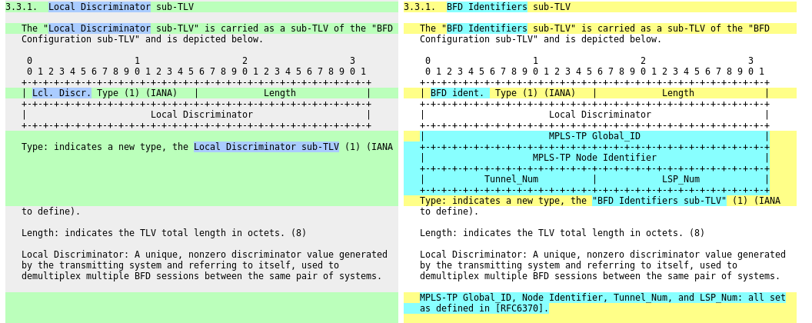
Post LC change to: draft-ietf-ccamp-rsvp-te-mpls-tp-oam-ext
Problem pointed out by Fei Zhang in http://www.ietf.org/mail-archive/web/ccamp/current/msg13559.html "... the tunnel number assigned by the egress LER should be carried back ...".
  Both MEPs needs to know MEP-ID from the other end-point
  Two alternatives discussed: ASSOCIATOPN Object or
  extended sub-TLV ← selected option

Slide 9
Reminder: IPR Process
Process put in place as a result of very late IPR disclosures
Includes
  Polling of draft authors & contributors
    Prior to moving to next step in WG process
      e.g., before an individual draft becomes a WG document or a WG document goes to last call
    Requires IPR compliance statement from all listed in draft

Slide 10
WG Drafts on the Agenda
draft-ietf-ccamp-gmpls-g709-framework
draft-ietf-ccamp-otn-g709-info-model
draft-ietf-ccamp-gmpls-ospf-g709v3
draft-ietf-ccamp-gmpls-signaling-g709v3
draft-ietf-ccamp-lsp-attribute-ro
draft-ietf-ccamp-lsp-diversity
draft-ietf-ccamp-rsvp-te-srlg-collect
draft-ietf-ccamp-te-metric-recording
draft-ietf-ccamp-wson-signal-compatibility-ospf
draft-ietf-ccamp-wson-signaling
86th IETF CCAMP Working Group

Slide 11
WG Drafts Not on Agenda
draft-ietf-ccamp-general-constraint-encode
draft-ietf-ccamp-mpls-tp-rsvpte-ext-associated-lsp
draft-ietf-ccamp-rwa-info
draft-ietf-ccamp-rwa-wson-encode
draft-ietf-ccamp-swcaps-update
  Status sent to list

Slide 12
Liaisons and Communications
Broadband Forum
  Received 01-25: (misaddressed)
    Initiation of Work on Packet and DWDM Optimization
General comment
  Please review incoming documents and comment on ccamp@ietf.org
12

