Slide 1
Framework for GMPLS based control of Flexi-grid DWDM networks draft-ogrcetal-ccamp-flexi-grid-fwk-02 CCAMP WG, IETF 86
Oscar González de Dios, Telefónica
Ramon Casellas, CTTC
Fatai Zhang, Huawei
Xihua Fu, ZTE
Daniele Ceccarelli, Ericsson
Iftekhar Hussain, Infinera
Contributors:
Qilei Wang, Malcolm Betts, Sergio Belotti, Cyril Margaria, Xian Zhang, Yao Li, Fei Zhang, Lei Wang, Guoying Zhang, Takehiro Tsuritani, Lei Liu, Eve Varma, Young Lee, Jianrui Han, Sharfuddin Syed, Rajan Rao, Marco Sosa, Biao Lu, Abinder Dhillon, Felipe Jimenez Arribas, Andrew G. Malis, Adrian Farrel, Daniel King.
v6

Slide 2
What is the draft about?
Goals
Establish a framework, for the purposes of GMPLS control, of ITU-T DWDM flexi-grid enabled networks, including
Terminology,
Data plane element models (i.e., “link and node characterization”),
Layered / hierarchical network model
Routing and Spectrum Assignment modes
Mapping of GMPLS concepts (e.g. TE-links, LSP) with flexi-grid data plane
Applicability of GMPLS procedures
Identify Control Plane Requirements
Non Goals
Define protocol extensions / encodings → Separate solutions draft

Slide 3
Terminology (1/2)
193.1 THz
…
...
-9
-8
-7
-6
-5
-4
-3
-2
-1
0
1
2
3
4
5
6
7
8
9
DWDM link
Frequency slot 1:
Central frequency = 193.1 + 0.00625*(-5)
= 193.06875 THz
Slot width = 0.0125*3 = 0.0375 THz
Frequency slot 2:
Central frequency = 193.1 + 0.00625*(4)
= 193.125 THz
Slot width = 0.0125*4 = 0.05 THz
Flexi-Grid: a new WDM frequency grid defined with the aim of allowing flexible optical spectrum management, in which the Slot Width of the frequency ranges allocated to different channels are flexible (variable sized).
Frequency Slot: The frequency range allocated to a channel and unavailable to other channels within a flexible grid. A frequency slot is defined by its nominal central frequency and its slot width.
Central Frequency = 193.1 THz + n * 0.00625 THz
Slot Width : the full width (in Hz) of a frequency slot, a multiple (m) of 12.5 GHz.

Slide 4
Terminology (2/2)
Media Channel: a media association that represents both the topology (i.e., path through the media) and the resource (frequency slot) that it occupies.
As a topological construct, it represents a (effective) frequency slot supported by a concatenation of media elements (fibers, amplifiers, filters, switching matrices...).
Term used to identify the physical layer entity
Network Media Channel: a media channel that supports a single OCh-P network connection.
It represents the concatenation of all media elements between an OCh-P source and an OCh-P sink.
Media element: only directs the optical signal. Examples include optical filters, switching matrices, fibers.

Slide 5
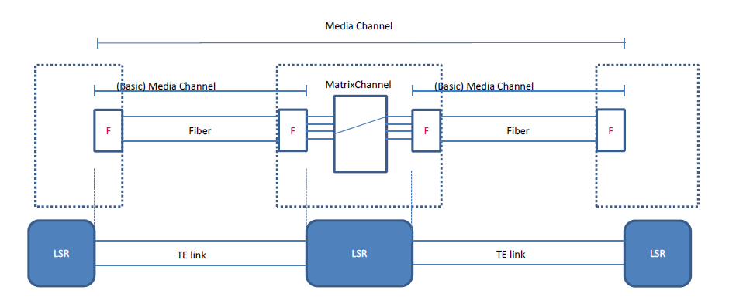
GMPLS modeling (1/2)
The framework is related to the management of spectrum i.e. Media Channels and Media Elements. Management of optical signal is out of scope
2. TE-link: TE links represent the association of a filter and a fiber.
- Supported/Available central frequencies (N)
- Supported/Available slot width/granularity (M)
- Spectrum availability

Slide 6
GMPLS modeling (2/2)
3. LSP: The flexi-grid LSP is seen as a control plane representation of a media channel.
- Open question: An LSP can also be a group of media channels.
4. LABEL: As in flexi-grid the switched element is a frequency slot, the label represents a frequency slot. Consequently, the label in flexi-grid must convey the necessary information to obtain the frequency slot characteristics (i.e, center and width, the n and m parameters). The frequency slot is locally identified by the label.

Slide 7
Q1 – What is the relation between optical signal layer (OCh) and media layer?
Which are the allowed combinations?
1. Single Och over single Network Media Channel (trivial)
2. Single Och over multiple Network Media Channel? (inverse multiplexing)
3. Multiple Och over single Network Media Channel? (no by definition?)
Do we need to consider express channel?
Multiple (Network) Media Channels over a single Media Channel
If yes, what is contemplated:
Network media channel over media channel?
Media channel over media channel?
THIS IS IMPORTANT FOR GMPLS AS IMPLIES MANAGING HIERARCHIES. Which hierarchy (if any) must be considered?
Signal over Media
Media over Media

Slide 8
Q2 – How do we characterize links and nodes?
What are the attributes of a link?
Supported/Available central frequencies (N)
Supported/Available slot width/granularity (M)
Portion of spectrum available
Are there other attributes that can’t be expressed via M and N?
What are the attributes of a node?
Connectivity matrix
Anything else????

Slide 9
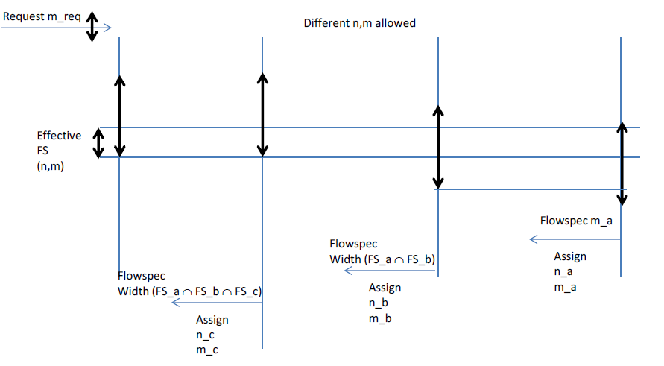
Q3 – Resource allocation
Different M are allowed, what about different N?
If different N are allowed, how is it possible to ensure valid effective frequency slot?

Slide 10
Q4 – Additional link properties?
Is it envisioned to consider the impact of signal characteristics on the link information?
How it would be represented in the control plane?

Slide 11
Next steps
Receive feedbacks from WG and Q6
Clean up text
Remove editor‘s note
Adopt as working group after doing what above

Slide 12
BACKUP

Slide 13
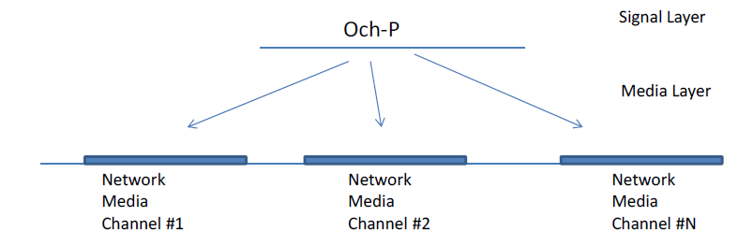

Slide 15
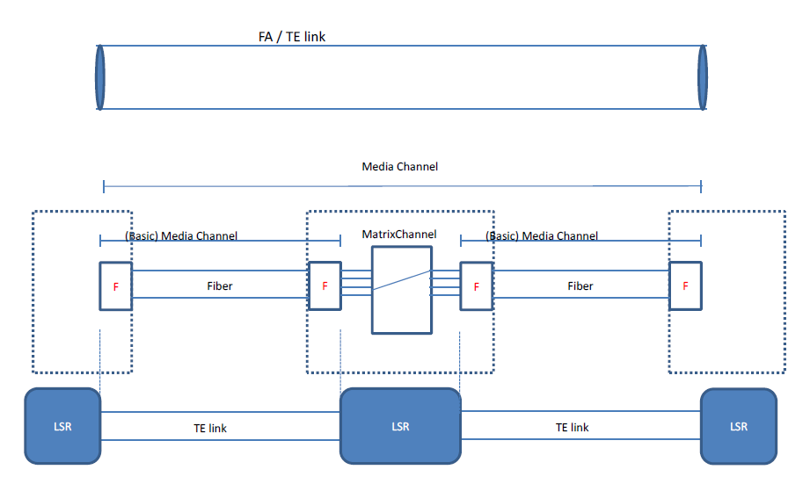

Slide 16
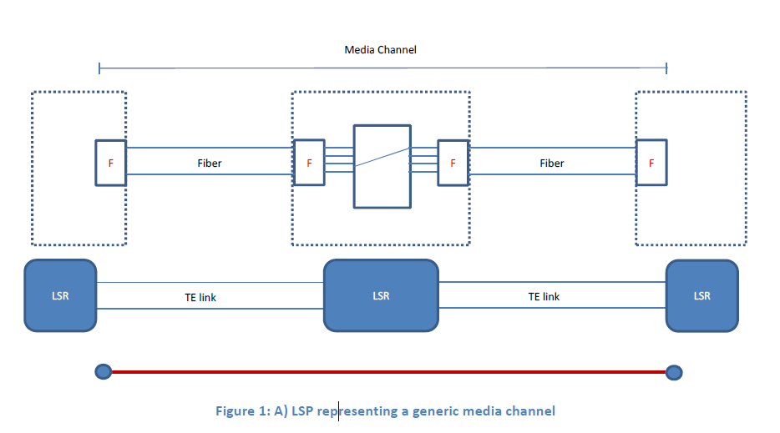
LSP representing a simple media channel

Slide 17
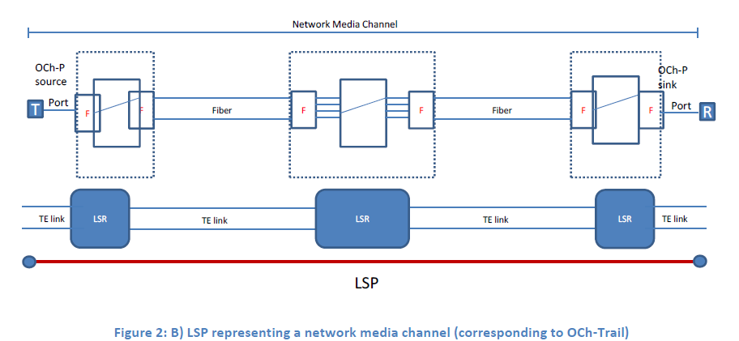
LSP representing a network media channel

Slide 18
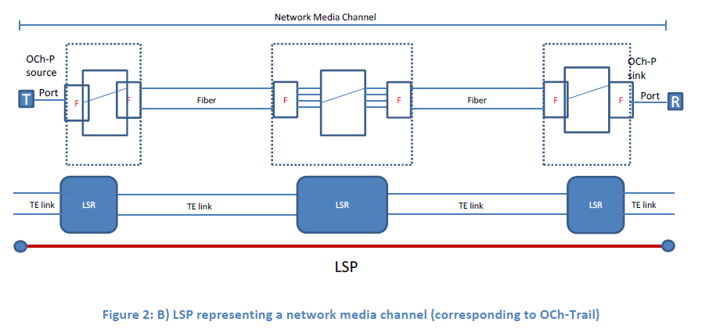

Slide 19
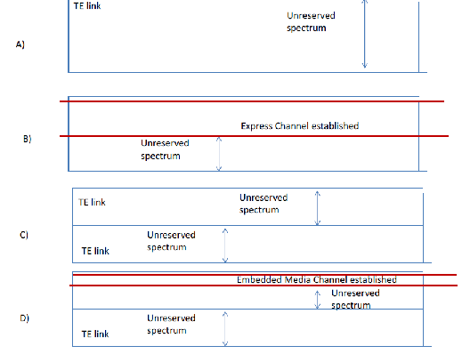

Slide 20
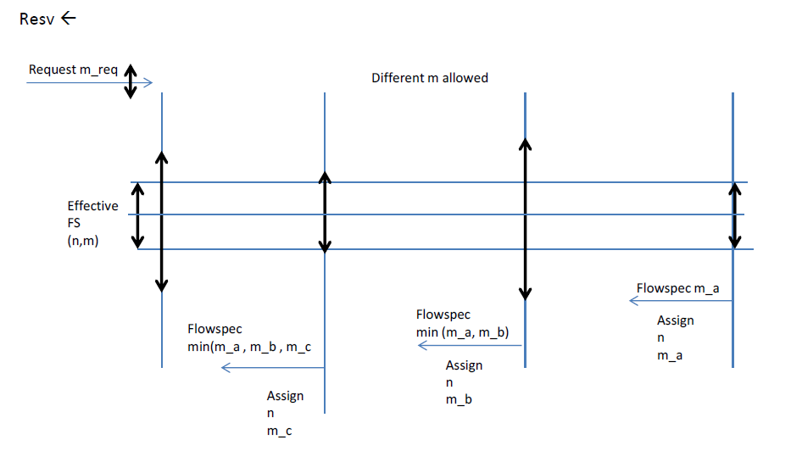
Different M allowed

