Slide 1

Mobility Anchor Selection
draft-aliahmad-dmm-anchor-selection
H. Ali-Ahmad
D. Moses
H. Moustafa
P. Seite

Slide 2
Motivation
The current dmm intuition is that whenever a mobile node connects to the network, the mobility anchor serving it should be the closest to it.
This is driven by the following assumptions:
Most flows are short
New flows are always anchored by the MA that is co-located with the current access router
After IP-handover, these flows are tunneled via their MA (until they end)
Is this always the most efficient selection?

Slide 3
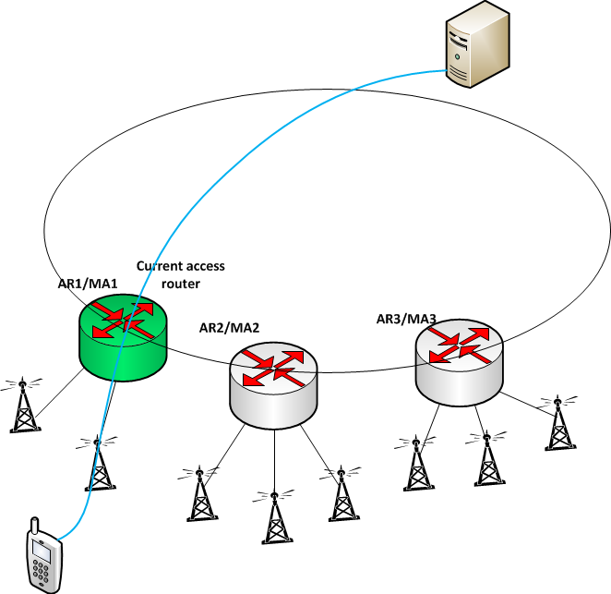
Problematic Use-case
(2)
The MN typically attaches through AR2
Current MA
(1)
The MN has long flows (long-lived after undergoing an IP-handover)
(3)
But in this case, it is attached through AR1…

Slide 4
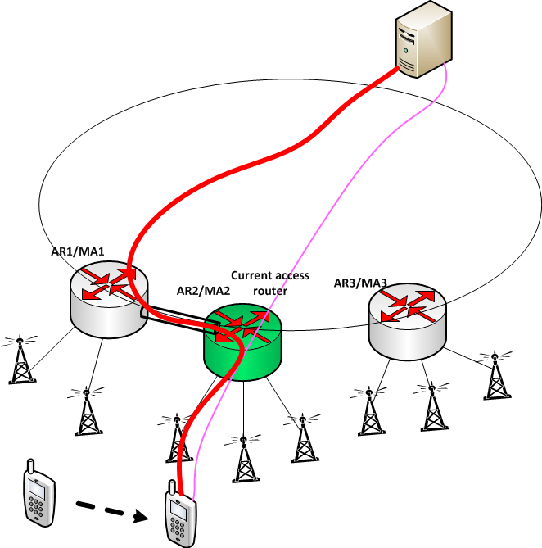
After IP-handover
A Long Flow !!!
New traffic
Handover traffic
Current MA
(4)
So what is the situation after IP-handover?

Slide 5
Problematic Use-case - Solution
Knowing that –
the MN typically attaches through AR2 and –
the flows are long…
What if we select AR2 as the Mobility Anchor in the first place

Slide 6
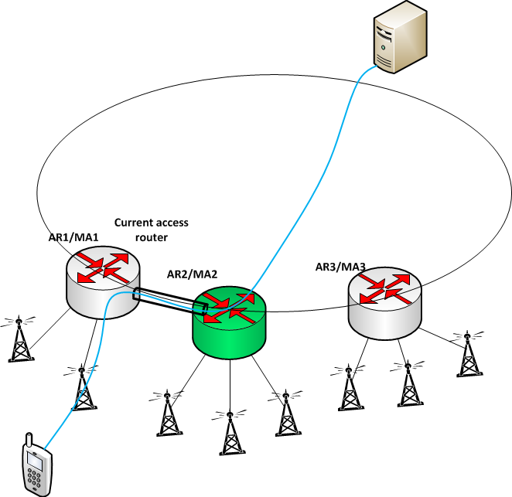
Before IP-handover
Yes, the traffic is tunneled, but for a short while, since the MN is typically connected through AR2
Current MA
(1)
Although the MN is attached through AR1, MA2 is selected as the MA

Slide 7
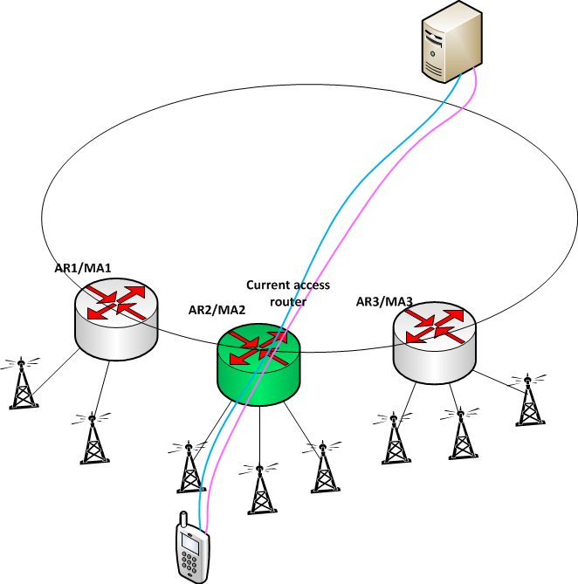
After IP-handover
Handover traffic
New traffic
Both new and IP-handover flows are handled without any tunnel
☺
Current MA
Current MA

Slide 8
Summary
There may be use-cases where a more intelligent selection process can reduce overhead and improve performance (reduce end-to-end delay)
draft-aliahmad-dmm-anchor-selection proposes the following contexts for analyzing the different use-cases:
Mobile node context (how mobile is it? Does it connect through a typical location?)
Application context (what type of flows are generated by the application in the mobile node?)
Network context (what is the load situation on each MA?)
It describes various use-cases that require different selection methods to achieve minimum overhead

Slide 9
Next Steps
Feedback from the WG is needed on the draft
Are there any additional use-case that come to mind?
What are the additional tools needed to enable a better mobility anchor selection?

