Slide 1
Service Flows Distribution and Handoff Technique based on MIPv6
draft-liu-dmm-flows-distribution-and-handoff-00
liumin@ict.ac.cn

Slide 2
DMIPv6 & MIPv6
Distributed Mobile IPv6 (DMIPv6) is a distributed network layer mobility solution compatible with mobile IPv6, which would take different mobility management strategies according to the CN's position, network conditions and service requirements of different service flows so as to achieve the session based handoff and transmission path control.
 | Component | Management Granularity | Management Strategies | Deployment Method | Operation Process
MIPv6 | HA (HoA), MN, CN, etc. | Entire Node | Single | Single | Similar
DMIPv6 | DHP (DHoA), MN, CN, etc. | Single service flow | Different strategies to different occasion | Distributed

Slide 3
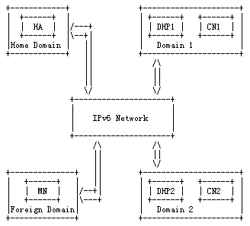
Basic Framework
DMIPv6 allows a MN to choose multiple Distributed Home-Proxys (DHPs) and Distributed Home Address (DHoAs) while there are HA and HoA already. MNs choose whether to start DMIPv6 according to the type and initiator of each session. DMIPv6 could select and maintain different DHPs for a MN's different service flows at the same time.

Slide 4
DHP & HA
Management on service flow granularity
Intercept and forward the packet between the MN and CN
A router on a mobile node's home link
Route optimization
“Operation process”
Router(s) near the CN
Distributed Home-Proxy(DHP)
Home Agent (HA)
DHP is a router near the CN, with the function for an extension of the HA, which assigns distributed home addresses (DHoAs) for the MN, receives and forwards packets between the MN and CN. It plays a role in route optimization and switching management on service flow granularity.

Slide 5
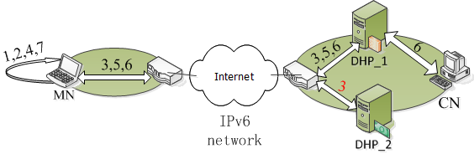
The Processing Procedure of a New Service Connection
1. Judgment of the Mobility Requirement of the Service Flow
2. Judgment of the Initiator of the Service Flow
3. DHP Query
4. DHP Selection
5. DHoA Application
6. Establishing the Communication Connection
7. Confirming the Communication Mode

Slide 6
The Processing Procedure when MN Moves
Judging the QoS condition of the new access network
For sessions need to be maintained
MN binds the new CoA to the selected DHP again
DHP replies the binding update
DHP performs proxy functions
Route optimizes if permitted
For sessions need to be terminated
MN will not bind the new CoA with DHP

Slide 7
Message Types
Some New Message Types
DHP Query Message
DHoA Request/Response Message
DHP Binding Update/Confirmation Message
Details to the draft please

Slide 8
Reference
[RFC2119] Bradner, S., "Key words for use in RFCs to Indicate
Requirement Levels", BCP 14, RFC 2119, March 1997.
[RFC2460] Deering, S., "Internet Protocol, Version 6 (IPv6)
Specification", RFC 2460, November 1997.
[RFC4862] Thomson, S., Narten, T. and T. Jinmei, "IPv6 Stateless
Address Autoconfiguration", RFC 4862, September 2007.
[RFC5944] Perkins, Ed., C., "IP Mobility Support for IPv4, Revised",
RFC 5944, November 2010.
[RFC6275] Perkins, Ed., C., Johnson, D., and J. Arkko, "Mobility Support in IPv6", RFC 6275, July 2011. [RFC5380] Soliman, H., Castelluccia, C., ElMalki, K., and L. Bellier,
"Hierarchical Mobile IPv6 (HMIPv6) Mobility
Management", RFC 5380, October 2008.

Slide 9
Q&A?

Slide 10
Thank you!

