Slide 1
Energy Management UML-Based Information Model
Control and Monitoring
Brian Hedstrom
CableLabs

Slide 2
Agenda
Collaboration with SCTE
Use of UML Modeling Tools
Management Protocols
Gaps in current Information Model
UML-Based Information Model

Slide 3
SCTE Collaboration
Collaboration with SCTE Sustainability Management Subcommittee Adaptive Power System Interface Specification (APSIS™) working group
IETF should develop & maintain the master common Energy Management Information Model for the industry
SCTE willing to contribute into this model as necessary

Slide 4
UML Modeling Tools
UML Class Diagrams provide a powerful syntax based modeling/design language for defining Information Models
Create a holistic view of the EMAN information framework (static class diagrams, object & deployment diagrams for use cases)
Create behavioral diagrams if needed
Include UML Information Model in RFC Appendix as XMI output text file for tool interchange

Slide 5
Management Protocols & Data Models
Information Model is protocol-agnostic
Should not be structured/designed to any data modeling language or their constraints
Data Models are translated/derived from the Information Model and represent the protocol-specific implementation component
Industry moving to XML-based provisioning & more efficient and scalable monitoring/collection
TR-069, NETCONF for provisioning
TR-232, etc for monitoring

Slide 6
Information Model Gaps
Power/Energy modeled as interfaces
See Class Diagrams in next slides
How to best model Physical Device and Physical/Logical interface relationships
IF-MIB provides a framework
Modeling relationships
Parent-Child implies UML inheritance (specialization/generalization)
No need to have a flat relationship in our model (can be a hierarchical tree
How to best configure relationships
Battery relationship
How do you correlate a battery to a Physical Device?

Slide 7
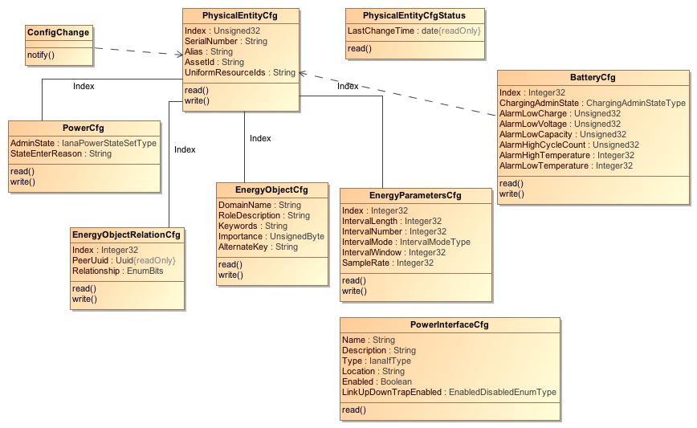
UML Information Model Control

Slide 8
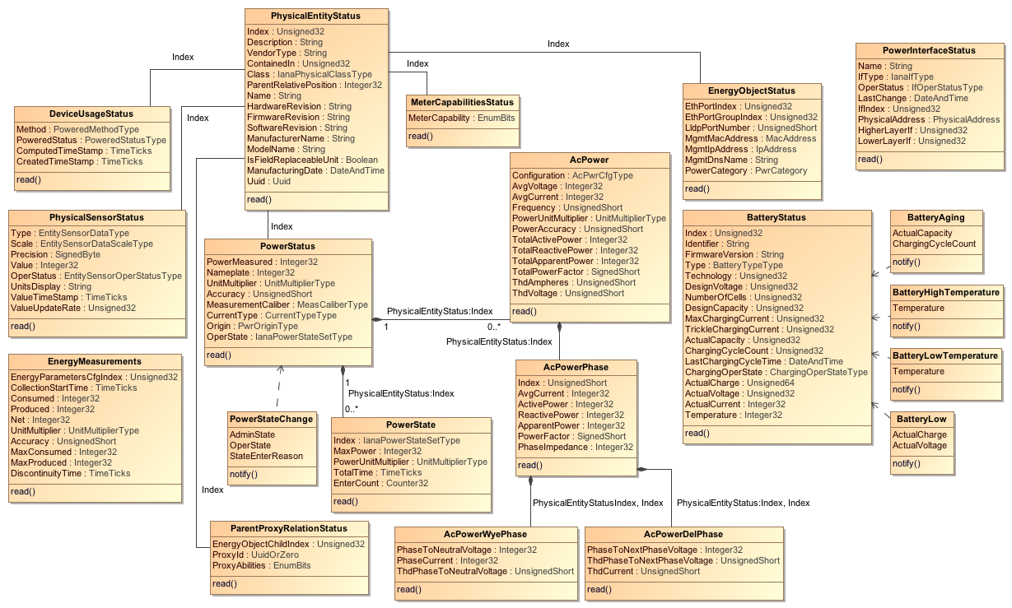
UML Information Model Monitor

Slide 9
Key Decisions
draft-ietf-eman-framework-07 consensus on:
Information Model will be developed using UML modeling language and included in the draft as XMI interchange format (XML text)
Information Model will be architected in a protocol agnostic approach (e.g., data model independent)

Slide 10
Issues
draft-ietf-eman-framework-07
Further work is needed to clarify relationships more generally than Parent-Child
Further research into modeling physical interfaces
draft-ietf-eman-battery-mib-08 consensus on:
Further work is needed to clarify the relationship between a battery and it’s associated physical device
draft-ietf-eman-energy-aware-mib-07 consensus on:
Further work is needed to better clarify how to best configure relationships
Further research into modeling physical interfaces at the implementation level (e.g., in the SNMP MIB data model)

