Slide 1
I2RS Use Case Taxonomy

Slide 2
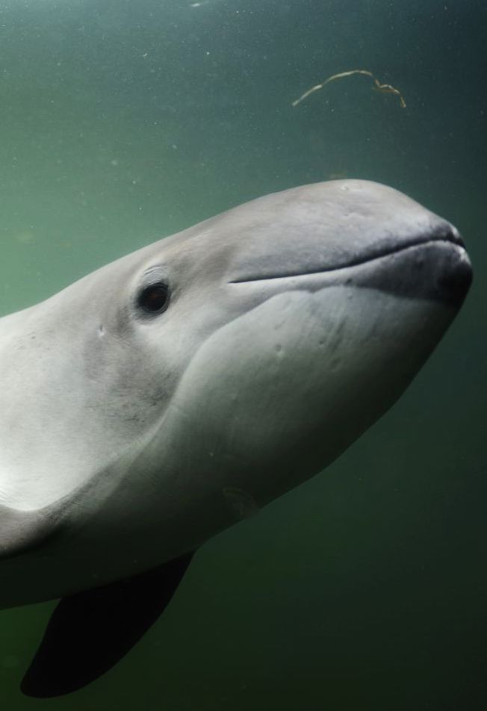
The Porpoise
Make certain we fully understand the problem space
Make certain we fully understand the requirements
We aren’t gathering use cases for fun. ☺
If a use case doesn’t really add to the requirements in some interesting way, we probably don’t need to document it

Slide 3
The Process
Cast a wide net for every possible use case
Find the set of use cases that justify/support the widest set of requirements
These requirements are the “ultimate goal”
Not to be mistaken for any sort of immediate or intermediate goal
Narrow requirements to bite sized chunks
Kelp balls of the right size
Build the pieces needed to fulfill that set of requirements
Dip out the next set of requirements to work on

Slide 4
Use Cases
Two ways to think about use cases
Enterprise verses service provider verses content provider
Security verses traffic engineering verses…
Data center verses campus verses core verses…
What is the “right” approach to organizing the use cases
Make certain we have most of the useful use cases
Without too much overlap

Slide 5
Use Cases
 | Location |  |  | Net |  | Purpose
 | Core | Edge | DC | SP | Ent | TE | Sec | Prov | Ops
amante-topology | X | X |  | X |  | X |  | X | X
hares-vn-vc | X | X | X | X | ?? |  |  | X
hu-overlay |  | X |  |  |  |  |  | X
keyupate-bgp | X |  |  | X |  | X | X | X | X
white-i2rs | X | X | X | X | X | X | X | X

