Slide 1
PID: A Generic Naming Schema for Information-centric Network
Xinwen Zhang, Ravi Ravindran
Haiyong Xie, Guoqiang Wang
Huawei Technologies

Slide 2
Background
Naming a content object is fundamental for ICN
  Affect all other design options
There are multiple roles for a name, for example:
  R1 (relatively unique) -- identifying
  R2 (always locatable) - routing
  R3 (readable/semantic) – meaning (to app)
  R4 (bindable ) – security verifier
  R5 (trustable) – trust verifier
Previously, community try to achieve many roles with single-entity name
  Flat name
  Hierarchical readable name
  Hierarchical flat name
We propose a different way
  A name consists of multiple entities
  Each for different purposes

Slide 3
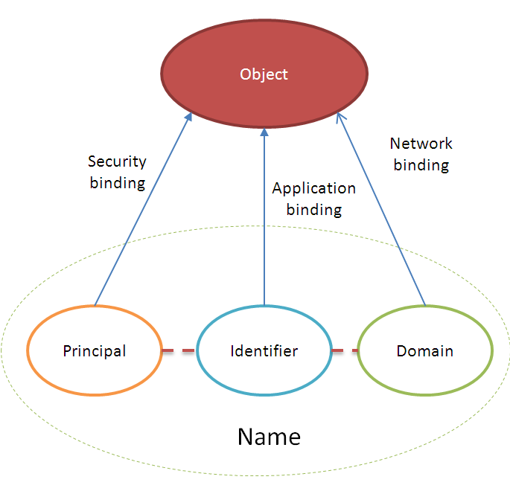
P:I:D naming schema
I is the identifier of the object
  can be something chosen by publisher
  can be hierarchical or flat, user-readable or non-readable, and location-independent.
D is the domain that provides resolution from identifier to the real location of the object by routers.
  The locator of the target object if the locator is persistent;
  The resolution service name which maps the content identifier to its real location, if the resolution service name is persistent;
  A resolution service name that maps the content identifier to another resolution service name or location, that is, a meta-domain;
  Any combination of above.
P is the principal to bind the object with complete name for security purpose
  for different relationships, e.g., ownership, administration, and social relations.
  usually constructed by hashing the public key of the principal, or the hashing the content object itself if it is static.

Slide 4
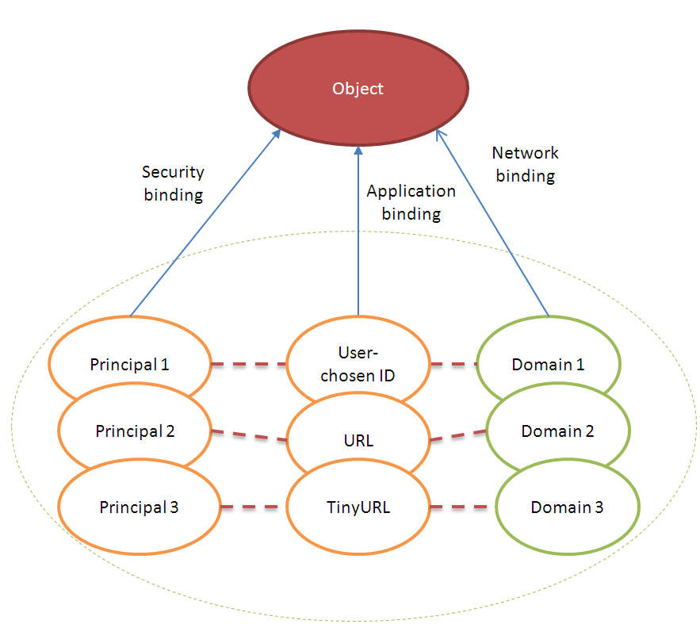
Generalized naming scheme

Slide 5



P:I:D naming resolution protocol
D
(A name resolution service)
D’
Name resolution
PDUs before movement
Resolution update
A content name (P:I:D)
PDU after movement
Check CS with (P:I)
If yes return PDU
Else, routing I_PDU with D
Obtain content location
Augment I_PDU with location
Retrieve content with I_PDU
Application
I_PDU (P:I:D)
Content publisher/owner

Slide 6
Features
Multi-home of content
  with multiple domains in one name
  Which supports multiple NRS at the same time
Mobility support
  Late-binding of address to PDU
Flexibility
  Support names in legacy and ICN proposals
Strong binding
  Enable efficient check if a content is correctly named in network
Enable trust verification at end side
  With help of external trust management mechanisms (e.g., PKI)

Slide 7
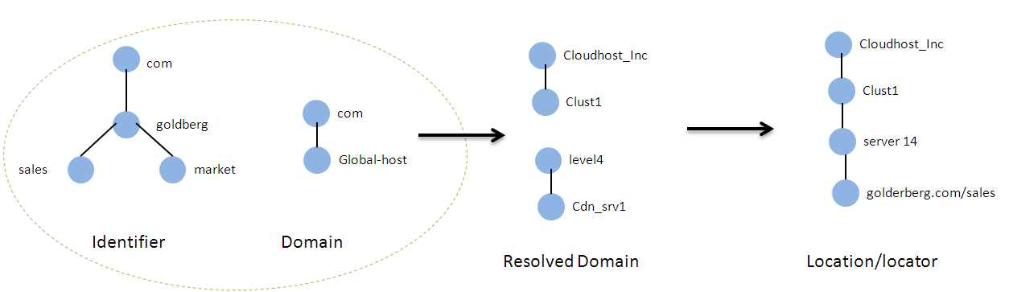
Example

Slide 8
Thank You
www.huawei.com

