Slide 1
IDR at IETF 86
Chairs slides

Slide 2
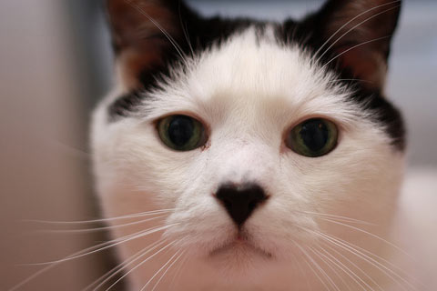
Note Well
Any submission to the IETF intended by the Contributor for publication as all or part of an IETF Internet-Draft or RFC and any statement made within the context of an IETF activity is considered an "IETF Contribution". Such statements include oral statements in IETF sessions, as well as written and electronic communications made at any time or place, which are addressed to:

Slide 3
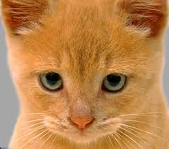
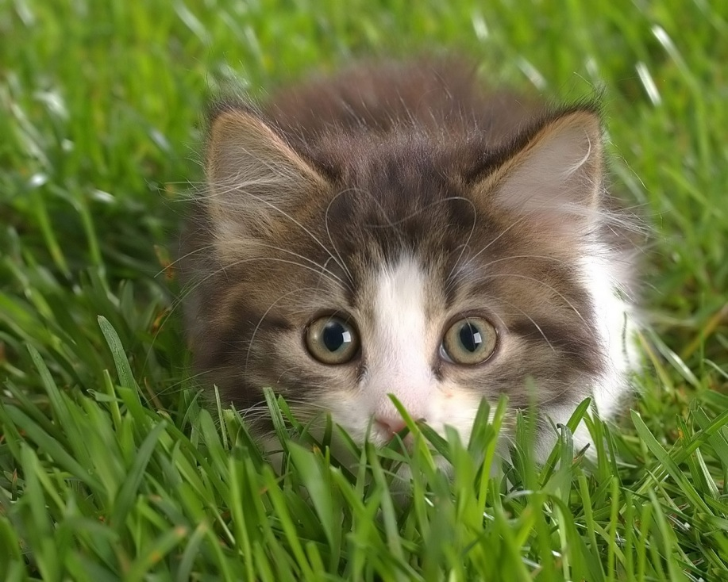
Which is address to:
The IETF plenary session
The IESG, or any member thereof on behalf of the IESG
Any IETF mailing list, including the IETF list itself, any working group or design team list, or any other list functioning under IETF auspices
Any IETF working group or portion thereof
Any Birds of a Feather (BOF) session
The RFC Editor or the Internet-Drafts function
All IETF Contributions are subject to the rules of RFC 5378 and RFC 3979 (updated by RFC 4879).
Statements made outside of an IETF session, mailing list or other function, that are clearly not intended to be input to an IETF activity, group or function, are not IETF Contributions in the context of this notice.

Slide 4

Note Well
Please consult RFC 5378 and RFC 3979 for details.
A participant in any IETF activity is deemed to accept all IETF rules of process, as documented in Best Current Practices RFCs and IESG Statements.
A participant in any IETF activity acknowledges that written, audio and video records of meetings may be made and may be available to the public.

Slide 5
Note Well
Note Well
Any submission to the IETF intended by the Contributor for publication as all or part of an IETF Internet-Draft or RFC and any statement made within the context of an IETF activity is considered an "IETF Contribution". Such statements include oral statements in IETF sessions, as well as written and electronic communications made at any time or place, which are addressed to:
The IETF plenary session
The IESG, or any member thereof on behalf of the IESG
Any IETF mailing list, including the IETF list itself, any working group or design team list, or any other list functioning under IETF auspices
Any IETF working group or portion thereof
Any Birds of a Feather (BOF) session
The IAB or any member thereof on behalf of the IAB
The RFC Editor or the Internet-Drafts function
All IETF Contributions are subject to the rules of RFC 5378 and RFC 3979 (updated by RFC 4879).
Statements made outside of an IETF session, mailing list or other function, that are clearly not intended to be input to an IETF activity, group or function, are not IETF Contributions in the context of this notice.
Please consult RFC 5378 and RFC 3979 for details.
A participant in any IETF activity is deemed to accept all IETF rules of process, as documented in Best Current Practices RFCs and IESG Statements.
A participant in any IETF activity acknowledges that written, audio and video records of meetings may be made and may be available to the public.

Slide 6
Agenda
Administrivia Chairs Sue Hares & John Scudder 10 min.
Note Well , Scribe, Etherpad, and Blue Sheets, Document status
North-bound Distribution of Link-State and TE information using BGP
draft-ietf-idr-ls-distribution-02 Stefano Previdi 20 min.
Update on Attribute Flag Low Bits Sue Hares & John Scudder 30 min.
draft-hares-idr-update-attrib-low-bits-fix-01
Speaker shuffling time 5 min.
Total: 65 minutes

Slide 7
Status - outgoing
Publishing Pending RFCs (RFC editors queue)
Draft-ietf-idr-as0-05
(awaiting draft-ietf-idr-error-handling-03)
draft-ietf-idr-deprecate-dpa-etal-00
Submitted for IESG approval
drafdraft-ietf-idr-as-private-reservation-03
Passed WG last call
draft-ietf-idr-rfd-usable-01
In MIB Doctor review (need status)
Draft-idr-bgp4-mibv2

Slide 8
Looking for implementations - Must have 2 to progress
draft-ietf-idr-aigp-09
draft-ietf-idr-as4octet-extcomm-generic-subtype-05
draft-ietf-idr-bgp-enhanced-route-refresh-03
draft-ietf-idr-bgp-flowspec-oid-01
draft-ietf-idr-bgp-gr-notifications-
draft-ietf-idr-bgp-ipv6-rt-constrain-01
Draft-ietf-idr-bgp-nh-cost-01
draft-ietf-idr-bgp-optimal-route-reflection-02
Draft-ietf-idr-bgp-mibv2-13
draft-ietf-idr-bgp-multisession-07

Slide 9
Looking for implementations - Must have 2 to progress
draft-ietf-idr-custom-decision-02
draft-ietf-idr-dynamic-cap-14
draft-ietf-idr-enhanced-gr-02
Draft-ietf-idr-error-handling-03
draft-ietf-idr-ext-opt-param-02
draft-ietf-idr-ix-bgp-route-server-02
Draft-ietf-idr-link-bandwidth-06
Draft-ietf-idr-reserved-extended-communities-04
Draft-ietf-idr-sla-exchange-00

Slide 10
NM - MIBS
Draft-ietf-idr-bgp-mibv2-13 –
Heading for Last call (see messages)
Draft-ietf-idr-bgp-mibv2-tc-mib-03
Will be coming

Slide 11
Q & A

