Slide 1
Advanced Stream and Sampling Framework for IPPM draft-morton-ippm-2330-update-01
Joachim Fabini and Al Morton
March 2013

Slide 2
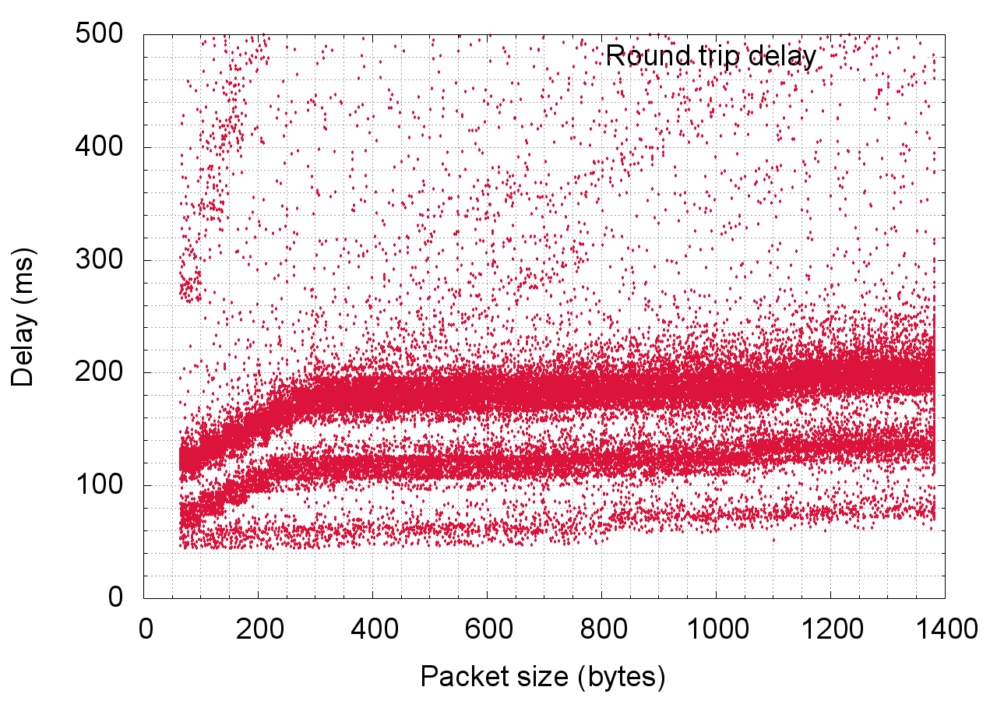
Status & Motivation
Networks have evolved
RFC 2330 assumes linear network behavior (“wire“)
Smart networks: Measurement results depend to a large extent on measurement stream (on-demand allocation)
RFC 2330 metric and methodology properties are a useful theoretical instrument - limited in real life now (repeatability)
Network-internal flow state at layers below IP
Proposal: Update 2330
Notes:
Diagram: round-trip delay measurements in HSPA network, random payload and random start-time, 35+ hours of measurements, 50K samples

Slide 3
Scope of Advanced Framework
Describe useful additional stream parameters
Restore repeatable measurements in modern networks
Aspects
1. Network treatment depends on Type-P (concept ext.)
2. Packet history influences network/results
3. Access technology may change during session
4. Time-slotted service time in network paths

Slide 4
Main Comment: Define “Reactive Network”
Sec 1.1 Reactive Network Behavior
Sensing packet arrival/inactivity for a flow of interest
Assessment intervals or multiple arrivals
Result in new mode of operation in one or more network components
Deterministic/Observable w.r.t. the flow of interest
Defined at a particular layer (e.g., reactive at IP layer)
A network or path is said to be reactive when at least one link or host on the path exhibits reactive behavior

Slide 5
Examples: Reactive Behavior
Layer Independent:
Link establishment in response to flow activity
This is why a concept of pre-test load is needed
Channel capacity adaptation
Decision to increase or decrease capacity on a sub-IP link based on past or current flow rate.
Decision to use signaling channel for sporadic, small data packets instead of allocating dedicated bearer
Layer Dependent:
Link-level compression of packet payload(s) depending on Type-P and higher-layer content
For instance JPEG file downsizing and –scaling in mobile networks (server-side optimizers)
Content-based interception

Slide 6
Examples: NON-Reactive Behavior
“Green” features
Activate idle fiber link when Util>X
Deactivate fiber link when Util<Y
Policies triggering on total cell load
Mobile networks: bias of capacity allocation algorithms by current total cell load (all users)
Channel adaptation between low-capacity or high-capacity on a sub-IP link appears random.
Fall-back to accommodate appearance of a legacy device
Signal quality (lower-layers, position, interference)
Activating or de-activating a dedicated VC on an xDSL link (e.g., some DSL modems do this when switching on or off a VoIP phone or an IPTV box, substantially reducing the capacity available for best-effort traffic).

Slide 7
Summary Status and Discussion
Detailed discussion on the mailing list (2012)
Support to do the work
Adopt as a working group item?
Possible future work: Define methods to test for reactive network behavior, based on fundamental IPPM metrics

Slide 8
Backup

Slide 9
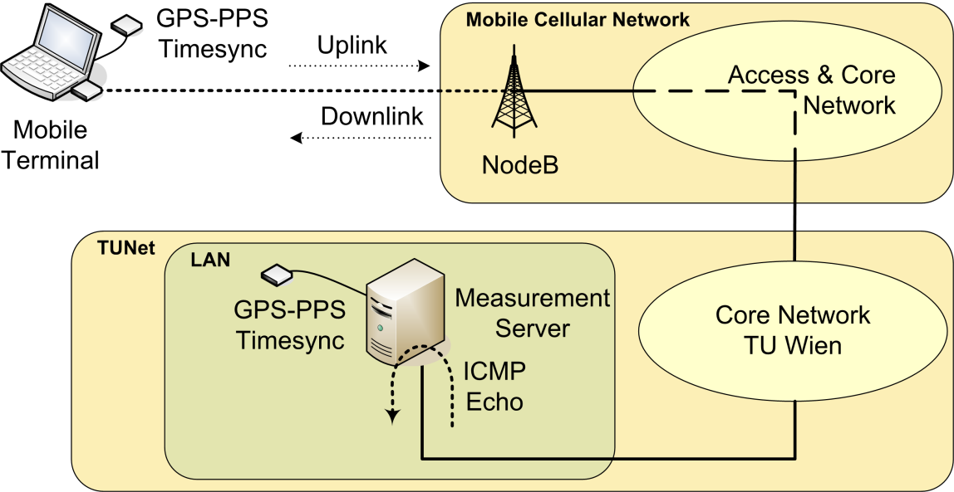
Measurement Methodology & Setup
End-to-end ICMP round-trip delay measurements
Initiated by UE (mobile client), reflected by server
Client and server synchronous with global time (PPS, ~10µs).
Randomness in space and time
Packets having random payload size are sent out at random start times

Slide 10
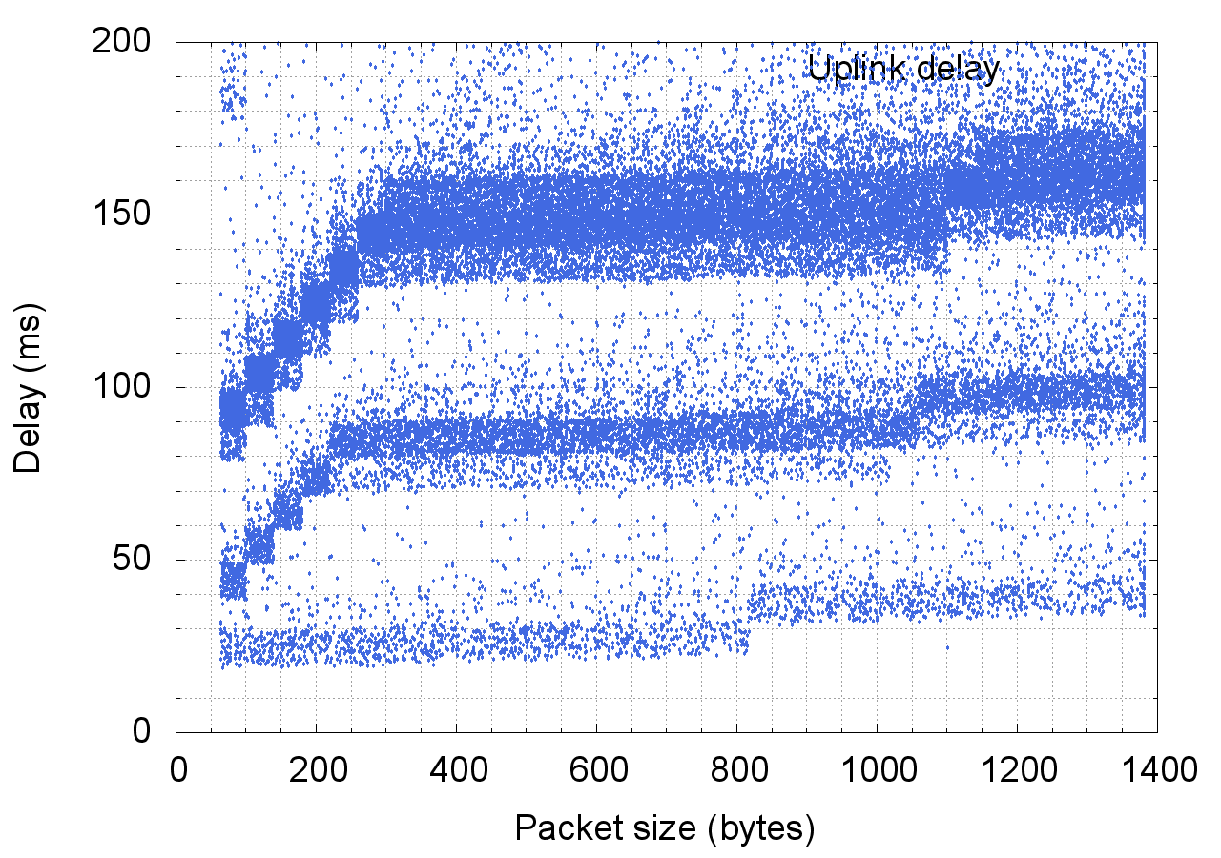
1. Expand elements of Type-P 2. Packet History Influence
Test packet length
Content optimization
Flow state: multi-modal distributions
Notes:
Diagram: uplink delay measurement in HSPA network, 35+ hours of measurements, 50K samples

Slide 11
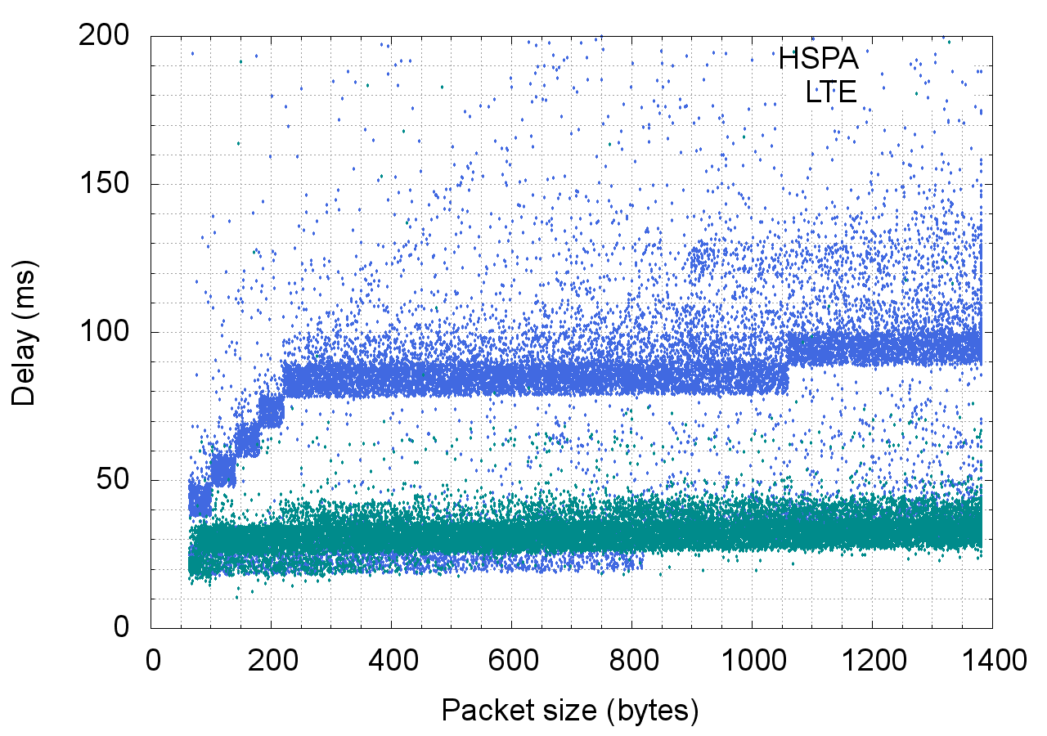
3. Access Technology Change (App-transparent)
Applications might not detect changes
Overlayed
Mobile measurements (LMAP)
Representativeness?
Notes:
Diagram: uplink delay measurement in HSPA+LTE network, 6 hours of measurements, 40K samples (artifically overlayed)

Slide 12
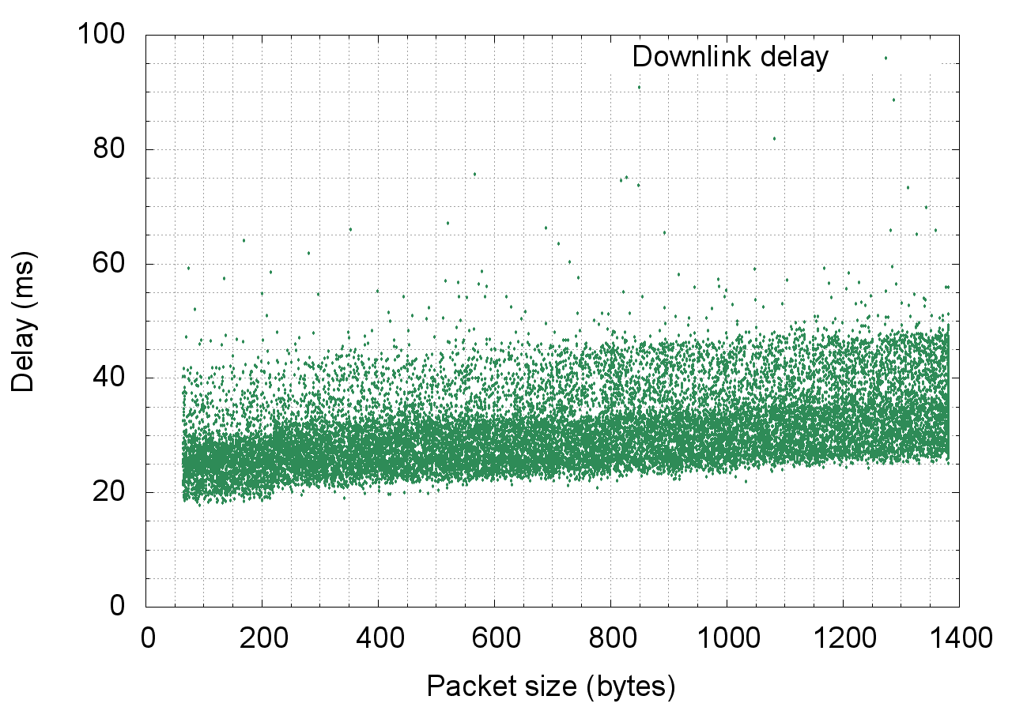
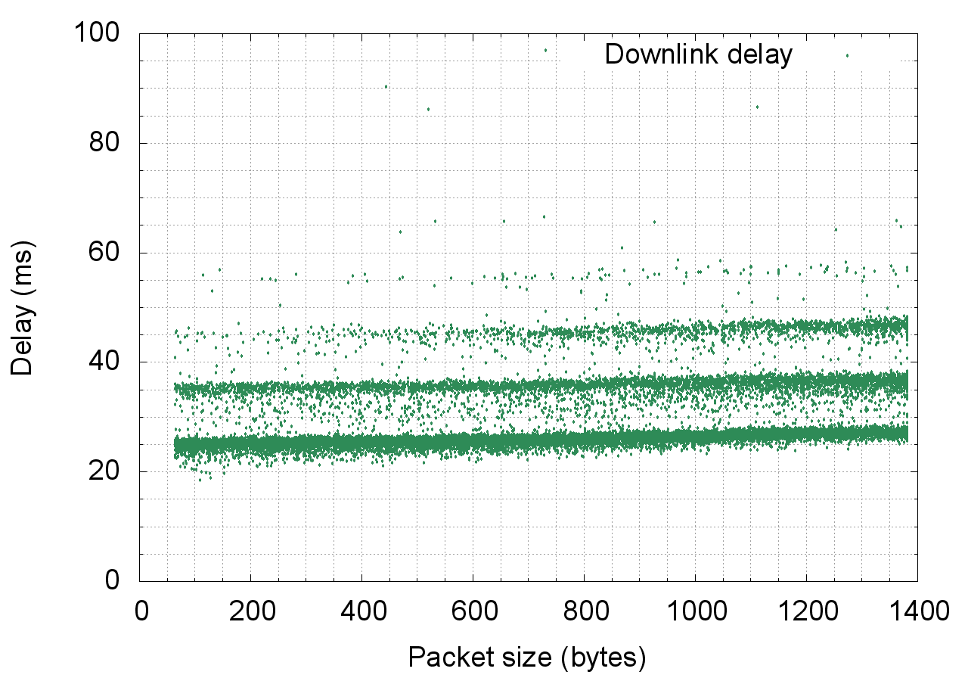
4. Time-slotted Networks
First time-slotted segment cancels randomness
Biased samples lead to multi-modal delay distributions
Notes:
Diagram: downlink delay in HSPA network, 3+ hours of measurements, 20K samples
Left: unbiased samples. Right: biased samples (extracted from round-trip delay samples: uplink is time-slotted, therefore downlink measurement samples are biased – interaction with downlink timing)

Slide 13
IPPM Feedback on the list
Matt Mathis
Add “actionable” metrics
Pre-test load – special aspect of “packet history”?
Rüdiger Geib, Matt Mathis
Characterization of special treatments
Traffic shaping
Flow suppression
Add as subtopic under Test Packet Type-P
Define “reactive network behavior”
Discussion of test traffic preferences in the wild

Slide 14
Goals – Next Steps
Metric & Methodology properties:
Improve Repeatability, Continuity, Extensibility
Can/should we formalize these properties?
Assess “Quality of Measurement” to evaluate if properties are satisfied for two measurement sample sets?
Aim: find minimum set of parameters such that measurements have one or several of the above-mentioned properties.
Classification: methodology-invariant metrics?

