Slide 1
JSON Serialization Specifications
JOSE WG @ IETF 86
JWS JSON Serialization
JWE JSON Serialization
March 13, 2013
Nomura Research Institute
Nat Sakimura

Slide 2
Documents:
JSON Web Signature JSON Serialization
draft-jones-jose-jws-json-serialization
JSON Web Encryption JSON Serialization
draft-jones-jose-jwe-json-serialization
http://tools.ietf.org/html/draft-jones-jose-jwe-json-serialization-04
http://tools.ietf.org/html/draft-jones-jose-jws-json-serialization-04

Slide 3
JSON Serialization Goals
JSON representation for JWS, JWE values
Support multiple signatures/recipients
Use identical crypto operations as compact (dot-separated) serializations

Slide 4
Design Methodology
Use JSON members for each JWS/JWE element
(instead of separating them with ‘.’ characters)
Use single JSON values for elements common to multiple signatures/recipients
JWS Payload
JWE Initialization Vector
JWE Ciphertext
Use JSON arrays for elements specific to each signature/recipient
JWS Header, JWS Signature
JWE Header, JWE Encrypted Key, JWE Integrity Value

Slide 5
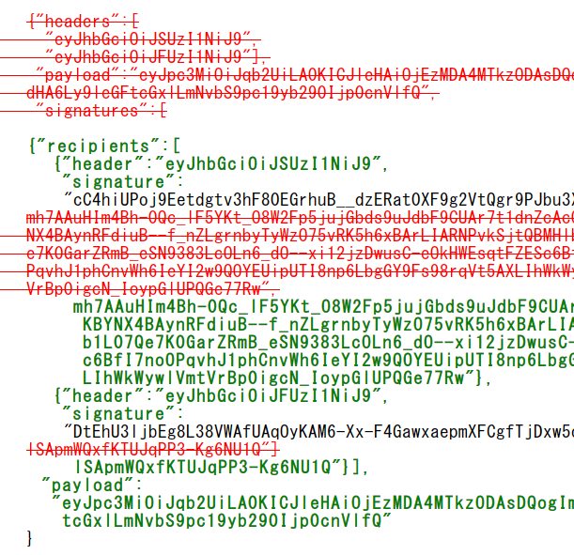
Specs Very Stable
Last change was to use an array of structures for per-recipient values (Oct. 20, 2012)
At the request of the working group

Slide 6
It’s Time for WG Draft Status
Once rechartering is complete, it’s time to add these as working group documents
To meet needs of use cases requiring multiple signatures/recipients
Whether to combine these with JWS, JWE?
Rechartering will allow us either option
Simpler to first publish WG versions of existing docs
Keeping them separate makes life easier for developers who only need the Compact Serialization

Slide 7
Backup Slides

Slide 8
Headers from Example JWS-JS
{"alg":"RS256"}
{"alg":"ES256"}

Slide 9
Example JWS-JS
{"recipients":[
{"header":"eyJhbGciOiJSUzI1NiJ9",
"signature":
"cC4hiUPoj9Eetdgtv3hF80EGrhuB__dzERat0XF9g2VtQgr9PJbu3XOiZj5RZ
mh7AAuHIm4Bh-0Qc_lF5YKt_O8W2Fp5jujGbds9uJdbF9CUAr7t1dnZcAcQjb
KBYNX4BAynRFdiuB--f_nZLgrnbyTyWzO75vRK5h6xBArLIARNPvkSjtQBMHl
b1L07Qe7K0GarZRmB_eSN9383LcOLn6_dO--xi12jzDwusC-eOkHWEsqtFZES
c6BfI7noOPqvhJ1phCnvWh6IeYI2w9QOYEUipUTI8np6LbgGY9Fs98rqVt5AX
LIhWkWywlVmtVrBp0igcN_IoypGlUPQGe77Rw"},
{"header":"eyJhbGciOiJFUzI1NiJ9",
"signature":
"DtEhU3ljbEg8L38VWAfUAqOyKAM6-Xx-F4GawxaepmXFCgfTjDxw5djxLa8IS
lSApmWQxfKTUJqPP3-Kg6NU1Q"}],
"payload":
"eyJpc3MiOiJqb2UiLA0KICJleHAiOjEzMDA4MTkzODAsDQogImh0dHA6Ly9leGF
tcGxlLmNvbS9pc19yb290Ijp0cnVlfQ"
}

Slide 10
Headers from Example JWE-JS
{"alg":"RSA1_5","enc":"A128CBC+HS256"}
{"alg":"RSA-OAEP","enc":"A128CBC+HS256"}

Slide 11
Example JWE-JS
{"recipients":[
{"header":"eyJhbGciOiJSU0ExXzUiLCJlbmMiOiJBMTI4Q0JDK0hTMjU2In0",
"encrypted_key":
"O6AqXqgVlJJ4c4lp5sXZd7bpGHAw6ARkHUeXQxD1cAW4-X1x0qtj_AN0mukqE
Ol4Y6UOwJXIJY9-G1ELK-RQWrKH_StR-AM9H7GpKmSEji8QYOcMOjr-u9H1Lt
_pBEieG802SxWz0rbFTXRcj4BWLxcpCtjUZ31AP-sc-L_eCZ5UNl0aSRNqFsk
uPkzRsFZRDJqSSJeVOyJ7pZCQ83fli19Vgi_3R7XMUqluQuuc7ZHOWixi47jX
lBTlWRZ5iFxaS8G6J8wUrd4BKggAw3qX5XoIfXQVlQZE0Vmkq_zQSIo5LnFKy
owooRcdsEuNh9B9Mkyt0ZQElG-jGdtHWjZSOA",
"integrity_value":"RBGhYzE8_cZLHjJqqHuLhzbgWgL_wV3LDSUrcbkOiIA"},
{"header":"eyJhbGciOiJSU0EtT0FFUCIsImVuYyI6IkExMjhDQkMrSFMyNTYifQ",
"encrypted_key":
"myoFYZHErXG4gMVWl9UrFOCFIwvOUudYrxTsRsOt6maTc3W8G1FqGVOIBSZve
BdZz2LqS42xta5OXEwLYaocObUxtfH9H8vMsjO-mBo7U9mp_PkS9PqVJMkeEe
PLhzNLH0ecq7nYT6AFr5sSt4WMOPjSwHVQWtx43fZt4HvYaE_vgeSrxdi8KAb
xbLzK_-qcYT6H7cwOMZrT6SFcXgLXESuKpF0azSGQtUmo0MLICP0YPBecGLTo
PiveOH2awKZx0FkzPwi4JmOIvnAJ_wVQQJDVELwO9SIoF8olCQRHGyZ9rzDrr
GRkoYgm2jVz-x0BuFVQFa4ZNufudtiT8pQxKg",
"integrity_value":"i45dXWFjRKk805VtjIw_8iqGq1r9qPV7ULDLbnNAC_Q"}],
"initialization_vector":"AxY8DCtDaGlsbGljb3RoZQ",
"ciphertext":
"1eBWFgcrz40wC88cgv8rPgu3EfmC1p4zT0kIxxfSF2zDJcQ-iEHk1jQM95xAdr5Z"
}

