Slide 1
draft-sd-l2vpn-evpn-overlay-01.txt
A. Sajassi (Cisco), J. Drake (Juniper), N. Bitar (Verizon), A. Issac (Bloomberg), J. Uttaro (ATT), W. Henderickx (ALU), Y. Rekhter (Juniper), R. Shekhar (Juniper), B. Schliesser, S. Boutros (Cisco), K. Patel (Cisco), S. Salam (Cisco), D. Rao (Cisco), L. Yong (Huawei)
IETF 86, March 2013
Florida

Slide 2
History
Presented draft-sajassi-l2vpn-evpn-overlay-00 in IETF 85
Merged with draft-drake-nvo3-evpn-control-plane-00
Resultant draft was published in December
draft-sajassi-drake-l2vpn-evpn-overlay-00
Changed the name to adhere to the naming convention
draft-sd-l2vpn-evpn-overlay-01

Slide 3
The merged draft covers
Ethernet over MPLS (MPLS & MPLS over IP)
Ethernet over IP (VXLAN & NVGRE)
Multi-homing capability native to IP
Functionality needed for NVE residing
In TOR
In Hypervisor

Slide 4
Changes since initial merge
Added a new section to further clarify the need for global versus local VNI scope
Added a new section for VNI to EVI mapping

Slide 5
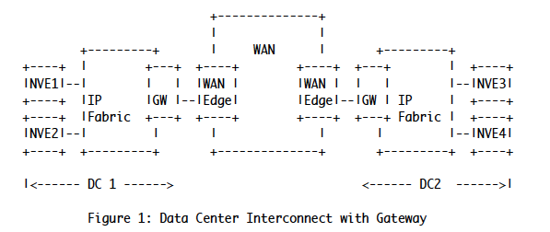
Global VNI Scenario

Slide 6

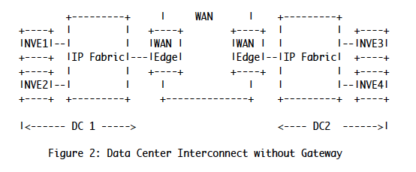
Local VNI Scenario

Slide 7
VNI to EVI Mapping: Single VNI per EVI
A single VNI of a given tenant is mapped to an EVI
Pros
RT constrain can be applied on a per VNI basis to distribute routes to VTEPs interested in a particular VNI
Cons
Additional over head in provisioning

Slide 8
Multiple VNIs per EVI
All VNIs of a given tenant can be mapped to a single EVI
Pros
No provisioning on a per VNI basis
Cons
Route are distributed to all VTEPs participating in one or more VNI for that tenant

Slide 9
Next Step
Solicit more input from WG

