Slide 1
draft-sajassi-l2vpn-evpn-inter-subnet-switching-01.txt
A. Sajassi (Cisco), S. Salam (Cisco), Y. Rekhter (Juniper), John Drake (Juniper)
IETF 86, March 2013
Florida

Slide 2
Objectives
This draft describes how E-VPN can be used as part of an IRB solution to perform both intra-subnet as well as inter-subnet switching
The solution provides optimum unicast and multicast forwarding both within a DC as well as between DCs (East-West traffic)

Slide 3
E-VPN PE Model for IRB

Slide 4
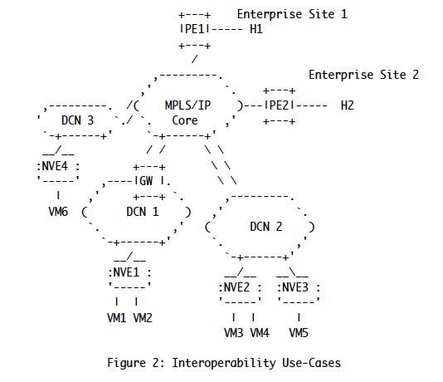
Reference Diagram

Slide 5
Scenarios of Interest
Connecting E-VPN sites within a DC
Connecting E-VPN sites in different DCs without route aggregation
Connecting E-VPN sites in different DCs with route aggregation
Connecting IP-VPN sites and E-VPN sites with route aggregation
Connecting IP-VPN sites and E-VPN sites without route aggregation

Slide 6
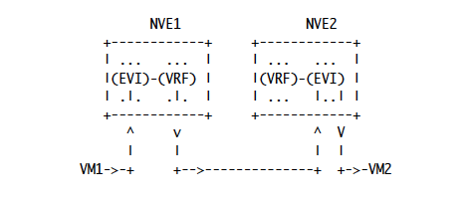
Scenario-1
Inter-Subnet Forwarding Among E-VPN NVEs within a DC

Slide 7
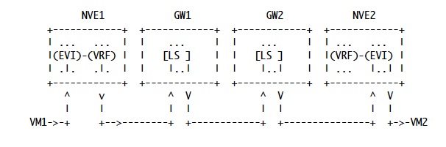
Scenario-2
Inter-Subnet Forwarding Among E-VPN NVEs in Different DCs
without Route Aggregation

Slide 8

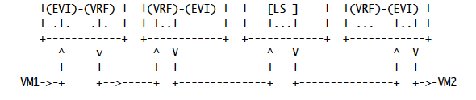
Scenario-3
Inter-Subnet Forwarding Among E-VPN NVEs in Different DCs
with Route Aggregation

Slide 9
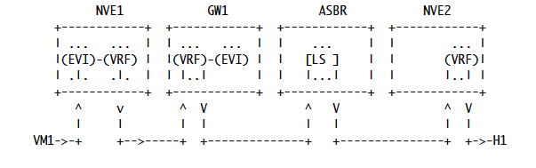
Scenario-4
Inter-Subnet Forwarding Among IP-VPN Sites and E-VPN NVEs
with Route Aggregation

Slide 10
E-VPN based IRB Solution provides
Optimal forwarding for intra-subnet (L2) traffic
Optimal forwarding for inter-subnet (L3) traffic
Support for both ingress replication as well as P2MP tunnels for multicast traffic
Support for multi-homing with active/active redundancy and per-flow load balancing
Support for network-based as well as host-based overlay models
Support for consistent policy-based forwarding for both L2 and L3 traffic

Slide 11
Next Steps
Solicit comments from WG

