Slide 1
LISP Gap Analysis for NVO3
<draft-maino-nvo3-lisp-cp-02>
F. Maino, V. Ermagan (Cisco)
D. Farinacci
M. Smith (Insieme Networks)
March 2013

Slide 2
NVO3 Status
NVO3 problem statement, framework on last call
Architectural document on the works
  Solution Categories:
WG is now looking for Gap Analysis
  GA documents addressed in NVO3 WG
  Solutions documents addressed in related WGs
 |  | Data Encapsulation (NVE)
 |  | IP-based | MPLS-based
Network Service | L2 (Ethernet) | Yes | Yes
 | L3 (IP) | Yes | Yes
LISP

Slide 3
LISP Control Plane
Support multiple data path encapsulations:
  L3 LISP (draft-ietf-lisp)
  L2 LISP (draft-smith-lisp-layer2)
  VXLAN (draft-mahalingam-dutt-dcops-vxlan)
  NVGRE (draft-sridharan-virtualization-nvgre)
Extensible via LISP Canonical Address Format (LCAF)
  draft-ietf-lisp-lcaf
Scalable and Modular Mapping System
  DDT (hyerarchical)
  ALT (BGP overlay)
  DHT
  Database, …
L3 NVE Services
L2 NVE Services

Slide 4
Benefits
Reduced use of Multicast
  Replace “flood-and-learn” with unicast mapping system lookup
  Contained ARP broadcast domain
  Underlay multicast not needed for unicast overlay services
Support multi homing
Support fast mobility
Support L2/L3 NVE services
Address Family independent (IPv4/IPv6)

Slide 5
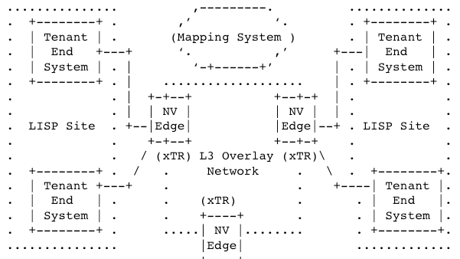
Terminology
NVO3 | LISP
NVE (Network Virtualization Edge) | xTR (Tunnel Router) Ingress Tunnel Router (ITR) Egress Tunnel Router (ETR)
VNID (Virtual Network ID) | IID (Instance ID)

Slide 6



No Flood-and-Learn
Mapping System
LISP
Map-Request
(EID=<IID1, MAC_Z>)
LISP
Map-Reply
(EID=<IID1, MAC_Z>,
RLOC=IP_B1,
RLOC=IP_B2)
EID: IID1, MAC_Z
Locator-set:
IP_B1, priority: 1, weight: 50
IP_B2, priority: 1, weight: 50
L3 Underlay
LISP
Map-Register
(EID=<IID1, MAC_Z>,
RLOC=IP_B1,
RLOC=IP_B2)
IP_A -> IP_B1
RLOCs =
IP_B1, IP_B2
RLOC=IP_A
MAC_X -> MAC_Z
xTR A
(NVE)
xTR B
(NVE)
Map-Cache Entry
EID: IID1, MAC_Z
Locator-set:
IP_B1, priority: 1, weight: 50
IP_B2, priority: 1, weight: 50
Network Attach
(IID1, MAC_Z)
MAC_X -> MAC_Z
MAC_X -> MAC_Z
App
App
App
App
OS
OS
OS
OS
EID=<IID1, MAC_W>
EID=<IID1, MAC_X>
EID=<IID1, MAC_Y>
EID=<IID1, MAC_Z>

Slide 7
Contained ARP
Broadcast Domain
Mapping System
LISP
Map-Request
(EID=<IID1, IP_Z,*>)
LISP
Map-Reply
(EID=<IID1, IP_Z,MAC_Z>,
RLOC=IP_B1,
RLOC=IP_B2)
EID: IID1, IP_Z,MAC_Z
Locator-set:
IP_B1, priority: 1, weight: 50
IP_B2, priority: 1, weight: 50
L3 Underlay
(No Multicast)
LISP
Map-Register
(EID=<IID1, IP_Z,MAC_Z>,
RLOC=IP_B1,
RLOC=IP_B2)
RLOCs =
IP_B1, IP_B2
RLOC=IP_A
xTR A
(NVE)
xTR B
(NVE)
Map-Cache Entry
EID: IID1, IP_Z,MAC_Z
Locator-set:
IP_B1, priority: 1, weight: 50
IP_B2, priority: 1, weight: 50
Network Attach
(IID1, IP_Z, MAC_Z)
Broadcast
ARP-Request(IP_Z)
Unicast
ARP-Replay(IP_Z,MAC_Z)
App
App
App
App
OS
OS
OS
OS
EID=
<IID1, IP_W,MAC_W>
EID=
<IID1, IP_X, MAC_X>
EID=
<IID1, IP_Y,MAC_Y>
EID=
<IID1, IP_Z,MAC_Z>

Slide 8
Thanks!

