Slide 1
LSP Ping TLV and sub-TLV Registry
draft-pac-mpls-lsp-ping-tlv-sub-tlv-registry-00
Mach Chen (mach.chen@huawei.com)
Tom Petch (tomSecurity@network-engineer.co.uk )
Loa Andersson (loa@mail01.huawei.com)
IETF86 MPLS Mar. 2013 Orlando

Slide 2
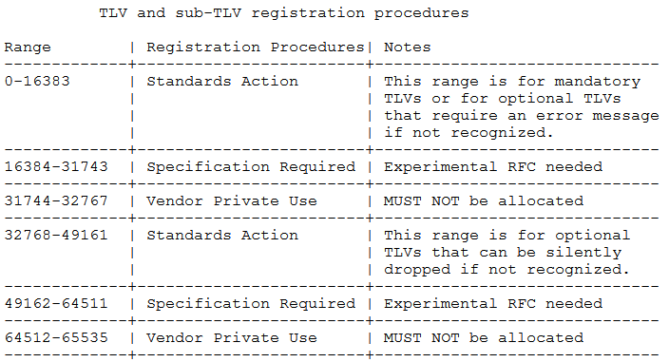
Problem Statement
Current allocation policy
All TLVs and sub-TLVs have the same allocation policies
Block
1
2
3
4
5
6

Slide 3
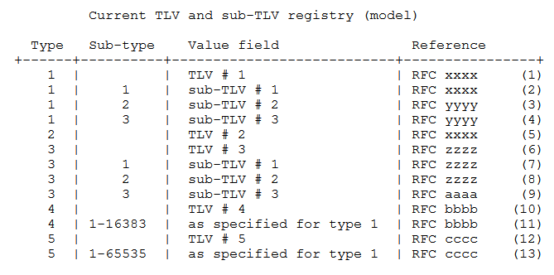
Problem Statement (cont.)
Current allocation model
All TLVs and sub-TLVs are found in a single table
Sub-TLVs are scoped by the TLVs

Slide 4
Problem Statement (cont.)
With an increasing number of TLVs, and with some sub-TLVs shared across TLVs, it has become increasingly difficult to understand how the allocation policies interact.
Type16 and 21 TLV share the sub-TLVs defined for Type 1 TLV.
Type 21 TLV also has its own dedicated sub-TLVs.
Target FEC Stack TLV (1)
Reverse-path Target FEC Stack TLV (16)
Reply Path TLV (21)
Sub-TLVs
Shared with TLV 1
Shared with TLV 1
Dedicated sub-TLVs

Slide 5
Problem Statement (cont.)
The name space of sub-TLVs is very large
65 535 potential TLVs times 65 535 sub-TLVs per TLV, gives a maximum of 4 294 836 335 sub- TLVs.
65 535 sub-TLVs shared among all TLVs seems to be more than sufficient.
If the IANA registries had been set up with one registry for TLVs and another for sub-TLVs
The registries and allocation policies would be much easier to understand and comprehend.
But it is now impossible to create a single registry for sub-TLVs which encompasses all existing sub-TLVs.

Slide 6
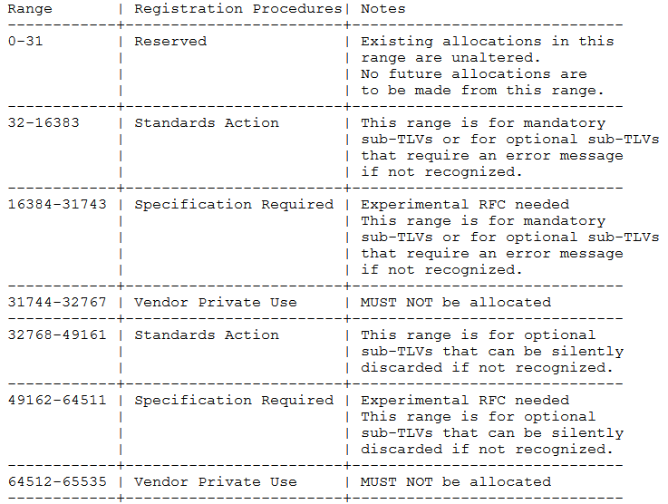
Solutions
A single, common sub-TLV namespace for all the TLVs
No changes to any existing allocations of sub-TLVs
The policy for the allocation of TLVs is unchanged
Backward compatible with the existing registries
Backward compatible with the existing registries
Future allocations of sub-TLVs

Slide 7
Next Steps
Solicit comments and opinions of the WG and refine the document.
The authors would like to request to adopt this document as a WG document.

