Slide 1

Network Coding Overview
NWRC meeting
March 11, 2013

Slide 2
Coding → Network Coding
Coding Tomorrow
(using Random Linear Network Coding)
Coding Today
(all end-to-end)
Network
Classical
Multipath
Multicast
Multisource – Multi-destination / Mesh

Slide 3
Why RNLC is Different
Code Capabilities | RLNC | Rateless (e.g. Fountain) Codes | Block Codes
Erasure correction | ✔ | ✔ | ✔
Code is carried within each packet | ✔ | ✗ | ✗
Completely distributed operation | ✔ | ✗ | ✗
De-code using unencoded packets | ✔ | ✗ | ✗
Able to generate valid codes from coded or unencoded packets | ✔ | ✗ | ✗
Composability without decoding (add incremental redundancy) | ✔ | ✗ | ✗
Encode data in a sliding window | ✔ | ✗ | ✗

Slide 4
Initial RLNC Stack Implementations
RLNC
RLNC
Operating System Agnostic Implementation
(Software)
Application Layer
RLNC
TCP Socket
TCP
UDP
RLNC
Kernel
Implementation
(Software)
IP Layer
RLNC
Network Layer
Chip
Implementation
(Hardware)
Physical Layer
RLNC
Implementable at any layer as a patch

Slide 5
Application Layer TCP Case Study
Classical
RLNC
RLNC
Application Layer
Network
RLNC
TCP Socket
Multipath
TCP
UDP
RLNC
Multisource – Multi-destination
IP Layer
RLNC
Network Layer
Physical Layer
RLNC

Slide 6
TCP Ill-Suited to Random Losses
sender
window
TCP
p₁ p₂ p₃ p₄
p₁
p₂
ACK(p₁)
p₃
p₄
ACK(p₁)
ACK(p₁)
p₂ p₃ p₄ p₅
p₅
ACK(p₁)
p₂ p₃
Triple-duplicate ACKs!
Window closing:
W ← W/2
Can’t increment window by 1
Partial sliding window

Slide 7
Coded TCP Maintains Throughput
sender
window
Coded TCP
p₁ p₂ p₃ p₄
Σp
Σp
SEEN(1)
Σp
Σp
SEEN(2)
SEEN(3)
p₄ p₅ p₆ p₇
Σp
Σp
SEEN(4)
Σp
SEEN(5)
Σp
SEEN(6)
SEEN(7)
p₇ p₈ p₉ p₁₀ p₁₁
p₈ p₉ p₁₀ p₁₁ p₁₂
There is a lag in the “SEEN” acks: To avoid lag, introduce redundancy!
Prevents random losses being interpreted as congestion!
Minij Kim, Muriel Médard, João Barros
Modeling network coded TCP throughput: a simple
model and its validation
Valuetools, 131-140 (2010)

Slide 8
Performance With Congestion Losses
sender
window
TCP
sender
window
TCP/NC
p₁ p₂ p₃ p₄
p₁
p₁ p₂ p₃ p₄
Σp
p₂
ACK(p₁)
Σp
SEEN(1)
p₃
Σp
p₄
Σp
p₂ p₃ p₄ p₅
p₂ p₃ p₄ p₅
Waiting…
Waiting…
p₂
p₂
Time-out!
Time-out!
Window closing:
W ← 1
Window closing:
W ← 1
Still allows congestion control while masking random losses!

Slide 9
Experimental Results: Single Path
wlan0
Server: Amazon EC2 instance in CA
Client: Desktop at RLE MIT, using WiFi(s)
> 100 ms
Loss rate | 0% | 1% | 2% | 3% | 4% | 5%
TCP (Mbps) | 19.04 | 3.07 | 1.07 | 0.82 | 0.53 | 0.47
CTCP (Mbps) | 20.40 | 18.99 | 16.52 | 15.20 | 13.46 | 13.53
Coded TCP
6 seconds to transmit
TCP
130 seconds to transmit
Leo Urbina
Applying Network Coding to TCP
MIT M.Eng. Thesis 2012

Slide 10
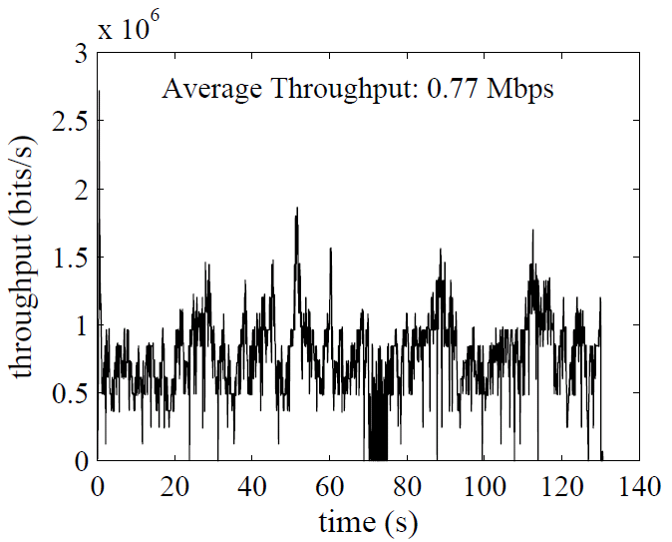
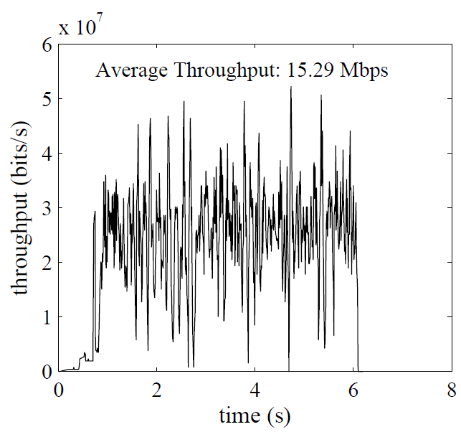
Experimental Results: Single Path
Average Throughput: 0.77 Mbps
Average Throughput: 15.29 Mbps
Example: 2% loss

Slide 11
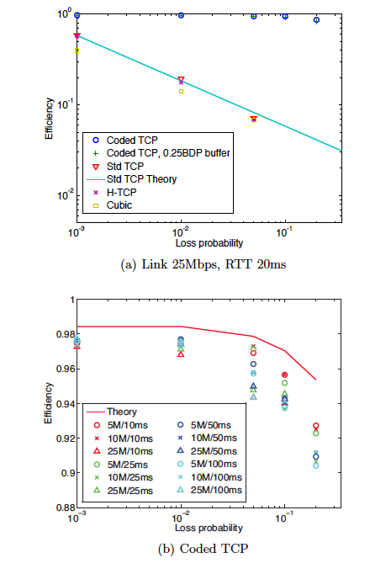
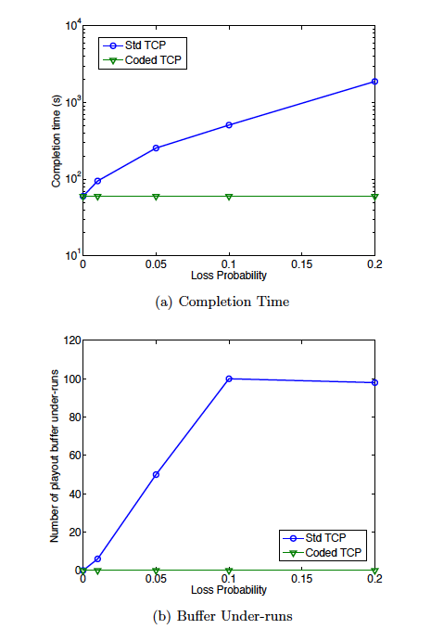
Testbed Measurements
60 s video
Full download
60 s video
Progressive download
Minji Kim, Jason Cloud, Ali ParandehGheibi, Leonardo Urbina, Kerim Fouli, Douglas Leith, Muriel Médard
Network Coded TCP (CTCP) arXiv: 1212.2291v2

Slide 12
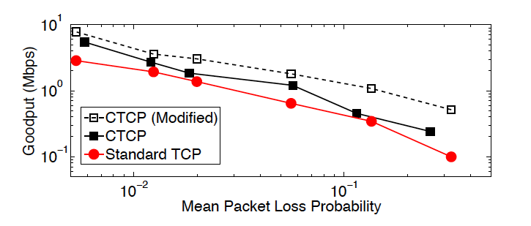
WiMax Experiments
Notes:
Rountrip time variability

Slide 13
Coded TCP Network Improvements
Classical
RLNC
RLNC
Application Layer
Network
RLNC
TCP Socket
Multipath
TCP
UDP
RLNC
Multisource – Multi-destination
IP Layer
RLNC
Network Layer
Physical Layer
RLNC

Slide 14
Coded TCP (CTCP) Over a Network
10% loss
10% loss
source
client
10% loss
10% loss
Longer paths lead to higher losses, resulting in poor performance
  TCP’s performance degrades super-linearly with end-to-end loss rate → benefits of Coded TCP are even greater in this scenario
 | RLNC (using Coded TCP) | End-to-End Coding (including Fountain Codes)
Best Possible Throughput Rate | 0.9 | 0.66
Notes:
If p1 is the probability of success in link 1 (and so on) why is effective success rate (1-p1)(1-p2)… and not p1*p2… ?

Slide 15

Composability: Redundancy When Needed
Randomized Distributed Network Coding
20% Loss Node
P_{1+ P2+4 P3+ 2 P4}
2 P₁+ 8 P₂+ 9 P₃+P₂
8 P₁+ 6 P₂+ P₃+ P₄
7 P₁+2 P₂+3 P₃+4 P₄
Re-encode → add a packet without de-coding
(4 variables, 5 packets)
Over reliable network send minimum packets
(4 variables, 4 packets)
2 P₁+ 8 P₂+ 9 P₃+P₂
3P₁₊ 5P₂₊ 2P₃₊ 7P₄
3P₁₊ 5P₂₊ 2P₃₊ 7P₄
P_{1+ P2+} 4 P_{3+ 2 P4}
8 P₁+ 6 P₂+ P₃+ P₄
2 P₁+ 8 P₂+ 9 P₃+P₂
7 P₁+2 P₂+3 P₃+4 P₄
8 P₁+ 6 P₂+ P₃+ P₄
Needed packets arrive
(4 variables, 4 packets)
7 P₁+2 P₂+3 P₃+4 P₄
RLNC allows optimized packet sends at any node

Slide 16
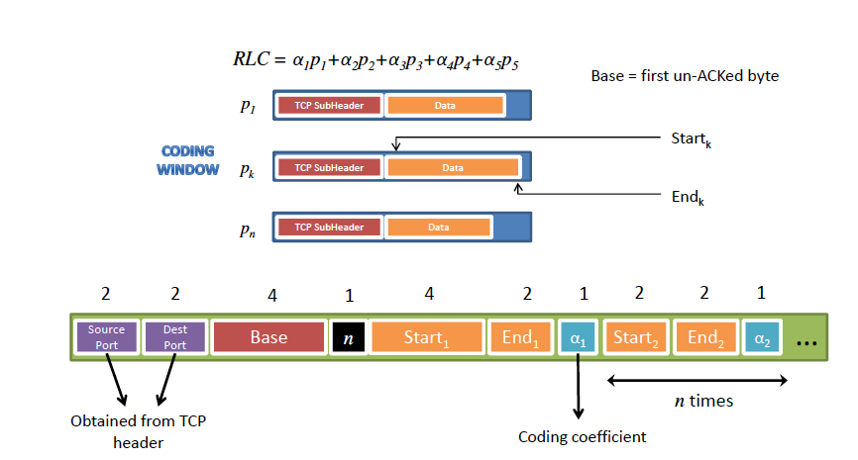
Coding Coefficients Carried within Packet
Jay Kumar Sundararajan, Devavrat Shah, Muriel Médard, Szymon Jakubczak, Michael Mitzenmacher, João Barros,
Network Coding Meets TCP: Theory and Implementation. Proceedings of the IEEE 99 (3): 490-512 (2011)

Slide 17
Multihop Wireless Network
FTP
sender
FTP
receiver
1
2
3
4
From given data

Slide 18
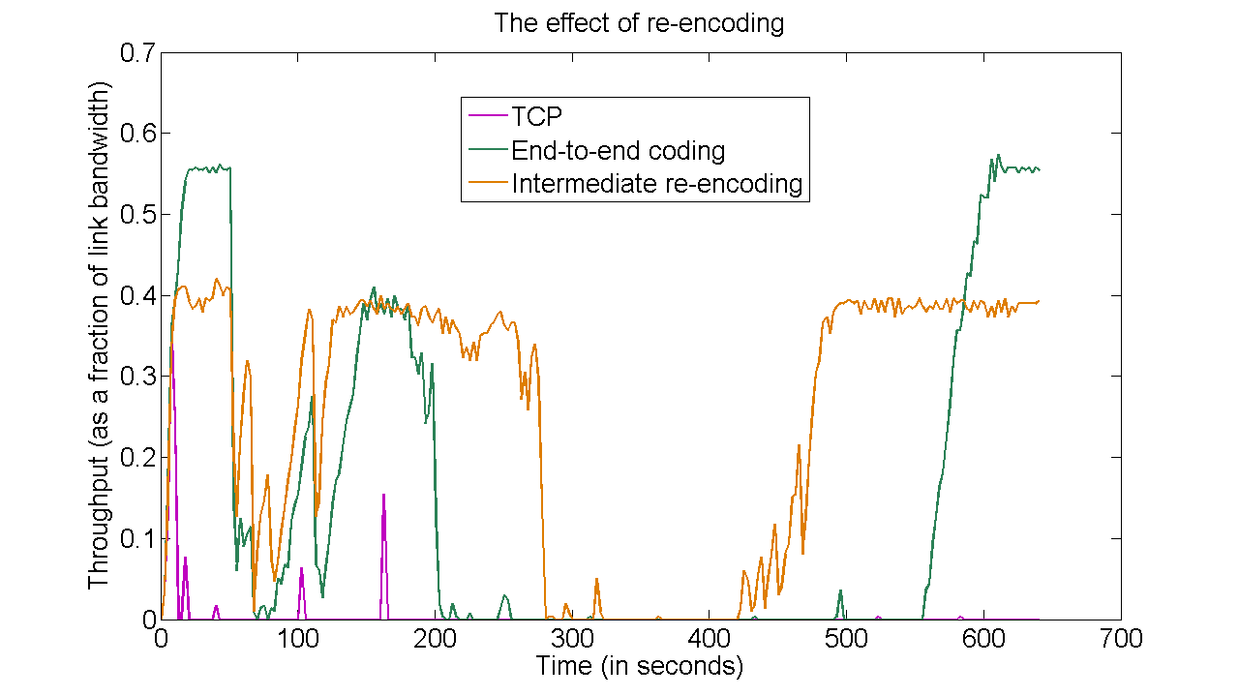
Performance Comparison
TCP | End-to-end coding | Re-encoding at node 3 only
0.0042 Mbps | 0.1420 Mbps | 0.2448 Mbps
Time average throughput (over 641 seconds)
(assuming each link has a bandwidth of 1 Mbps in the absence of erasures)

Slide 19
CTCP versus Multipath TCP Using Routing
10% loss on each link
-10%
-10%
-10%
-10%
-10%
source
-10%
-10%
-10%
-10%
client
-10%
-10%
-10%
-10%
MPTCP may potentially provide multi-path communication BUT:
  Difficult and complex scheduling at the source needed
  Round-robin scheduling is inefficient
CTCP provides multi-path communication throughput of 2.7 without complex scheduling at the source
Notes:
If p1 is the probability of success in link 1 (and so on) why is effective success rate (1-p1)(1-p2)… and not p1*p2… ?

Slide 20
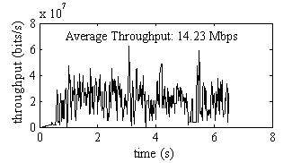
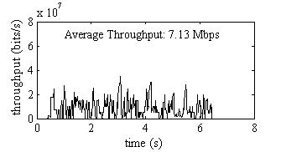
Experimental Results: Multiple Path
wlan0
Server: Amazon EC2 instance in CA
Client: Desktop at RLE MIT, using WiFi(s)
Limited each path to < 8-9 Mbps
> 100 ms
wlan1
Loss rate | 0% | 1% | 2% | 3% | 4% | 5%
wlan0 (Mbps) | 7.13 | 6.08 | 6.43 | 6.25 | 5.16 | 5.08
wlan1 (Mbps) | 7.11 | 5.92 | 6.53 | 5.90 | 5.01 | 4.58
CTCP (Mbps) | 14.23 | 12.03 | 13.08 | 11.88 | 10.10 | 9.34
Example:
0% loss
Combined throughput at Client
Throughput on wlan0

Slide 21
Application Layer Base Station Case Study
Classical
RLNC
RLNC
Application Layer
Network
RLNC
TCP Socket
Multipath
TCP
UDP
RLNC
Multisource – Multi-destination
IP Layer
RLNC
Network Layer
Physical Layer
RLNC

Slide 22
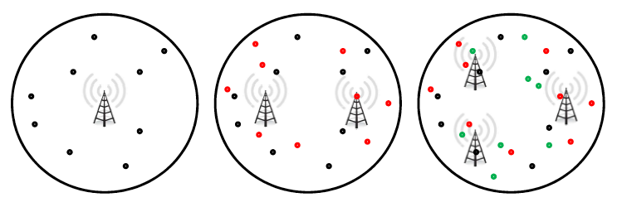
Value of Goodput with User Growth
Problem Statement: As # of users grows, additional base stations are added for throughput, not coverage
MinJi Kim Thierry Klein Emina Soljanin João Barros Muriel Médard
Modeling Network Coded TCP: Analysis of Throughput and Energy Cost
http://arxiv.org/abs/1208.3212 2012 CoRR abs/1208.3212 db/journals/corr/corr1208.html#abs-1208-3212
RLNC improved goodput = fewer Base Stations

Slide 23
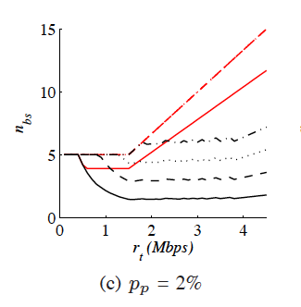
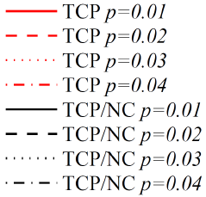
RLNC Expands Base Station Reach
Joint research with MIT and Alcatel-Lucent
5.08 MB
Increasing
User
Activity
# of Base Stations
With RLNC operators lower both OpEx and CapEx

Slide 24
Link Layer Implementation Case Study
Classical
RLNC
RLNC
Application Layer
RLNC
Network
TCP Socket
TCP
UDP
Multipath
RLNC
IP Layer
Multisource – Multi-destination
RLNC
Network Layer
Physical Layer
RLNC

Slide 25
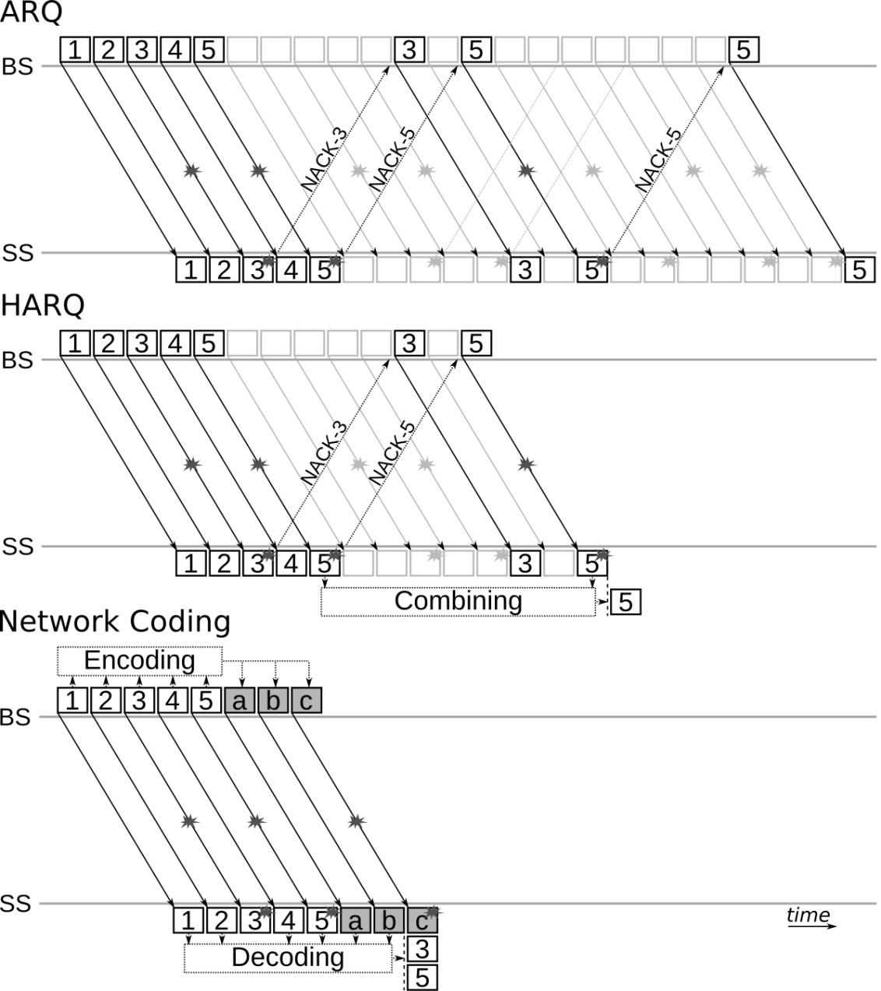
Network Coding vs. ARQ and HARQ
Scenario: 5-packet block transfer from BS to SS
Downlink: fixed 40% packet error pattern (every 3rd and 5th packet)
Uplink: feedback NACKs not subject to loss
ARQ: repeated transmissions create RTT feedback loops
HARQ: feedback reduced by combining corrupted packet versions
Network Coding: a-priori systematic coding with added redundancy of 3/5
Clear delay, throughput, and energy gains
  No feedback loop
  Redundancy cost amortized over block
Surat Teerapittayanon, Kerim Fouli, Muriel Médard, Marie-José Montpetit, Xiaomeng Shi, Ivan Seskar, Abhimanyu Gosain
Network Coding as a WIMAX Link Reliability Mechanism
MACOM 2012L 1-12
Surat Teerapittayanon, Kerim Fouli, Muriel Médard, Marie-José Montpetit, Xiaomeng Shi, Ivan Seskar, Abhimanyu Gosain
Network Coding as a WIMAX Link Reliability Mechanism: An Experimental Demonstration
MACOM 2012: 75-78

Slide 26
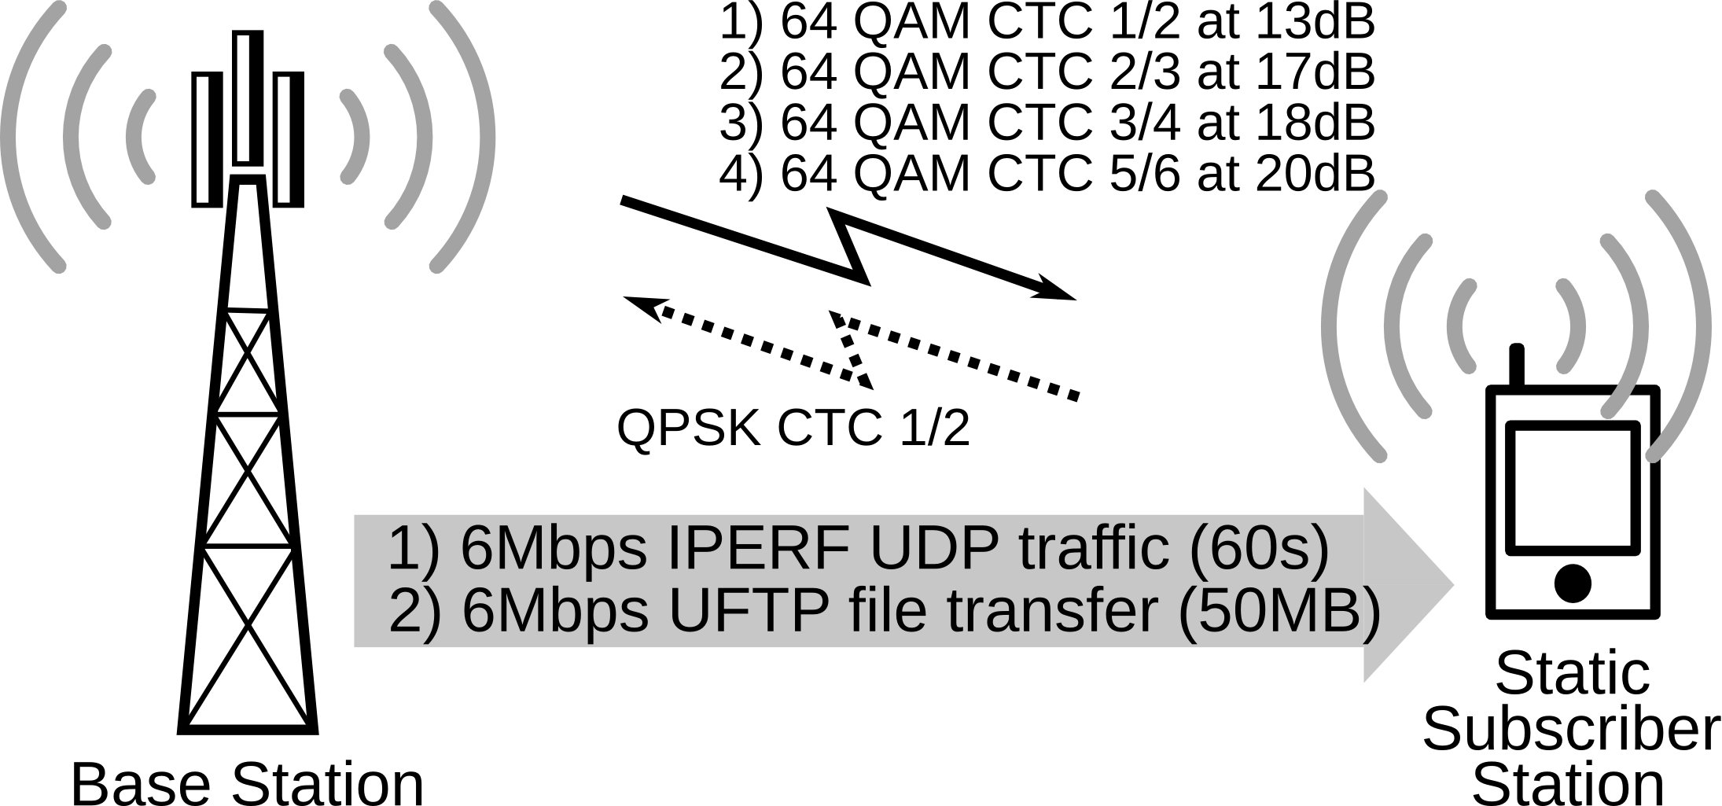
Experimental Setup
Intra-flow NC modules at the Base Station (BS) and Subscriber Station (SS)
Toggle ARQ, HARQ, and various NC configurations
IPERF → application-layer throughput / loss
UFTP (FTP over UDP) → application-layer file-transfer delay

Slide 27
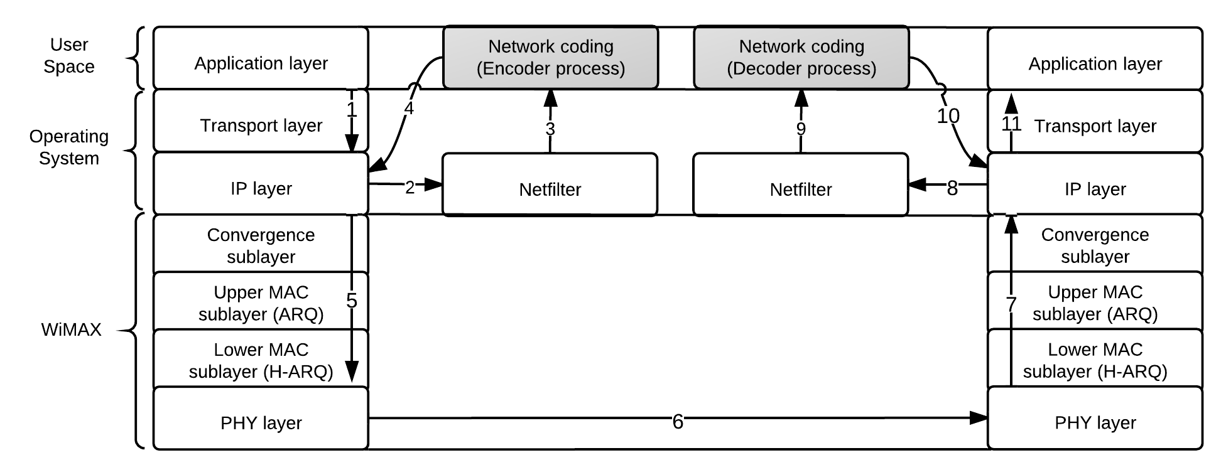
IP-Based Implementation
Remote access of eNode B
Card driver
WiMAX MAC inaccessible → IP-based implementation
Performance measurements at the application layer (IPERF and UFTP)
IP layer: Netfilter used to intercept packets, route them to encoder/decoder, then re-inject them to IP layer
PDCP does not need to be involved, although that may be quite doable
Network coding included at the e-Node B before handing it to the MAC, and ARQ and HARQ bypassed at the MAC – does not require a proxy, but can be used if convenient. Occurs below transport, so not touching TCP per se

Slide 28
Consistency
NC-Best decreases packet loss from 11-32% to nearly 0%
NC offers up to 5.9x gain in throughput and 5.5x reduction in file transfer delay
Loss
Throughput
File transfer delay

Slide 29
Looking Forward
The applications of network coding are varied and changing
This is indeed the right time for a standardization effort
Network coding can be implemented at different layers and in different portions of the network
Standardization should allow the flexibility needed to allow these diverse implementations

