Slide 1
Overview of the Aalborg University Network Coding Research and Demonstrators Life without network coding is possible, but not desirable!
Frank Fitzek
Aalborg University
(CodeOn/Steinwurf)

Slide 2
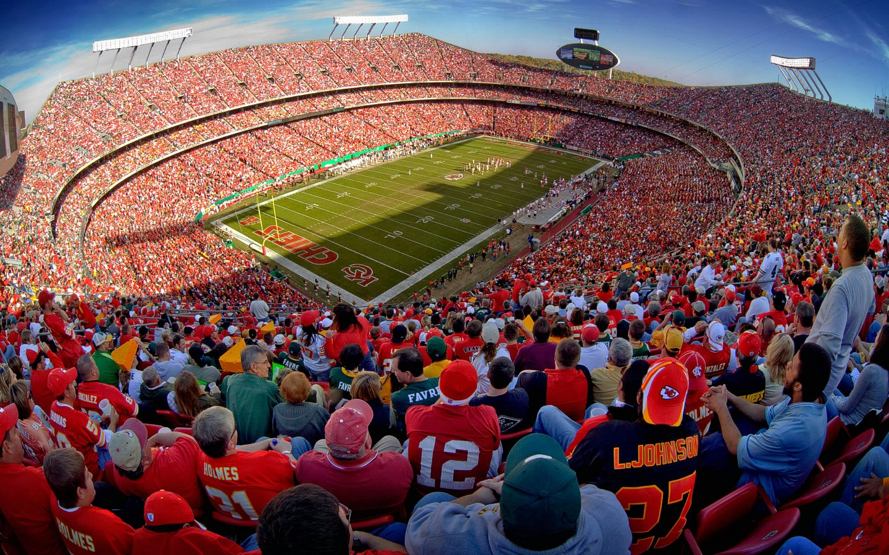
Our motivation back in 2004

Slide 3
Our solution ... Mobile Clouds
?

Slide 4
Network Coding
Digital Network Coding (bits and packets)
Inter-flow network coding
XOR type of coding
COPE, CATWOMAN
Intra-flow network coding
RLNC type of coding
MORE
Combination of Inter-flow and Intra-flow network coding
CORE
Analog Network Coding (signals)

Slide 5
Application
Application
Satellites
Coverage Extension
M2M
Distributed Storage
Car2Car
Mobile Sharing
Content Distribution

Slide 6
Why are we here?
Exchange of ideas with colleagues with the interest
Show some mature demonstration results in different areas
Convey the pitfalls of network coding (we did a lot of mistakes, but we learned from them)
Cross over from research to industry, we the first steps, but need more impact

Slide 7
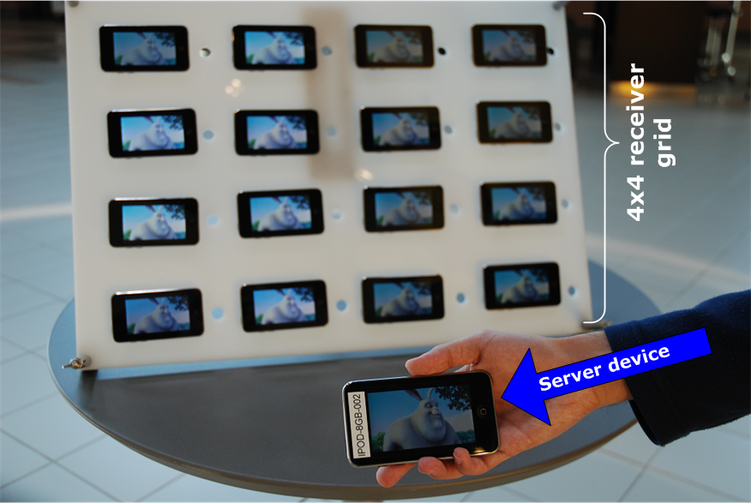


Where is network coding located?
Application Layer
http://www.youtube.com/watch?v=OnqGO7AWwxc
Transport Layer
Network Layer
Data Link Layer
Physical Layer

Slide 8
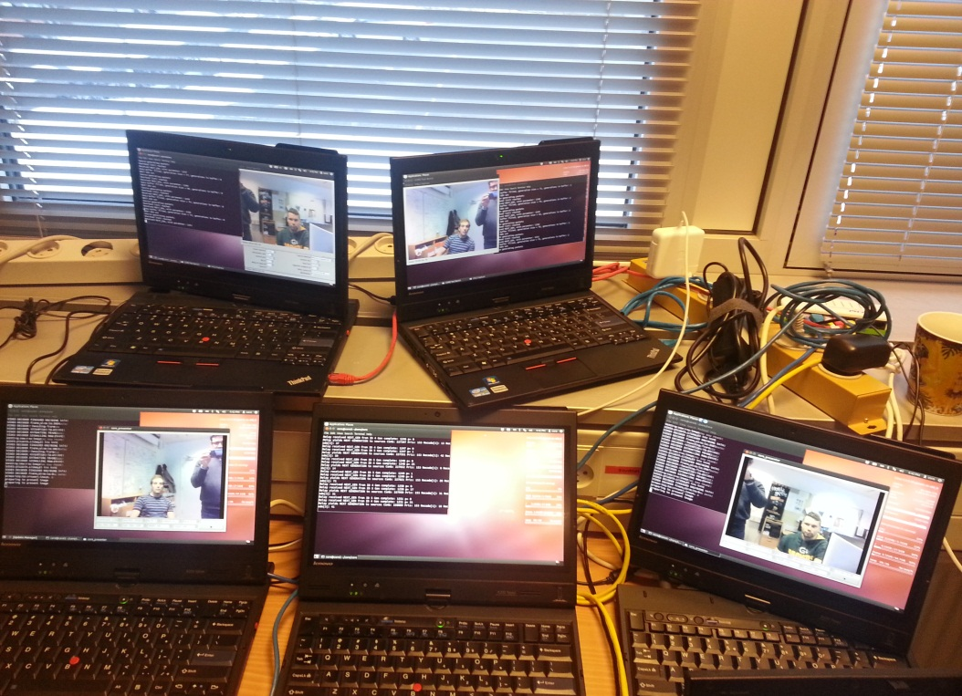
Where is network coding located?
Application Layer
Transport Layer
Network Layer
Data Link Layer
Physical Layer

Slide 9
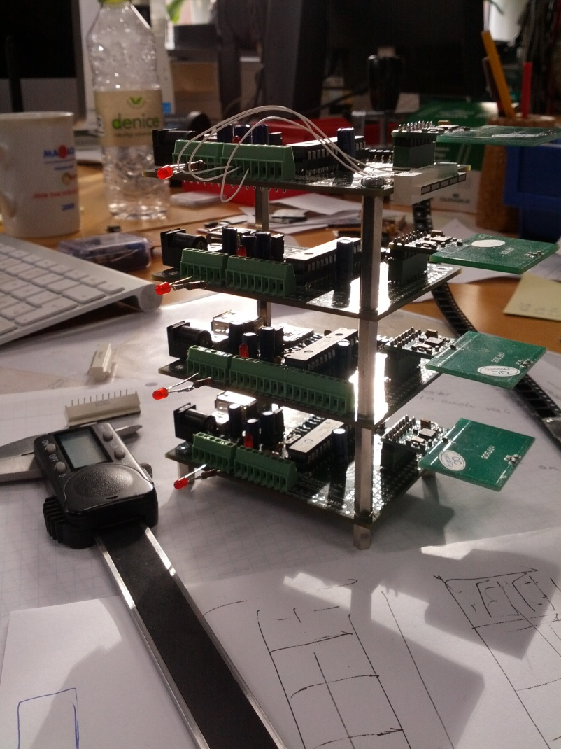
Where is network coding located?
Application Layer
Transport Layer
Network Layer
Data Link Layer
Physical Layer

Slide 10
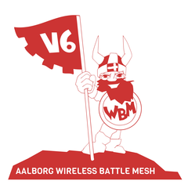
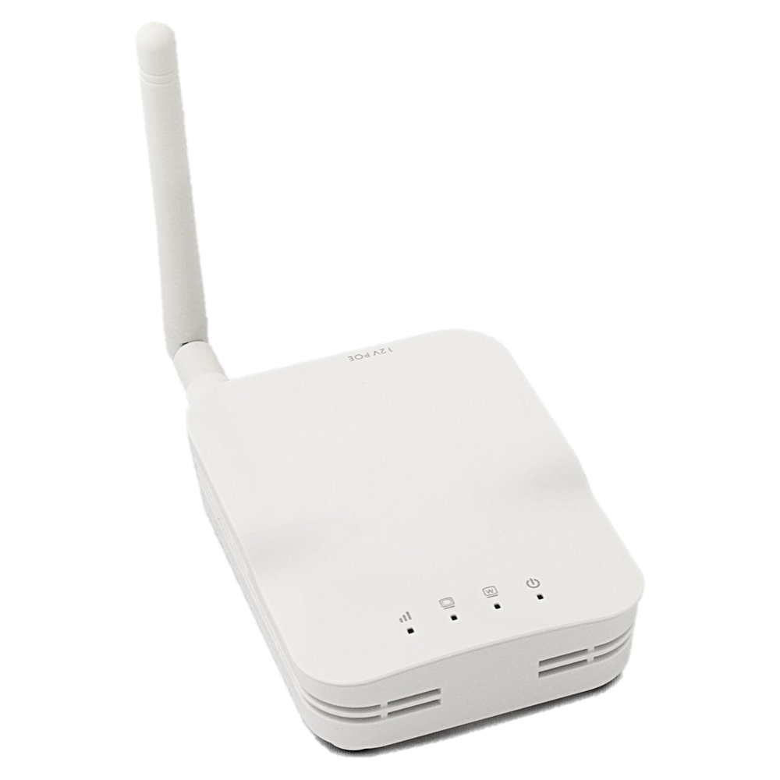
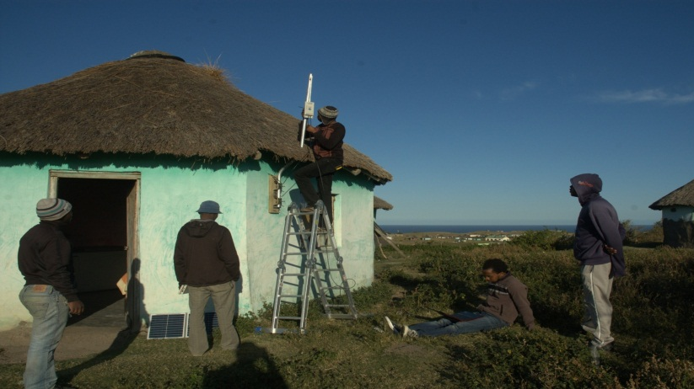
CATWOMAN (2011)
Multihop network based on B.A.T.M.A.N. routing (draft RFC)
Implementation of network coding on real WiFi access points
Multi hop
Available via BATMAN distribution (just inter flow for the time being)
Steve Song, VillageTelco

Slide 11
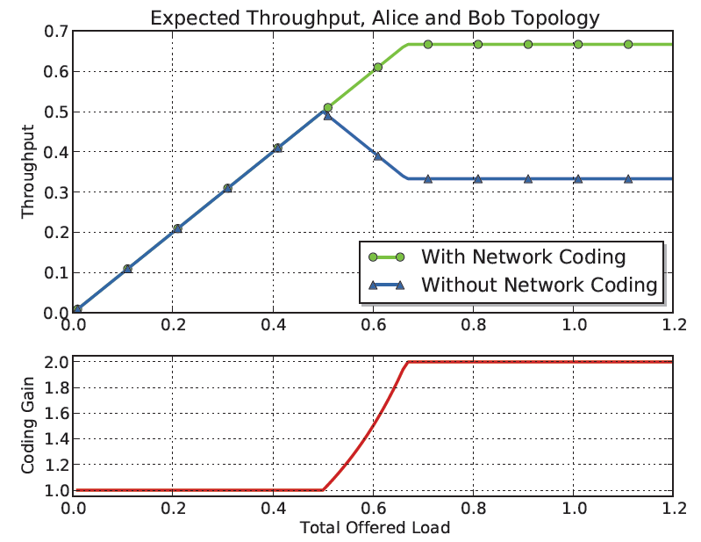
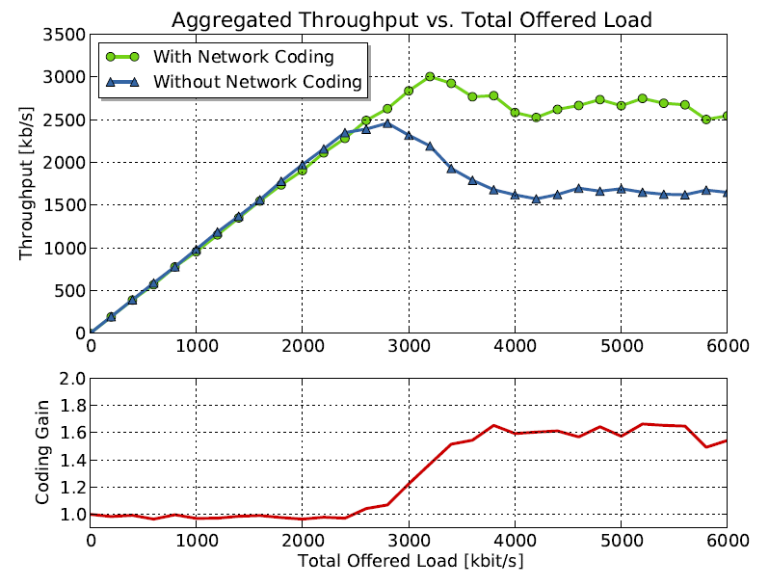
Alice and Bob
Blame the IEEE 802.11 ...
Model
Measurements
100%
62%
M. Hundeboll and J. Leddet-Pedersen and J. Heide and M.V. Pedersen and S.A. Rein and F.H.P. Fitzek. CATWOMAN: Implementation and Performance Evaluation of IEEE 802.11 based Multi-Hop Networks using Network Coding. 2012. in I E E E V T S Vehicular Technology Conference. Proceedings. IEEE

Slide 12
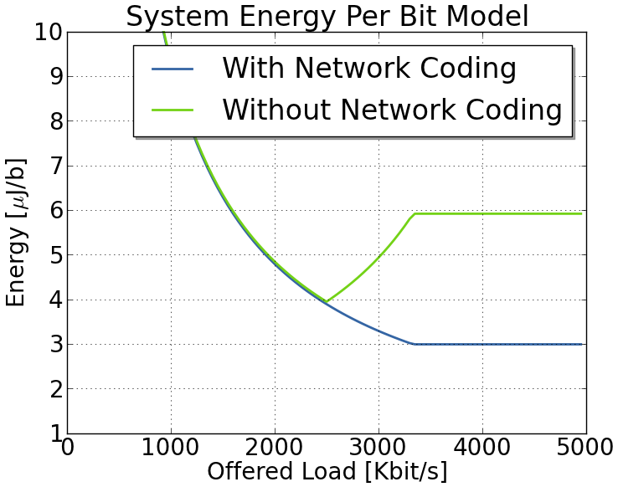
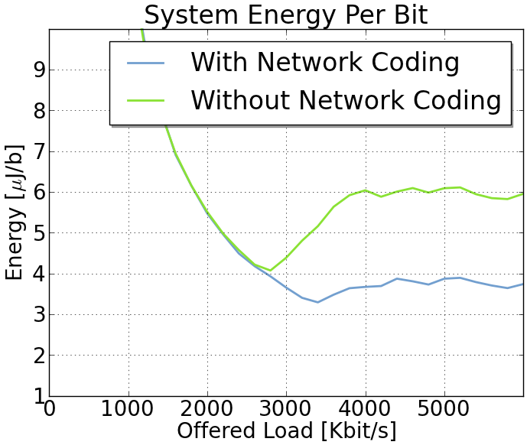
Green Mobile Clouds
Model
Measurements
A. Paramanathan and U. Wilken Rasmussen and M. Hundeboll and S.A. Rein and F.H.P. Fitzek and G. Ertli. Energy Consumption Model and Measurement Results for Network Coding-enabled IEEE 802.11 Meshed Wireless Networks.in IEEE International Workshop on Computer-Aided Modeling Analysis and Design of Communication Links and Networks (CAMAD). Barcelona, Spain.

Slide 13
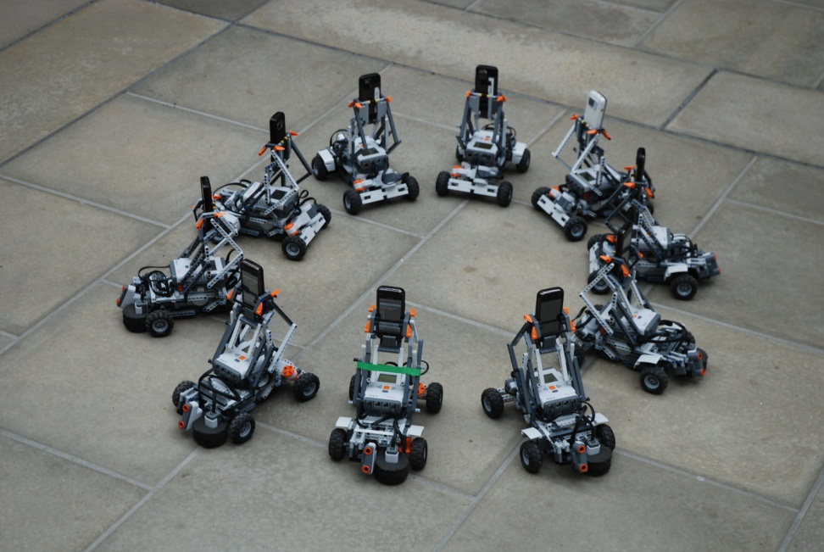
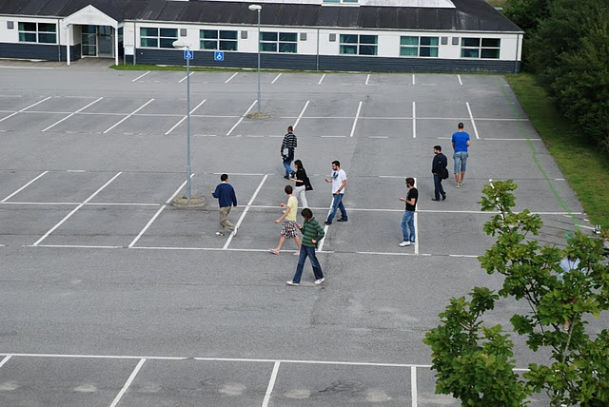
Why intra flow coding?
Inter flow is powerful in some scenarios, easy to implement, no complexity, but needs control messages
Intra flow is easier to handle
Regeneration of distributed clouds
Meshed networks with large degree and mobility
Reduced signaling needs
Complexity? Morten says no
Some researchers had problems to implement ...
It is not E2E anymore
Timing is important ...
Randomness

Slide 14
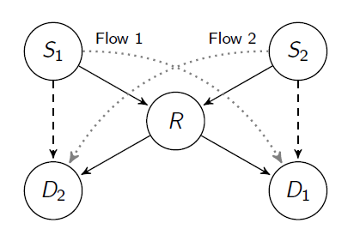
CORE = COPE + MORE
Wireless links are error prone
Traffic
Overhearing
RLNC ensures reliability
XOR is handling the MAC

Slide 15
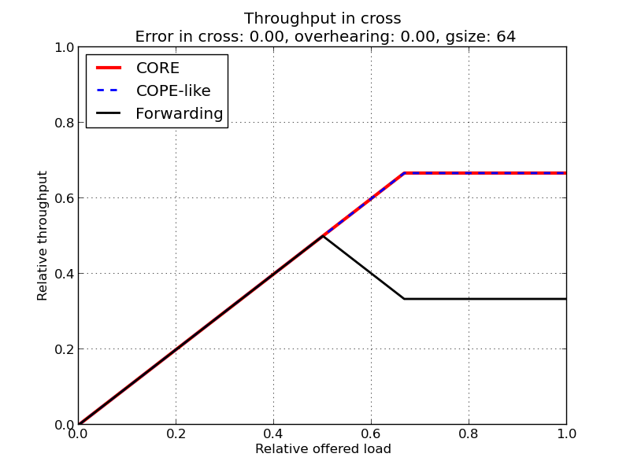

Slide 16
More information
Frank Fitzek
www.fitzek.net

