Slide 1
CONCERTO and BRAVO Experiences with practical, full implementations of Network Coding systems
Victor Firoiu 11 March 2013

Slide 2
Projects in Networking and Communications
DARPA CBMANET/ CONCERTO
Network Coding system for MANETs
ONR Adaptive Networks/ BRAVO
BRAVO NG
Network Coding using local info, high mobility
DARPA IAMANET/ PIANO
DARPA SAFER/ SONATA
Secure Network Coding
Anonymous Comms
through Net Coding
2006
2007
2008
2009
2010
2011
2012
2013

Slide 3
CBMANET/ CONCERTO Motivation
Challenges in Wireless MANETs
Wireless communication
MANET Broadcast transmissions – use Rx is better than ignore
Reception is prone to errors – needs as much help as can get
Mobility removes certainty from traditional routing
CONCERTO Approach
Clean slate network and transport layers
Network Coding Transport: fluid model
Routing on Subgraphs
Enabled by fluid model
Robust to link errors and topo change

Slide 4
Subgraph Computation
Optimal Subgraph computation is complex (exponential in no. neighbors)
Simplified approach: similar to MORE by Katabi et al
Requires Link State information
Computational complexity is O(n²) (n nodes in network)
Computes rate at which nodes should participate in forwarding mixtures
Basic Concept
Forwarding nodes are chosen from those that are most probable to advance the information propagation to each destination
Forwarding intensity is related to the probability of contributing to info advance
R_{ij}
Forwarding intensity:
Assigned Information rate
S
D
Can not contribute
significantly
to info advance to D
Can contribute significantly
to info advance to D

Slide 5
Packet Forwarding
Packet Forwarding
Uses transmit rates computed by
Subgraph computation
Computes “receive credit” as ratio of transmit rate to expected receive rate
Node earns credit when it receives innov. packet
Spends credit when it transmits packets
Provides automatic scaling to source rate
Repair process, semi-reliable protocol (media streaming)
Nodes request locally extra transmissions if necessary
Requests are piggy-backed on forwarded packets when possible
Fully reliable protocol (file transfer)
Additional algorithm for propagation of repair requests, detection of missing generations, beginning/end of files, late join, etc.

Slide 6
CONCERTO Architecture
PIM
App
OLSR
Ethernet
PIM
IGMP
Network Coding Engine
(intra-session)
Multipath
“Subgraph”
Routing
PIM
Module
IGMP
Module
AppIF
Group Def
Topology
Topo Info
Group
Def
Group Cache
SG
Constructor
SG Def
Net Coder
NC Pkt Window
NC Pkt Window
Gen Mgr
NC Pkt Window
NC
Buf
Fwdr
NC Pkt Window
Gen Mgr
NC
Buf
Fwdr
Role
Gen Mgr
NC
Buf
Fwdr
Gen Mgr
NC
Buf
Fwdr
Rank Feedback
Network Coding Forwarder
Master Fwder
Topo Info
Topo Cache
Nbr Info
Neighbor Discovery
Neighbor Discovery
Data Marshaller
Serialization
TransmitModule (Simple)
PhyRadio (UDP)
802.11
Layerless Modular Architecture: module info sharing ➔ Adaptation to wireless dynamics

Slide 7
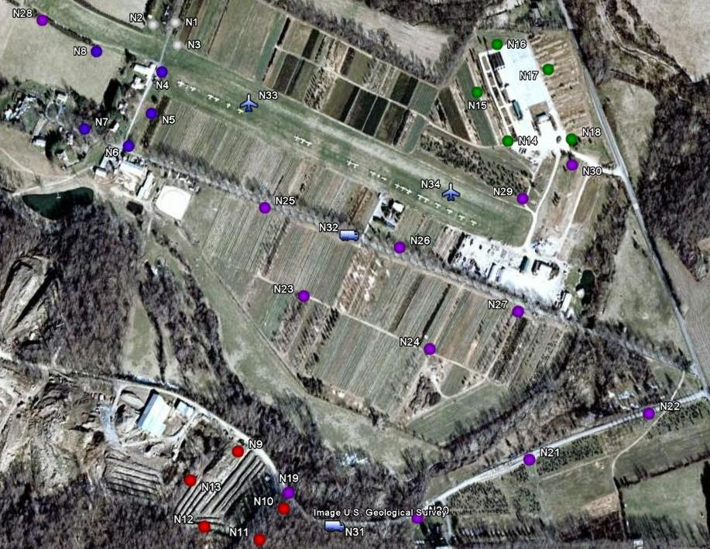

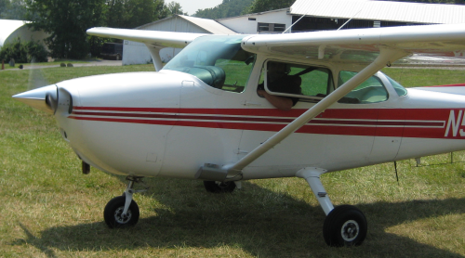
Scenario
Command
31 mobile nodes:
3 moving groups of 5 people each
2 Vehicles traveling on access roads
Tested with and without 2 aircraft
Applications
Chat
Video
File Exchange
Objective Alpha
Objective Charlie
Objective Bravo
1000 meters
Indicates FX node
7
Notes:
7

Slide 8
CONCERTO-Baseline Comparison
Tactical Applications
Tactical Applications
800 MHz ARM Processor
256 MByte (20 Mbytes used)
7 Watts average power
533 MHz ARM Processor
256 MByte memory
5 Watts average power
CONCERTO Protocols
Baseline Protocols
Network Coding
Subgraph Computation
Reliable Forwarding
OLSR
Basic Multicast Forwarding
Nack-Oriented Reliable Multicast
Compare
802.11b PHY
802.11b PHY
Common applications and PHY allow “apples-to-apples” comparison

Slide 9
Air Scenario – Distance Utility Metric
CONCERTO close to max metric during tactical phases
Alpha/Bravo
Bravo/Char.
Engineering
Parking Lot
Deployment
7x
Baseline barely able to support local video post-deployment
CONCERTO provides 7x higher performance than baseline in Air Scenario

Slide 10
Challenges In Subgraph Construction
Requires Link State from all network
Inaccurate LS info results in inefficient or defective subgraph
Solution: subgraph construction based on local info
Gradient-based Routing
Constructs field and currents for information flow
Made possible by network coding fluid flow
Provides natural properties of (Electric) Potential Fields
Efficient flow allocation
Locality of perturbation, Stability
No local minima: data never stalls in the middle

Slide 11
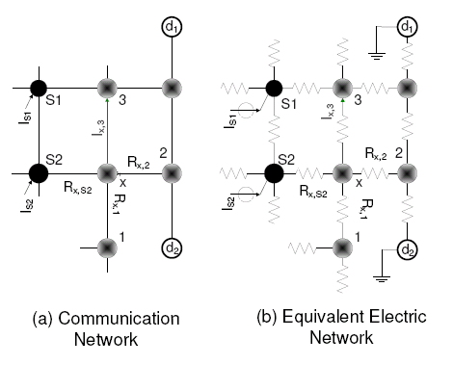

Gradient-based Routing Information Flow Modeled on Electric Network
Objective: Minimize total transmissions: G=Σ{all links ab} |Iab|/Qab
Iab = Information rate from a to b; Qab = P[success Tx from a to b]
Solution: Data network – equivalent to electric network:
Approximation: minimize G= Σ(Iab)²/Qab ➔ minimize E= Σ(Iab)²Rab
Information rate from a to b ➔ intensity of current Iab
Link quality from a to b = Qab ➔ 1/Resistance = 1/Rab
Minimize Data Transmission: reduced to minimizing total electric energy
Classic problem of solving electric circuits
Network Level
Flow Level

Slide 12
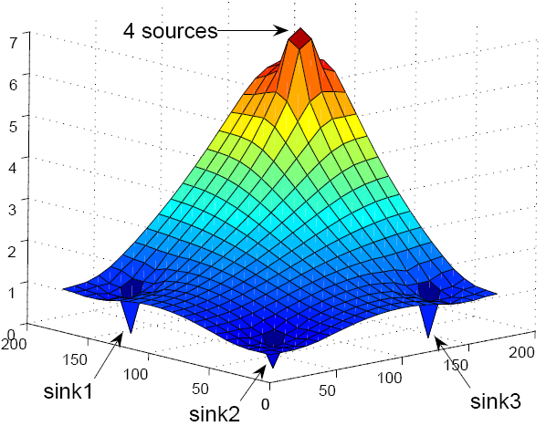
BRAVO: Network Coding over Gradient-based Subgraphs
Routing Challenges
Reduced overhead through local info
Multipath increases stability
Data Transport Challenges
Selective Tx is efficient
Opportunistic Rx increases Tx efficiency
Local & multi-path reliability increases end-end goodput effectiveness
Selective Tx
(no flooding)
Multipath
reliability
Opportunistic Rx
Multipath enables
robust mobility
Local reliability
Netcoded data over gradient routes gains from multipath, opportunistic network usage

Slide 13
BRAVO Performance
The Gauntlet Scenario
20 nodes, 2 stationary, 18 moving in random in regions
Scenario | Mean duration [s] | Std dev [s]
Full speed | 42.275 | 54.530
Half speed | 80.338 | 88.238
Quarter speed | 138.518 | 143.131

Slide 14
BRAVO Outperfroms SMF + NORM
BRAVO robust at high speeds
Why:
Gradient-based subgraph ajdusts locally to topo changes
Multi-path routing compensates the temporary lack of a link
Network Coding adds redundancy: help deliver data, no matter where they come from

Slide 15
Conclusions
Gains achieved besides information theoretical
Network Coding enables multi-path reliability
Network Coding enables hop-by-hop reliability
Gradient-based subgraph routing
More efficient and scalable multipath routing

Slide 16
BACKUP

Slide 17
Intra-Session Coding: Wireline Butterfly
Unit link capacities
D₁
S
D₂

Slide 18
Wireline Butterfly with Multicast Routing
Unit link capacities
D₁
Flow of rate 2
S
Flow of rate 2
D₂
Multicast to D₁ and D₂:
Can we support two flows of rate 2 with unit link constraint?

Slide 19
Wireline Butterfly with Intra-Session Network Coding:
Unit link capacities
A
D₁
<A, AB >→<A,B>
A
A
AB
S
AB
B
AB
B
B
D₂
<B, AB >→<A,B>
We can support “full rate” multicast to both destinations by XORing packets
Routing: Sum of “per destination” flows on a link must be less than link capacity
Network Coding: Maximum over “per destination” flows on a link must be less than link capacity

Slide 20
Wireless Butterfly with Multicast Routing
Lossless links
1
A
D₁
1
1
S
C
Routing: Sum of Tx Rates / symbol = 4
Contention-free schedule: S, A, B, C
B
D₂
1

Slide 21
Wireless Butterfly with Intra-Session Network Coding
Lossless links
½
A
A
D₁
1
(A,B)
AB
S
½
C
(Routing: Sum of Rates = 4)
NC: Sum of Tx Rates / symbol = 2.5
Contention-free schedule: S, S, A, B, C
B
D₂
B
½

Slide 22
Wireless Butterfly with Intra-Session Network Coding
Lossy links
A
D₁
P_{loss}=50%
S
C
Rate = (1-0.5²)⁻¹ = 4/3
B
D₂
When links are lossy, need only send at rate which transfers info to some next node on the other side of a cut set…

Slide 23
Intra-Session Network Coding
Ahlswede et al. proved that for a single multicast session, network coding achieves the maximum possible rate allowed in the network
Problem Decomposition
Computing Mixtures
How to combine packets into mixtures that “work”
Subgraph Construction
Which nodes forward mixtures and how much do they participate

Slide 24
Computing Mixtures: Random Linear Coding
Ho et al.: Random Linear Coding
Encoding:
Identity of packets received – does not matter
Only matters: Quantity of mixed packets = group size
Practical Network Coding (Chou et al.)
Break file into N packets
Collect packets into groups of G packets (generations)
Source/intermediate nodes transmit random mixtures from generations
Innovative (linearly independent) packets are stored for future mixtures
Packet headers collect coefficients used in random coding
Destination collects G linearly independent coded packets
Inverts the matrix of random coefficients to recover original packets
Intra-session coding is basically matrix inversion
P1
R1
α P1+ ß P2
P2
src
dst
P1
R2
γ P₁+ δ P₂
P2

Slide 25
Subgraph Construction
Not all nodes in a network should participate in each multicast flow
Want to maximize network capacity by minimizing transmissions
Subgraph
The nodes which participate in random linear coding for a multicast flow
The rate at which these nodes forward random linear combinations
R_{ij}
Forwarding intensity:
Assigned Information rate
S
D
Can not contribute
significantly
to info advance to D
Can contribute significantly
to info advance to D

Slide 26
Subgraph Computation: Optimization Problem
Convex cost function can capture goals of minimum energy, congestion, cost or maximum throughput
netcoded transmissions on link (i, j) greater than maximum per dest flow
conservation of flow to destination t at node i
link capacity constraints
Optimal Subgraph computation is complex (exponential in no. neighbors)

Slide 27
Video Utility - Ground
LZ
Deploy
Alpha/Bravo
Bravo/Charlie
Engineering
Ave. Utility
Baseline
100
82
61 42 39
82 60 43
40 33 28
CONCERTO
100
94
90 90 88
95 90 94
92 85 54
Baseline barely usable at lowest load; CONCERTO works well at highest tactical loads

Slide 28
Video Utility - Air
LZ
Deploy
Alpha/Bravo
Bravo/Charlie
Engineering
Ave. Utility
Maximum Throughput Utility
Baseline
100
82
66 51 46
83 56 53
39 33 29
CONCERTO
100
94
90 90 83
93 89 89
89 78 73
Baseline barely usable at lowest load; CONCERTO works well at highest tactical loads

