Slide 1
Role based Auto Mesh TE
draft-li-ccamp-role-based-automesh-00
lizhenbin@huawei.com
mach.chen@huawei.com
IETF86 OSPF Mar. 2013 Orlando

Slide 2
Problem Statement
Auto mesh TE defined in RFC4972
The LSRs of a TE mesh-group are connected by a full mesh of TE LSPs
IGP (OSPF and ISIS) extensions for membership auto-discovery
Largely simplify the configurations and deployments of TE LSPs.
Full mesh TE LSPs may not necessary for some scenarios
In a mobile backhaul network, TE LSPs are normally setup between the Cell Site Gateways(CSGs) and the Radio Network Controller (RNC) Site Gateways(RSGs)
The TE LSPs among CSGs and TE LSPs between RSGs may not necessary
With the existing Auto-mesh TE
Large amount of unnecessary TE LSPs established among CSGs and between RSGs
May not scale for the CSG devices and is waste of network resources.
Or, extra policies and configurations required to avoid unnecessary TE LSPs

Slide 3

Solution
Role based Auto mesh TE group
TE LSPs setup depends on the roles of the LSRs in a group
Two types of group introduced:
“Hub-Spoke” TE mesh-group
Two roles: Hub and Spoke LSR
TE LSPs SHOULD be setup between Spoke and Hub LSRs
TE LSPs MUST NOT be setup between/among Spoke LSRs
TE LSPs MUST NOT be setup between/among Hub LSRs
“Root-Leaf” TE mesh-group
Two roles: Root and Leaf LSR
Root LSRs signal P2MP TE LSPs toward all the Leaf LSRs once membership determined
Spoke or Leaf LSRs
Hub or Root LSRs
Auto mesh TE
Role based Auto mesh TE

Slide 4
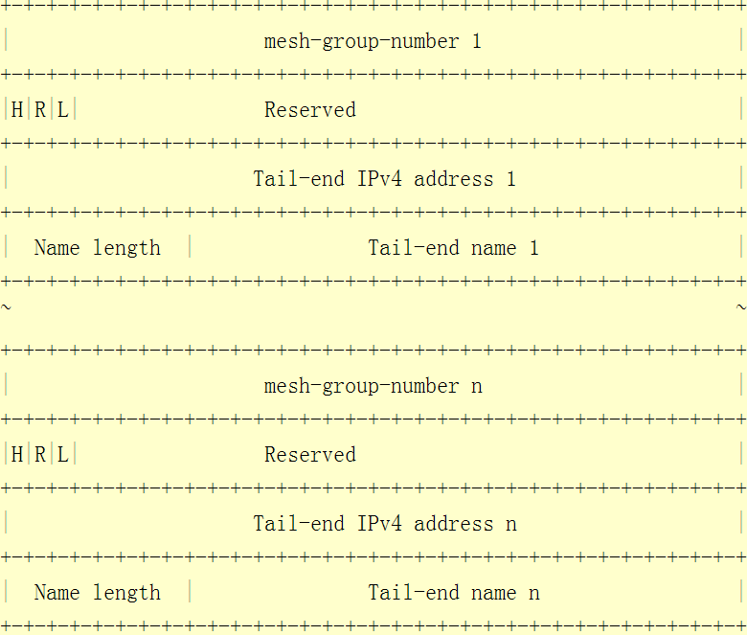
Extensions to OSPF
OSPF Role-based TE-MESH-GROUP TLV
H (Hub-spoke) bit
1 : Hub LSR, 0 : Spoke LSR
R (Root) bit
L (Leaf) bit
Carried within the OSPF Routing Information LSA
Originate new LSA whenever the content of any of the advertised TLV changes
Join/Leave a group
Role changed
Area or routing domain scope

Slide 5
Comments from the list
Mesh-group type (Thanks Gregory Mirsky)
One way is to explicitly encode the mesh-group type in the TLV.
Another way is to implicitly identify the mesh-group type by comparing the received TE mesh-group number with the TE mesh-group number of local configured TE mesh-groups (used in the current draft).
Which way does the WG prefer to ?

Slide 6
Next Steps
Would like to solicit comments and opinions of the WG.
This draft will be progressed in CCAMP WG.

