Slide 1
Outline
Status of the PAWS protocol document
Open Issues
Review extensibility and IANA registries

Slide 2
Changes from version 00
Added JSON encoding
GeoLocation uses RFC5491
Added Extensibility section
Described how to address new jurisdictions
References IANA registries
Added IANA section
Defined registry tables

Slide 3
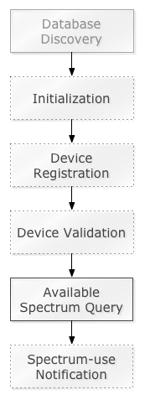
Protocol Overview
Database Discovery (TBD)
Initialization
Initial handshake: Exchange capability info
Optional for device, DB must support
Device Registration
Regulator-specific (e.g., not all regulators)
Device Validation
Validation of slave devices by master devices asking database
Regulator-specific
Available Spectrum Query
Spectrum-use Notification
Regulator-specific

Slide 4
Encoding: JSON-RPC
Examples
GeoLocation
Extensibility / IANA definitions

Slide 5
Encoding Example: Request
getSpectrum Request:
{
"method": "getSpectrum",
"params": {
"type": "AVAILABLE_SPECTRUM_REQ",
"version": "1.0",
"deviceDesc": {
"serialNumber": "XXX",
"fccId": "YYY",
...
},
"location": {
"point": {
"center": {"latitude": 37.0, "longitude": -101.3}
}
},
"antenna": {"height": 10.2, "heightType": "AGL"}
}
"id": "xxxxxx",
}

Slide 6
Encoding Example: Response
Available Spectrum Response
{
"result": {
"type": "AVAILABLE_SPECTRUM_RESP",
"version": "1.0",
"timestamp": "2013-03-02T14:30:21Z",
"deviceDesc": {
"serialNumber": "XXX",
"fccId": "YYY",
...
},
"spectrumSchedules": [
{
"eventTime": {
"startTime": "2013-03-02T14:30:21Z",
"stopTime": "2013-03-02T20:00:00Z",
},
"spectra": [
{
"bandwidth": 6e6,
"frequencyRanges": [
{"startHz":5.18e8, "stopHz":5.36e8,
"maxPowerDBm":30.0},
{"startHz":5.36e8, "stopHz":5.42e8,
"maxPowerDBm":36.0},
...
]
},
...
]
},
{
"eventTime": {
"startTime": "2013-03-02T22:00:00Z",
"stopTime": "2013-03-03T14:30:21Z",
},
"spectra": [
...
]
}
],
"needsSpectrumReport": false
},
"id": "xxxxxx”
}

Slide 7
Encoding: GeoLocation
Location encoding follows RFC5491
Point-with-uncertainty encoded using Ellipse
Region encoded using Polygon
WGS-84 default datum

Slide 8
Example GeoLocation
"location": {
"point": {
"center": {"latitude": 37.1, "longitude": -120.2},
"orientation": 45.0,
"semiMajorAxis": 50.0,
"semiMinorAxis": 45.0
}
}
"location": {
"region": {
"exterior": [
{"latitude": 37.1, "longitude": -120.2},
{"latitude": 37.1, "longitude": -120.1},
{"latitude": 37.0, "longitude": -120.1},
...
]
}
}

Slide 9
Extensibility
Defines processes for creating:
New message parameters
Additional error codes
Ruleset identifiers
Proposes new IANA registries
PAWS Parameters Registry
PAWS Error Code Registry
PAWS Ruleset ID Registry
Additions made under Designated Expert process with “Specification Required” [RFC5226]

Slide 10
Ruleset Identifier
Represents a set of rules to be used within a regulatory domain
A “harmonized” ruleset may be adopted by multiple domains
Associated with:
Database behavior
Device behavior
Parameters passed between Device and Database

Slide 11
General Procedure Handles Extensibility
Device makes a request that includes its location and may include:
List of rulesets it supports
Parameter values for the request
If necessary, Database responds with REQUIRED error and list of missing parameters
Device makes request again that includes its location and:
List of rulesets it supports
Parameter values that now include the required ones
Database sends the response, including applicable ruleset for the location

Slide 12
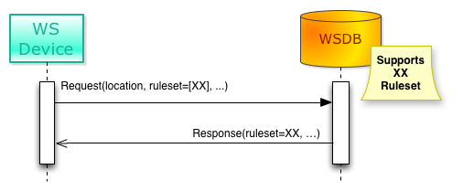
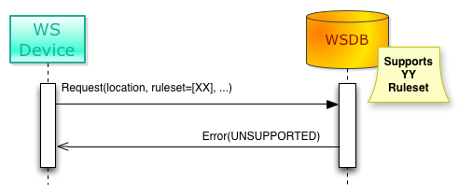
Ruleset Identifier Use Cases
Simple Cases: Single rulesets
Correct DB
Wrong DB

Slide 13
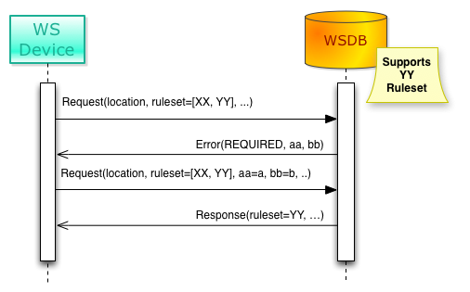
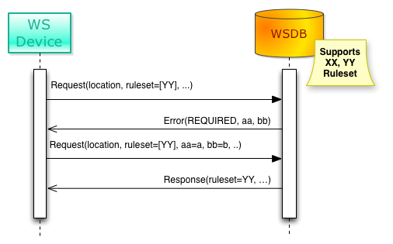
Ruleset Identifier Use Cases
Database supports multiple rulesets
(may avoid discovery)
Device supports multiple rulesets

Slide 14
IANA: PAWS Parameters Registry
Defines new parameters
E.g., to support regulatory-specific parameters
Must include:
Parameter name
Parameter usage location, e.g., which message(s)
Specification document
Initial contents:
“fccId”: FCC certification ID
“fccTvbdDeviceType”: “FIXED”, “MODE_1”, or “MODE_2”
Add other regulatory parameters as rules are finalized

Slide 15
IANA: PAWS Error Code Registry
Defines error codes
Specify:
Code
Name
Additional parameters, if any
Parameters separately defined in Parameters Registry
Description
Initial contents:
Defined in the Section 5.13 of protocol doc

Slide 16
Error Codes
Code Name Description
---- ---------------- -----------------------------------------------
-100 (reserved)
-101 VERSION The Database does not support the specified
version of the message.
-102 UNSUPPORTED The Database does not support the Device. For
example, it does not support the regulatory
domain specified in the request.
-103 UNIMPLEMENTED The Database does not implement the optional
request or optional feature.
-104 OUTSIDE_COVERAGE The specified geo-location is outside the
coverage area of the Database.
-200 (reserved)
-201 REQUIRED A required parameter is missing. The Database
MUST include a list of the required parameter
names. The Database MAY include only names of
parameters that are missing, but MAY include a
full list. Including the full list of missing
parameters may reduce the number of re-queries
from the Device.
-202 INVALID_VALUE A parameter value is invalid in some way. The
Database SHOULD include a message indicating
which parameter(s) and why the value is
invalid.
-300 (reserved)
-301 UNAUTHORIZED The Device is not authorized to used the
Database. Authorization may be determined by
regulatory rules or be dependent on prior
arrangement between the Device and Database.
-302 NOT_REGISTERED Device registration required, but the Device is
not registered.

Slide 17
IANA: PAWS Ruleset ID Registry
Defines ruleset identifiers
Specify:
Name
Additional message parameters, if any
Parameters separately defined in Parameters Registry
Specification Document
Initial contents
“FccTvBandWhiteSpace-2010”
Add other regulatory parameters as rules are finalized

Slide 18
Proposed IANA Process
Review by Designated Experts
“Specification Required”
Requests sent to: paws-ext-review@ietf.org
Two-week review period on the list
May approve before specification formally published, but must be assured that it will be published

Slide 19
Implementations
Reports of successful implementation using schema defined in current document
After fixing typos

