Slide 1
86th IETF – Orlando, USA
draft-asghar-pim-explicit-rpf-vector-01
J. Asghar
IJ. Wijnands
S.Krishnaswawy
V. Arya
jasghar@cisco.com
ice@cisco.com
sowkrish@cisco.com
varya@directv.com

Slide 2
Editorial Changes 00 -> 01
Section 3.0 – (Update) Added more details on pim-path-vector-tlv requirement in Video Transport Network use case where live-live resiliency model utilized with multicast tree path diversity requirement
Section 4.0 – (Update) Condensed figure and text
Section 5.0 – (New) Added vector attribute value
Section 6.0 – (New) Added handling of conflicting RPF vectors (as in RFC5496)
Section 7.0 – (Update) Explicit RPF Vector Attribute TLV Format

Slide 3
Problem Statement
This draft documents a solution to build multicast trees via an explicitly configured path sent in the PIM join
Describes a special use of the Reverse Path Forwarding (RPF) Vector TLV as defined in [RPC 5496]

Slide 4

Solution Requirement: Path Diversity in Live-Live Resiliency
Protection
Domain
Egress
Demarcation
Ingress
Demarcation
PE3
Explicit Path Vector TLV
(S,G)
(S1,G)
PE1
Explicit Path Vector TLV
(S,G)
Mcast
Src
(S2,G)
(S,G)
(S,G)
Native PIM-SSM
Network
PE2
PE4

Slide 5
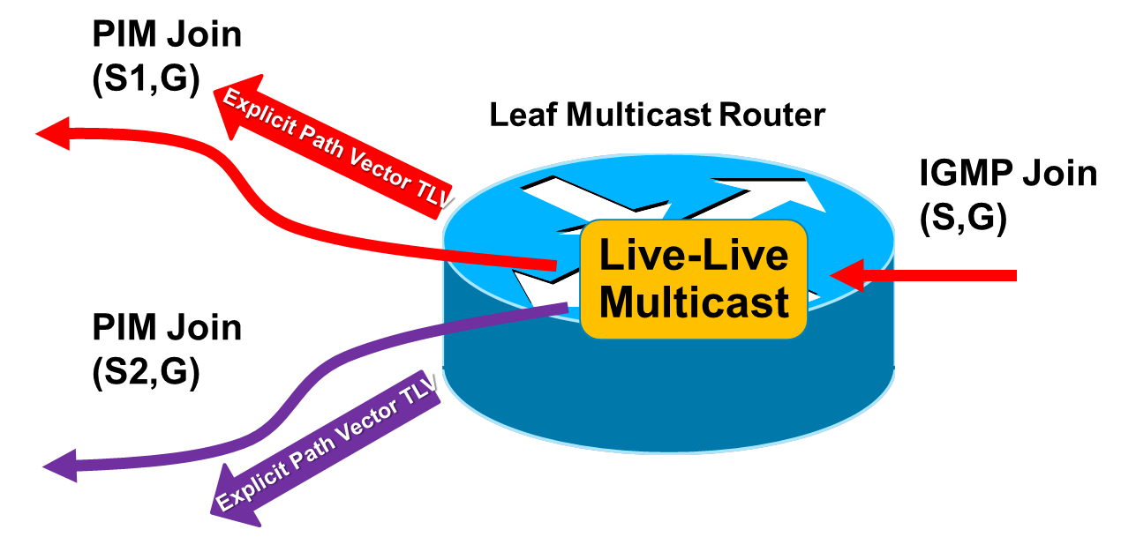
Motivation behind this draft
A stack of RPF vectors can be specified to route PIM Joins semi-explicitly using the neighbor addresses:
However, upon a link/node failure the addresses within a stack of RPF vectors could be unreachable
In this case, router will perform a RIB unicast source reachability lookup and route the PIM Join around the link/node failover and not use the desired RPF vector stack path
In a live-live multicast network or Ring topology, both disjoint multicast trees could be routed along the same path, and not longer be disjoint
Our draft addresses these issues by proposing a new encoding method that allows to explicitly route PIM Joins using Explicit RPF Vector TLV Stack:
draft-asghar-pim-explicit-rpf-vector-01
Maximally
Redundant Trees

Slide 6
Solution Example (this draft): Explicit Path Vector TLV Stack
Multicast Source IP: S = 10.0.0.1
R2: 12.0.0.1
R3: 13.0.0.1
R4: 14.0.0.1
Explicitly routed path for PIM Join using RPF vector TLV stack
PIM Join
R4
Link 14.0.0.0/30
R3
Link 13.0.0.0/30
R2
PIM Join
Link 12.0.0.0/30
IGMP Join
R1
S
Rx
IP: 10.0.0.1
R6
R5
PIM Join
RIB RPF computed path for PIM Join

Slide 7
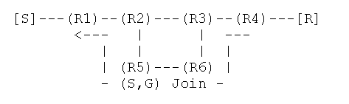
Solution (this draft)
Multicast join path R4->R3->R6->R5->R2->R1, where the multicast JOIN is explicitly routed to the source hop-by-hop using the explicit RPF vector list

Slide 8
Encoding
RFC-5384 PIM Join Attributes
Established IANA registry for join attribute types
0: RPF Vector TLV [RFC5496]
“Loose path vector / ERO”
1: MVPN Join Attribute [RFC6513]
2: MT-ID Join Attribute [RFC6420]
3: Pop-Count [RFC6807]
4 (tentative target): This draft
“Strict path vector / ERO”

Slide 9
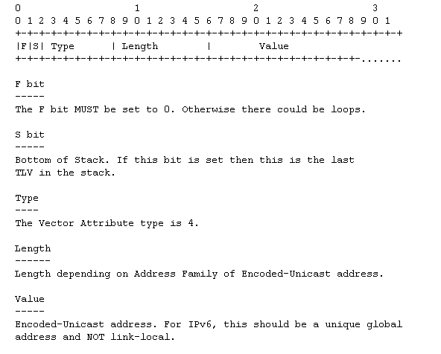
Explicit RPF Vector Attribute TLV Format

Slide 10
Moving forward
Looking for your feedback

