Slide 1
NADA: A Unified Congestion Control Scheme for Real-Time Media
Xiaoqing Zhu and Rong Pan
Advanced Architecture & Research
Cisco Systems
March 2013

Slide 2
Agenda
Design goals
Network congestion signals
Receiver behavior
Sender operations
Highlight of results

Slide 3
Design Goal #1: Limit Self-Inflicted Delay
Packet loss
Congestion
window Size
Rate
React early
Time
Time
network queue
network queue

Slide 4
Design Goal #2: Leverage A Suite of Feedback Mechanisms
PCN-based
Performance
Delay-based
ECN-based
Existing
loss-based
schemes
none
existing feature
new feature
Network Support

Slide 5
Design Goal #3: Weighted Bandwidth Sharing
Low-priority
High-priority
network
congestion
indication

Slide 6
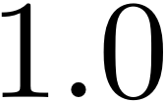




Congestion Signals At the Network Node
Marking Probability
Avg. Queue Occupancy
Loss
ECN
Delay

Slide 7



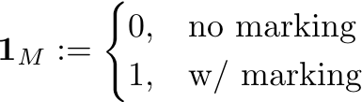
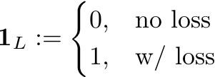
Receiver Behavior
Obtain per-packet observations:
Calculate equivalent delay:
Exponential smoothing:
Virtual delay
of marking
Virtual delay
of loss

Slide 8
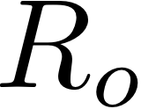
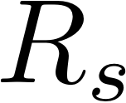



Sender Operation
target rate
calculation
RTCP report
(loss/delay/ECN marking)
Linear prediction:
Calculate target rate:
Adjust for sending buffer:
target
rate
sending rate calculation
buffer
level
video
rate
encoder
rate control
video
packets
rate shaping buffer

Slide 9
Result at Equilibrium

Slide 10
Simulation Setup
RTP
RTP
RTP
RTP
...
...
6 Mbps
5ms
RTP
RTP
Six competing streams
Comparison of three modes: w/o ECN, ECN-based, and PCN-based.

Slide 11
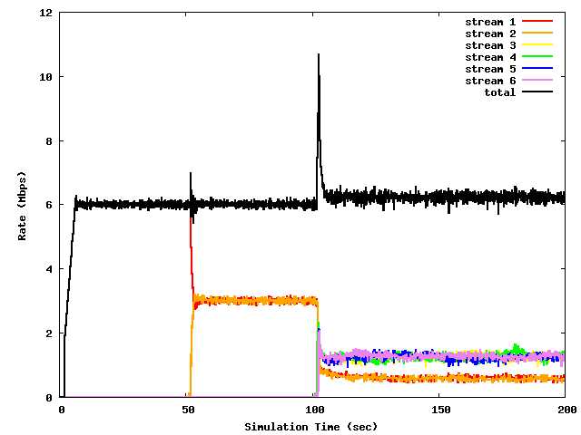
Without ECN: Per-Stream Rate
1 new stream
4 new streams
w = 2

Slide 12
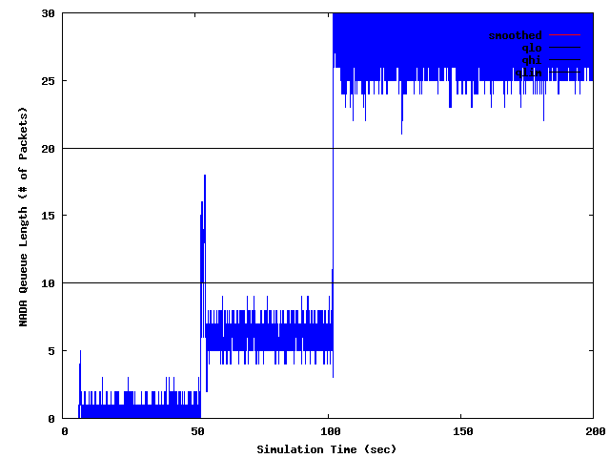
Without ECN: Bottleneck Queue Length

Slide 13
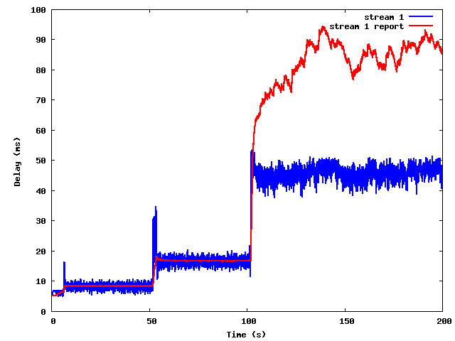
Without ECN: Congestion Signal

Slide 14
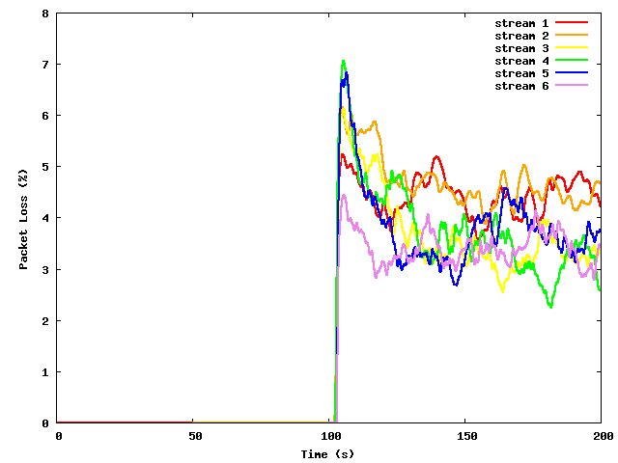
Without ECN: Packet Loss Ratio

Slide 15
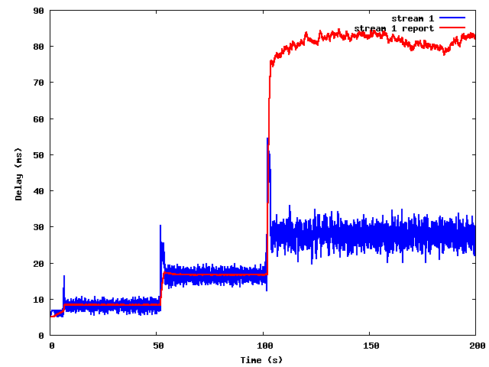
With ECN: Congestion Signal

Slide 16
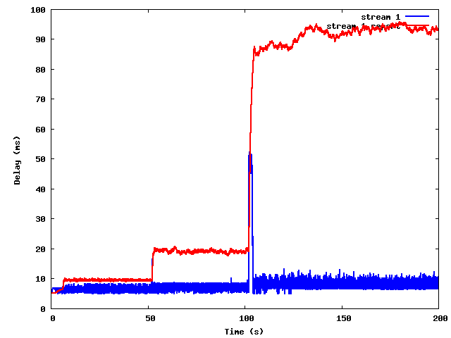
With PCN: Congestion Signal

Slide 17
Key Benefits of NADA
Fast rate adaptation
Weighted bandwidth sharing
Graceful transition within a range of congestion signals: delay, loss, ECN/PCN markings
In case of PCN: zero standing queue

Slide 18
Backup Slides

Slide 19
System Overview
optimal rate calculation
measure
delay/marking
RTCP report
video
playout
target
rate
encoder
rate control
buffer
level
update network
congestion notification
rate shaping
buffer
video
packets
sender
network node
receiver

Slide 20


Slow-Start Rate
Rate
Time
start time
time horizon

