Slide 1
Trust Router Overview
IETF 86, Orlando, FL
Routing Area Meeting
Margaret Wasserman
mrw@painless-security.com

Slide 2
Problem Statement
https://datatracker.ietf.org/doc/draft-howlett-abfab-trust-router-ps/
Describes the problems that motivated the Trust Router work

Slide 3
Trust Router Draft
https://datatracker.ietf.org/doc/draft-mrw-abfab-trust-router/
Describes the role and purpose of a Trust Router
Defines the concept of communities
COIs and APCs
Defines two protocols
Temporary Identity (TID) Protocol
Trust Router Protocol

Slide 4
Trust Router Overview
Trust Router Motivations
Trust Router Operation
Communities
Temporary Identity Protocol
Message contents
Role of Trust Router as gateway
Trust Router Protocol
Message contents
Trust link types
Implementation Status

Slide 5
Trust Router Motivations
Scalability of ABFAB Federations
Eliminate need to configure credentials for every pair of RPs and IdPs
Eliminate need to configure manual “routing” information in intermediate AAA Proxies
Reduce costs of adding new members, removing members, changes in peer relationships
Flexibility to create new Communities
Groups that want to share access to a set of services, m apped to registrar Communities for authentication
Eliminate need to set up new Registrar Community for every group

Slide 6
Looks Familiar?
Current SAML Federations are reminiscent of early Internet
SAML metadata (like host tables) is distributed manually and configured by every IdP or RP
Need for every end-site to know about every other end-site, or they can’t connect
Solution: Routing!
Although we won’t be forwarding IP packets, the distribution of trust information looks a lot like the distribution of routing information

Slide 7
Communities
Authentication Policy Communities (APCs)
Used to authenticate access to RP Services
Communities of Interest (COIs)
Group of RP Clients, IdPs and Trust Routers that share access to a set of services
COI must be resolved to an APC (for a given IdP Realm), before authentication can be achieved

Slide 8
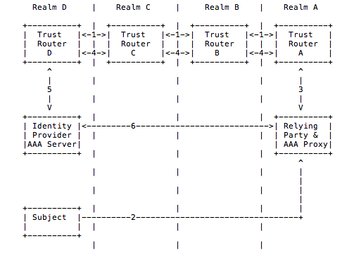
Trust Router Operation

Slide 9
Temporary Identity Protocol
Used by an RP to negotiate a Temporary Identity on a (set of) AAA Server(s) in a target realm
TID Request is sent to the RP’s local Trust Router and forwarded across a Trust Path to the target AAA Server(s)
Response is returned by reversing the Trust Path

Slide 10
Temporary Identity Protocol
Simple request/response protocol
Messages are encoded in JSON
Uses GSS-API for authentication
Request include ½ of a DH exchange
Server replies with a list of AAA Server IP Addresses
Response includes the other ½ of a DH exchange for each AAA Server
Both ends can compute a shared key that is used for the subsequent AAA authentication
Key cannot be computed by intermediate Trust Routers

Slide 11
Example TID Request
{"msg_type": "TIDRequest", "msg_body": {"rp_realm": ”mit.edu", "target_realm": ”oxford.uk.ac", "community": ”abfab-hackers.communities.ja.net", "dh_info": {"dh_p”: "FFFFFFFF…", "dh_g": "02", "dh_pub_key": "FBF98ABB…”} } }

Slide 12
Trust Router as TID Gateway
Trust Router receives a TID Request from an RP Client (e.g. AAA Proxy)
Determines appropriate APC for the community included in the original request
If different, moves original COI into orig-coi field
Finds matching rp_client entry (from gss_name), applies filters, and adds constraints to the message
Determines “Trust Path” and adds it to the message.
Forwards message to AAA Server (or next hop Trust Router)

Slide 13
Trust Router Protocol
Runs between pairs of Trust Routers
Configured as “peers” with GSS credentials to reach each other
“Routing” protocol used to dynamically distribute information about
Available Trust Links
Used to route TID requests and responses across the federation
RP Client membership in COIs
APC to use for each IdP Realm/COI pair

Slide 14
Trust Link Types
Trust Link Types (named by target type)
Routing Links
Trust Router Link
Indicates that the originating trust router can provide temporary IDs to reach the target trust router
IdP Realm Link
Indicates that the originating trust router can provide temporary IDs to reach the AAA servers in the target realm
Information Flooding Links
COI RP Membership Link
Indicates that the the target RP Client is a member of the indicated COI
APC Link
Indicates that authentication for a target realm and COI should use the target APC

Slide 15
Trust Path
A Trust Path is a set of Trust Links that forms a path across a federation between an RP and the AAA Server(s) in a Target IdP Realm
A Trust Path is valid for a given Community
Trust Routers forward TID Requests/Responses along Trust Paths, ultimately resulting in a TID that the RP can use to reach AAA Servers in the Target IdP Realm.

Slide 16
Next Steps
[We held a Bar BOF at lunch today]
We hope to hold a Pre-WG BoF at IETF 87
Need active discussion on the list
Join our mailing list!
trust-router@ietf.org

Slide 17
Questions? Feedback?

