Slide 1
Use Cases for Power-Aware Networks
Mingui, Beichuan
Alvaro

Slide 2
Background Power Consumption
Network devices consume a high level (for routers, >80%) ‘background’ power even no load is being carried.
IOW: power consumption of network devices is not proportional to traffic load.
Idle devices should be put into low power mode (e.g., sleeping state) to save energy consumption.
Notes:
http://enterprise.huawei.com/ilink/enenterprise/download/HW_200802
The S9700 uses a rotating ventilation channel to improve heat dissipation efficiency. In addition, it uses a variable current chip to dynamically adjust the power according to traffic, reducing power consumption by 11%.

Slide 3
Power Consumption of Line-Cards
Line-cards are the most power-hungry part for high-end routers and switches.
E.g., with chassis fully loaded with line cards, an EX8208 Switch can consume 5200 Watts, while nearly 70% is from the line-cards!
(chassis watts) + 8 (8-port SFP+ line card watts)=(1600 W + 8 (450 W)) =1600W+3600W=5200W
This means 3600/5200=70%
Notes:
http://www.juniper.net/techpubs/en_US/release-independent/junos/topics/task/configuration/ac-power-ex8208-requirements-calculating.html
For example, for a switch fully loaded with 8-port SFP+ line cards and using N+1 power redundancy, the maximum internal power consumption:
= (chassis watts) + 8 (8-port SFP+ line card watts)
= (1600 W + 8 (450 W))
= (1600 W + 3600 W)
= 5200 W

Slide 4
L2 Sleeping Links
Energy Efficient Ethernet (IEEE 802.3az)
Transceivers connecting an Ethernet link can enter Low Power Idle mode during the intervals of data streams.
Kind of opportunistic “sleeping”

Slide 5
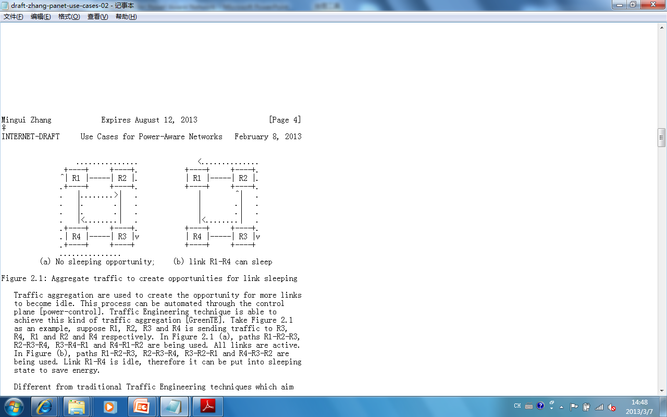
L3 Sleeping Links
Traffic can be aggregated on to part of links through Traffic Engineering.
Therefore, idle links are ‘scheduled’ to go asleep to save energy consumption for ISPs.

Slide 6
Awareness of Sleeping State at L3
We propose to add a new adjacency to represent sleeping links.
L3 devices build an extended LSDB for sleeping links just as they build a regular LSDB.
In this way, those sleeping links are “remembered”. In a proper time, it can be waken up.

Slide 7
L2 & L3 Coordination
Different from the opportunistic sleeping, the L3 sleeping links can be planned and the sleeping period can be much longer.
PHYs is probable to negotiate a longer time to enter LPI (deep sleeping modes).

Slide 8
Composite Links
Composite links are widely deployed by ISPs.
When the traffic load is lower than the overall bandwidth of a composite link, some component links can be put into sleeping state without cutting off the entire link.
Advantage: the connectivity is preserved.

Slide 9
Thanks!

