Slide 1
Using routing protocols for reducing power consumption - a metric-based approach
Shankar Raman, Balaji Venkat*, Gaurav Raina
Indian Institute of Technology Madras

Slide 2
Outline
Motivation
Power reduction approach
  Inter-AS,
  Inter-Area, Intra-Area
Router power profiles
Future work
  Multicast
  Power reduction trade-off

Slide 3
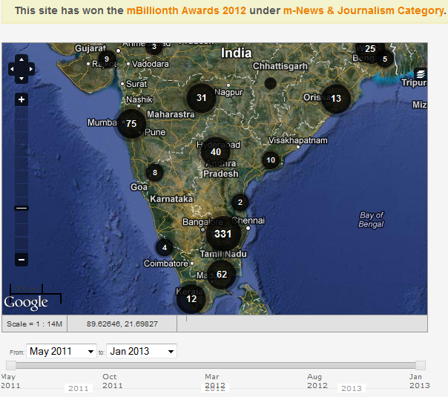
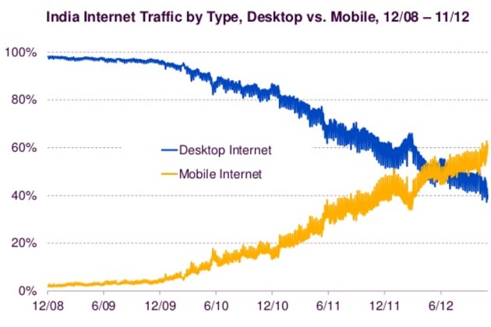
Power / Internet trends in India
Reported blackouts / brownouts
Mobile Internet Penetration
  http://powercuts.in
  http://ibnlive.in.com/news/mobile-internet-usage-in-india-outstrips-traffic-from-desktops-report/308772-11.html
Supply from Grid:
- From 6 to 24 hours
- Thermal power plants
Mobile Devices
- High penetration
- 900 Million Subscribers
- 600 Million unique
- More Video traffic

Slide 4
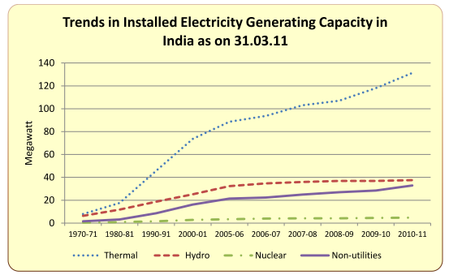
Future trends
2015
Internet
- Video > 50% by 2013
- 9 fold growth
- 53x in 2015 from 2005
- Mobile 28%
Power
- Thermal Power
- Solar (12 hours)
- Wind (Unreliable)
Power Generation
http://mospi.nic.in
Need:
Protocols that can automatically re-route to low power consuming devices during black/brown outs.
Service levels: Audio conference preferable instead of video/audio conference

Slide 5
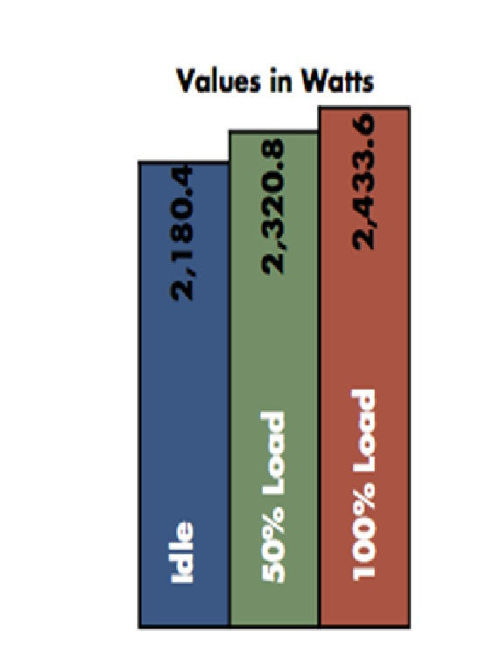
Motivation: router power variation
Device level power consumption
Base power to full utilization
  Approximately 11.6 % change
Part of areas and autonomous systems (AS)
  Power variation = Σ power variation in router `i’
all routers
AS have large variation
Make use of these variations
Picture source : EANTC
Full Chassis MX480 3D

Slide 6
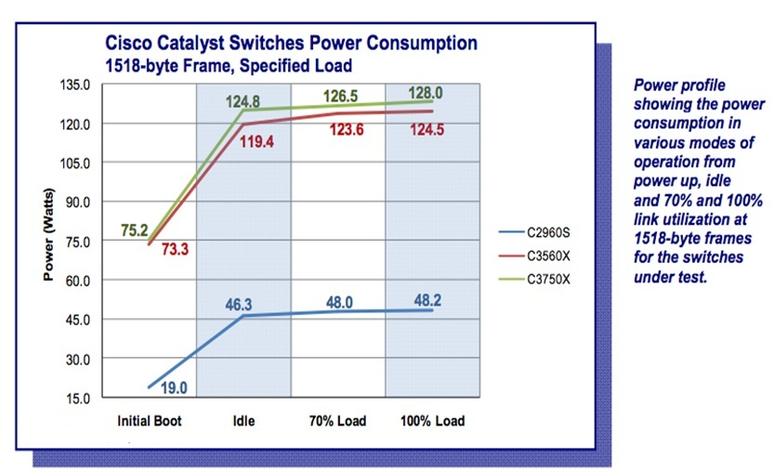
Motivation: variation between routers
Miercom, September 2010

Slide 7
Proposed techniques
Metric
  Consumed power to available bandwidth
  Consumed power to Multicast Replication Capacity
Topology
  BGP strands, OSPF/ISIS Link State Database and the OSPF/ISIS TE Database
Algorithm
  Modified BGP Power Sum Algorithm, Constrained Shortest Path first
Traffic Engineering
  RSVP TE
Hierarchical Approach
  Inter-AS and Intra-AS (Inter-Area and Intra-Area)

Slide 8
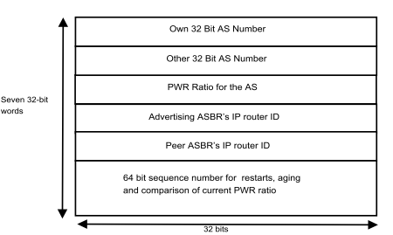
Example: Using BGP “the how”
Proposed PDU

Slide 9
Modified steps in BGP algorithm
If PWR metric is in use
{
  If there is only one AS path choose this path exit;
  If there are many AS paths
  {
  calculate the PWR based shortest path;
  install it in the routing table ;
  exit;
  }
}
Use the BGP algorithm

Slide 10
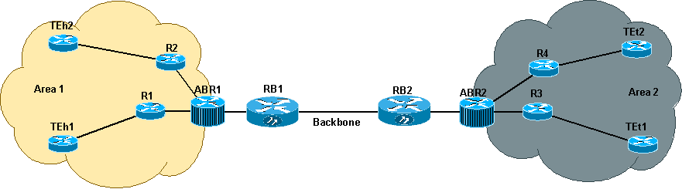
Selective low-power path leak
(inter-area)
Low Power Paths
Low Power Paths

Slide 11
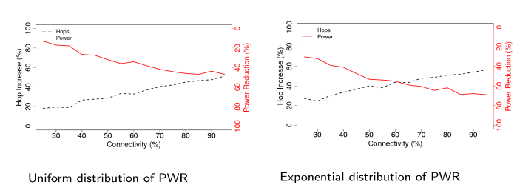
Simulations

Slide 12
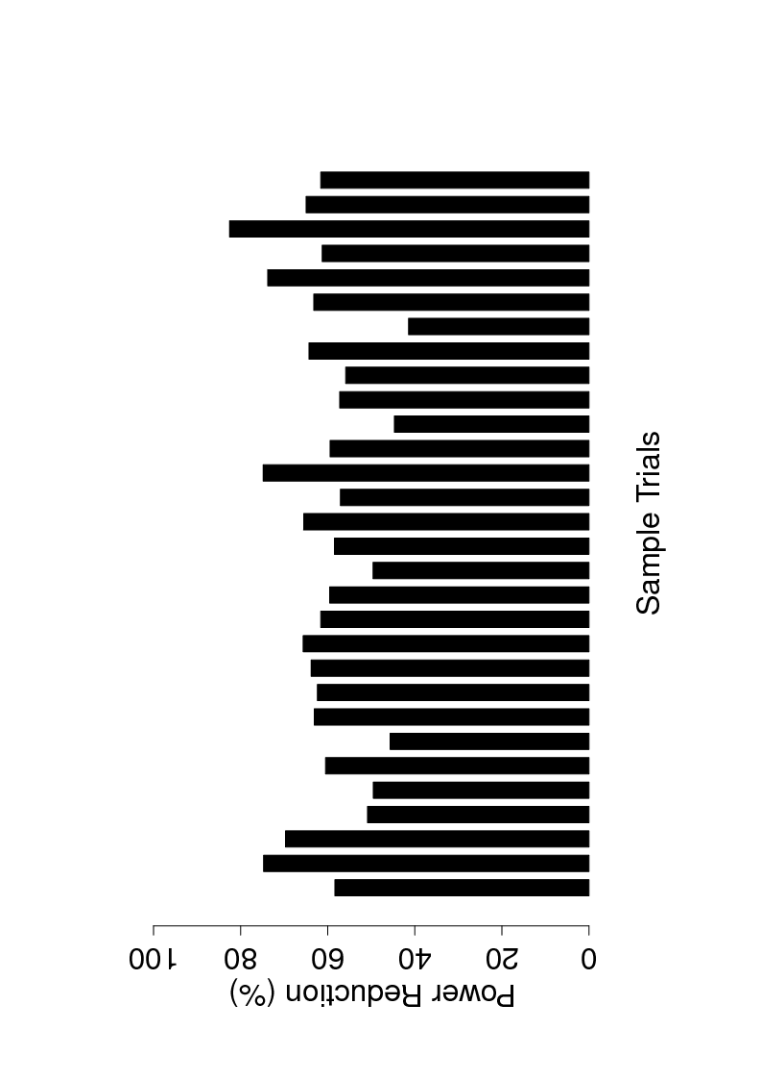
Potential power savings
Not aiming at maximum power savings
Trials = time instants
On average we get power reduction for a given power distribution (in routers, Area, AS)

Slide 13
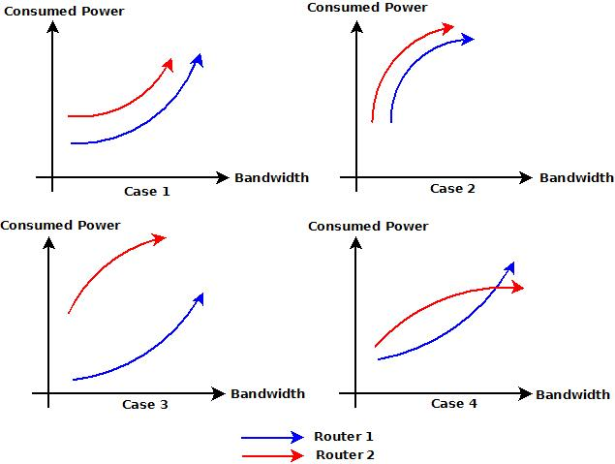
Router level measurement / profiles
Mix of optical / wired routers from vendors
Case 4: Switch over to Available Power / Available Bandwidth

Slide 14
Future work
Create power profile for areas and AS
  Cannot be optimal with power points
    currently used
Use metrics to drive the power reduction
  Implement for multicast as well
Inter-AS
  Minimize the tradeoffs latency/hops, delay-jitter
    Research on buffer sizing and queue management
  Increase accuracy of topology discovery

Slide 15
Thank you
Questions ?

Slide 16
Backup

Slide 17
Approach at every level
Metric
  Consumed Power to Available Bandwidth
  Consumed Power to Available Replication capacity
Building the Power based Topology
  BGP, OSPF, ISIS
  Use available routing protocols to exchange power information
Algorithm
  CSPF, Modified BGP power summation
Traffic Engineering
  RSVP TE

Slide 18
Benefits to Operators
Power reduction techniques can be under the control of the operator or the device vendor.
  Method can be chosen by the operator.
Operators get informed about devices that have high power consumption per gigabit of traffic.
- Little manual intervention needed.
Protocols take care of the operational power variation
Can redirect traffic if running on external power sources
Power variation during traffic load from base power is not differentiated currently.
Schemes use the hierarchical routing model of the ISPs

Slide 19
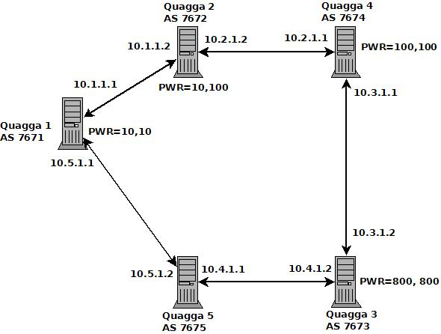
Experimental Setup
Quagga Router - Topology

Slide 20
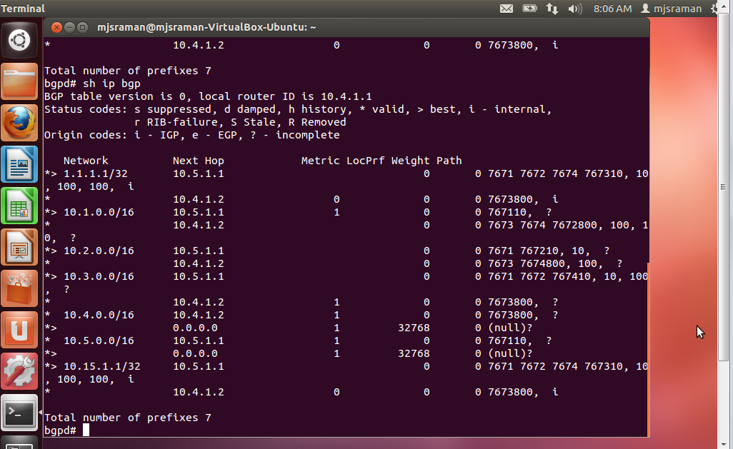
Show ip bgp (routes)

Slide 21
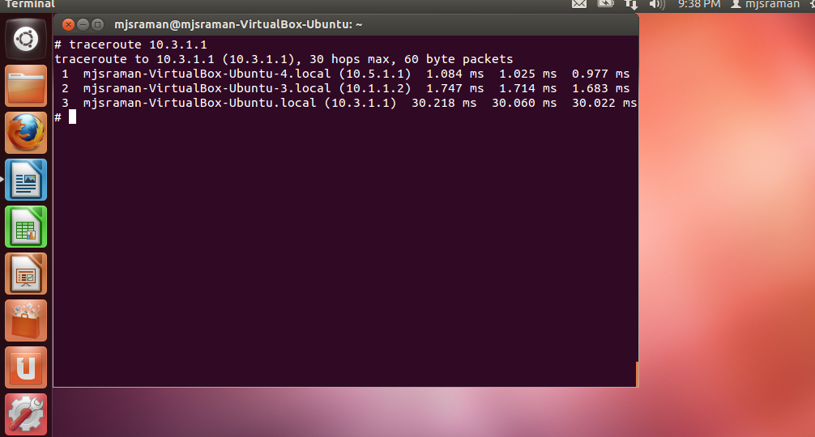
Traceroute from AS 7675

Slide 22
Hierarchical Approach with Protocols
AS level topology – intra-AS power reduction
  BGP
    draft-mjsraman-panet-bgp-power-path-01
  Without BGP
    draft-mjsraman-panet-inter-as-psp-01
Intra-AS
  Inter-area, Intra-area
    draft-mjsraman-panet-ospf-power-topo-00
    draft-mjsraman-panet-intra-as-psp-te-leak-00
Multicast, ECMP
    draft-mjsraman-panet-pce-power-mcast-replic-00
    draft-mjsraman-panet-pim-power-00
    draft-mjsraman-panet-ecmp-redirect-power-repl-cap-00

