Slide 1
SACM Architecture draft-waltermire-sacm-architecture-00

Slide 2
Overall Architectural Philosophy
Leverage existing IETF and other international standards where possible
  Leverage existing Layer 1 – 6 specifications
  Profile or extend existing application (Layer 7) specifications
Minimize the number of required data flows/interfaces
Keep it simple

Slide 3
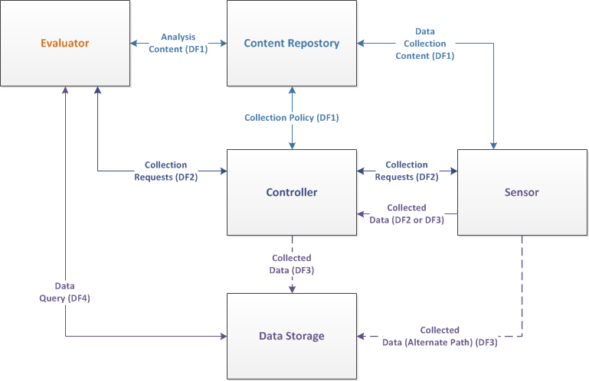
SACM Architecture

Slide 4
Data Flows / Interfaces
DF1: Content Retrieval
  Used to acquire content to drive data collection and analysis
DF2: Collection Tasking
  Used to orchestrate required data collection
DF3: Collected Data Publication
  Used to publish collected data to appropriate data store(s)
DF4: Collected Data Query
  Used to query previously collected data for analysis

Slide 5
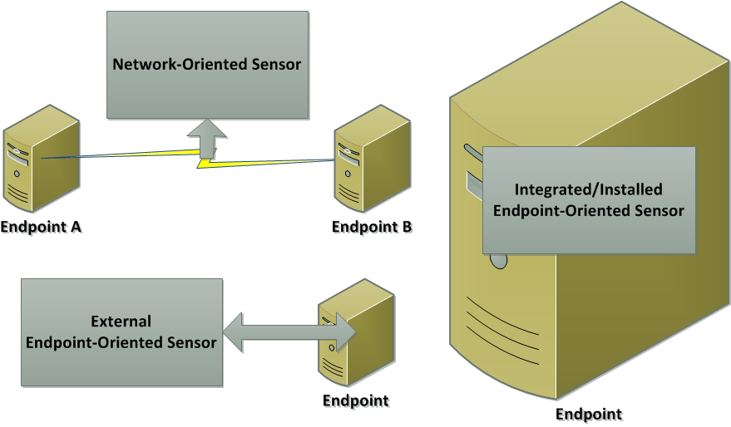
Sensors

Slide 6
Endpoint Sensor Data – Current Scope
Endpoint Identity
Posture attributes
  Hardware Inventory
  Software Inventory
    Operating System
    Applications
    Patches
  Software Configurations
Provenance data
  Identification of sensor
  Other sensor metadata/context
Entailment information
  Collection methods
  Additional context

Slide 7
Content Repositories
Provided standardized, secure access to data that drives:
  Collection policies (e.g. what, when, where)
  Data collection activities (e.g. what)
  Analysis activities (e.g. what)
Data agnostic, resource identification approach

Slide 8
Data Storage
Enables collected and analyzed data to be persisted
Provides standardized, secure methods to publish and retrieve data
Decouples dependencies between data collectors and analysis components providing architectural flexibility

Slide 9
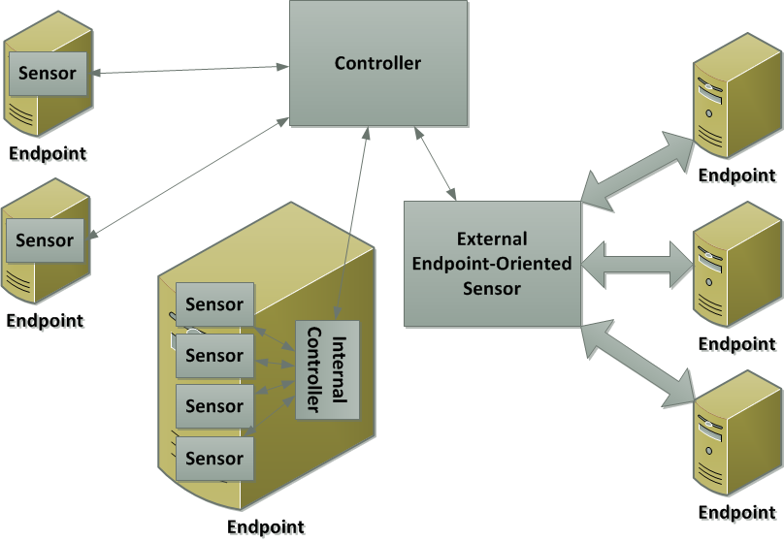
Controller
Responsible for securely orchestrating data collection by sensors
May manage other controllers
Enables evaluators to request on-demand or scheduled data collection

Slide 10
Evaluator
Performs analysis based on previously collected data
Securely interacts with controllers to orchestrate needed data collection

Slide 11
Open Questions
Sensors
  Are network-oriented sensors in scope?
  Are external endpoint-oriented sensors in scope?
Controllers
  Should controllers manage other controllers?
  Should controllers manage content repositories or data storage?

