Slide 1
Port set Type:
Contiguous vs. Non-Contiguous
http://tools.ietf.org/html/draft-ietf-softwire-map-04
http://tools.ietf.org/html/draft-sun-dhc-port-set-option-00
Qi Sun
2013.3 Orlando

Slide 2
Motivation for port sharing
IPv4 exhaustion
  Several nodes share one IPv4 address by assigning non-overlapped port sets to each node
  Providing IPv4 service without IPv4 routing on the provider IPv6 network
Port set: Is contiguous port-set sufficient or do we need non-contiguous port-sets?

Slide 3
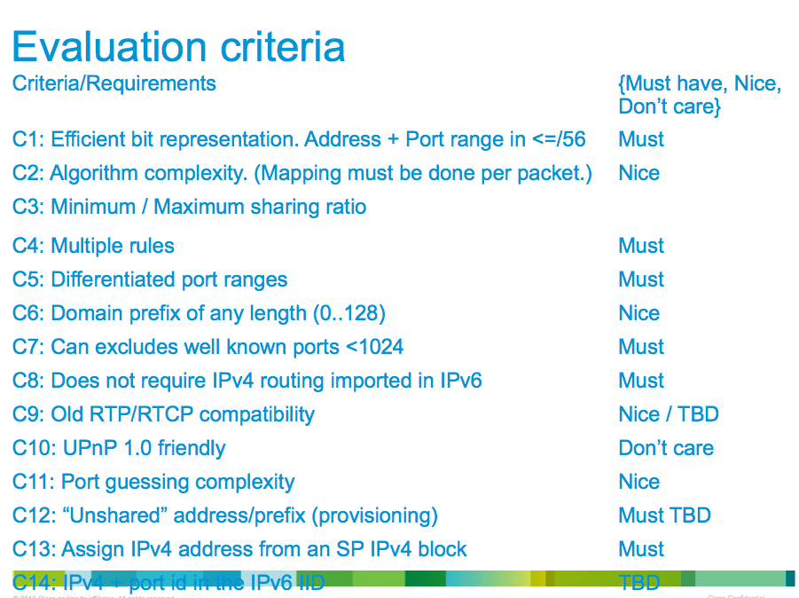
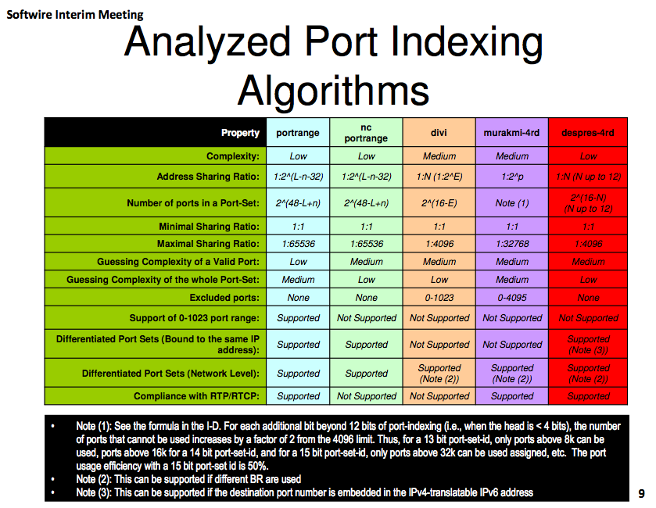
Back in Beijing Interim Meeting
From Ole’s slides
From Med’s slides
Mainly focus on statelessly mapping IPv4 address and port into IPv6 prefix

Slide 4
Comparison Points
Security
Preservation of Well-Known Ports
Complexity
Backwards Compatibility with uPnP IGD:1

Slide 5
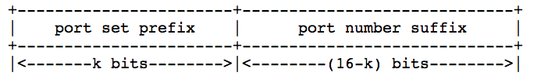
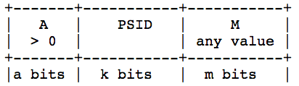
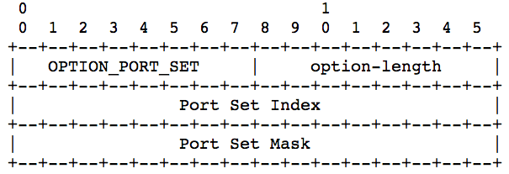
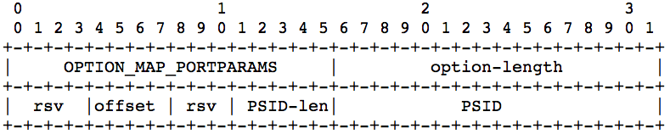
Contiguous / Non-Contiguous Port Sets
Contiguous: A single port range per-client
Non-Contiguous: Multiple port ranges distributed evenly across port space per-client
Bit Presentation
  Contiguous:
  Non-Contiguous:
Option format
  Port Mask GMA

Slide 6
Security
Limited port range reduces port entropy -> it could be simpler for an attacker to guess ports
  Source port randomization
Ratio of address sharing increases -> the next port easier to predict
  irrespective of whether it is contiguous or not
Contiguous
  Single port range: Predictable if allocation policy is known
Non-Contiguous
  Algorithmic port-set allocation: Predictable if allocation policy is known

Slide 7
Preserving Well-Known Ports
Contiguous
  Don’t assign PSIDs falling within the WKP range
  WKPs only available for the first few PSIDs
Non-Contiguous
  a-bits (A > 0)
  PSID can be arbitrary, so that ISPs won’t be required to exclude some of prefixes (as PSID is part of MAP IPv6 prefix)
  WKPs only available for the first few PSIDs

Slide 8
Complexity
Contiguous
  Simple for CPE, Tunnel Concentrator, provisioning system, logging system, etc.
  ‘Human readable’ format makes it easier to troubleshoot without tools
Non-Contiguous
  Brings complexity to all devices – CPE, server and clients (DHCP based)
  Necessitates the use of tools to calculate allocated port ranges, complicating troubleshooting, logging, etc.
  Could be hard to debug

Slide 9
Backward Compatibility to uPnP
Mainly about IGD:1
  No external port negotiation
  Fail if external port unavailable
Testing shows neither have good compatibility
Probability for IGD:1 to work normally is the same for both port-set algorithms

Slide 10
Summary
 | Contiguous Port-set | Non-Contiguous Port-set
Security | Predictable | Predictable
 | Sharing ratio increases -> Easier to predict (RFC[6056])
Cost to Preserve WKP | Not allocate first few PSIDs | a-bit in port number (A > 0) (PSID can be arbitrary)
Complexity | Low | High
Compatibility with IGD:1 | Not Good | Not Good
Non-contiguous port-sets offer little security with greater complexity.
Conclusion: a simple contiguous port range, plus port randomization on the client side is preferable

Slide 11
For the WG
Is contiguous port-set enough?
Conclusion?

