Slide 1
Mitigating spoofing and replay attacks in MPLS-VPNs using label-hopping with TicToc
Shankar Raman
Balaji Venkat
Gaurav Raina

Slide 2
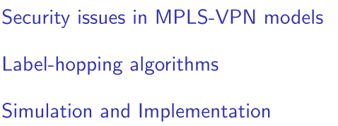
Outline

Slide 3
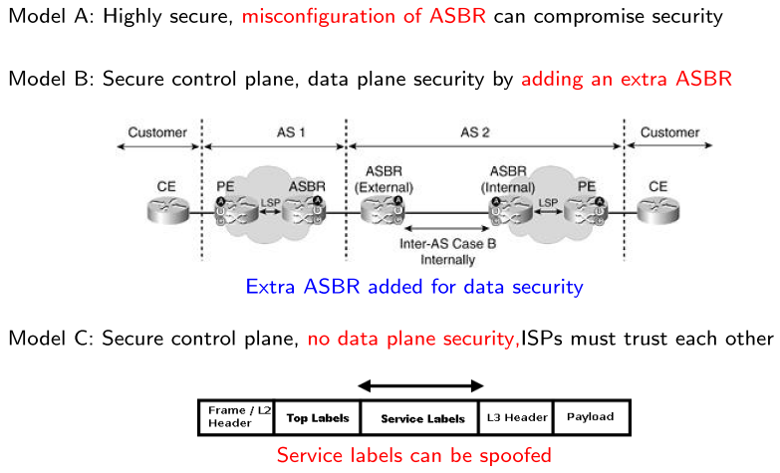
MPLS VPN Security Issues

Slide 4
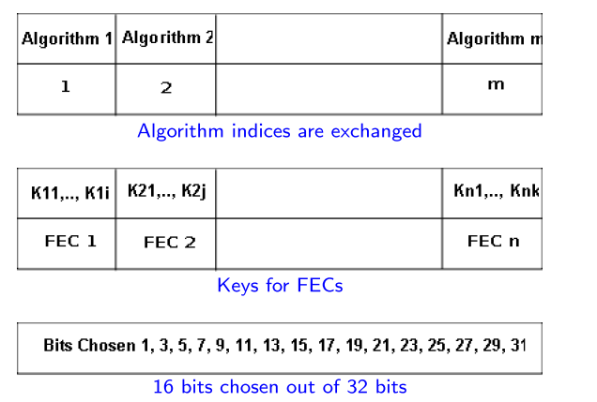
Router Configuration

Slide 5
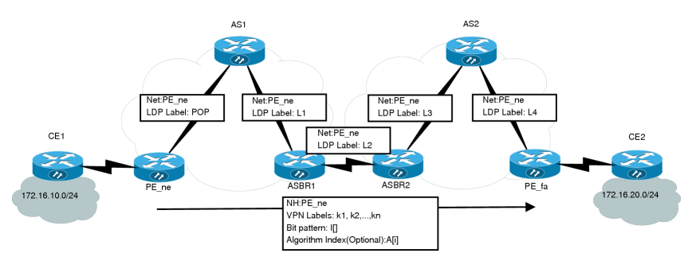
Secure Control Plane Exchange

Slide 6
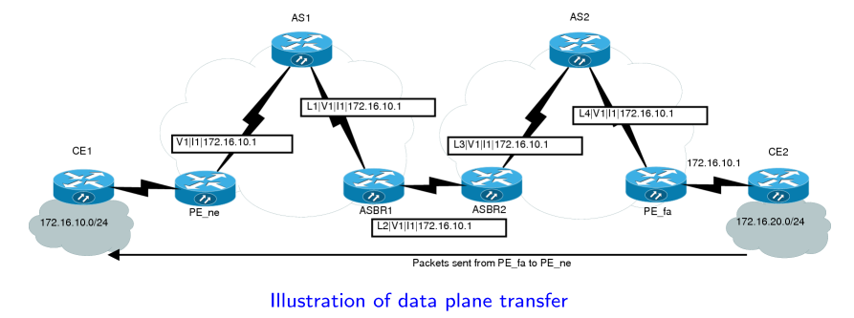
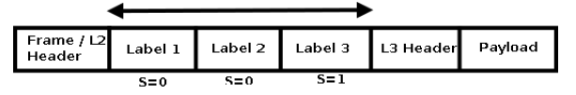

Label hopping applied to data plane

Slide 7
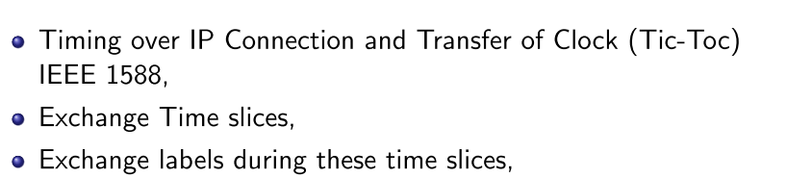
Tic-Toc based Scheme

Slide 8
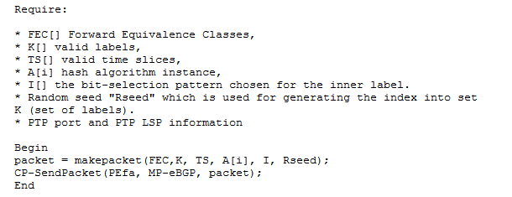
Control plane algorithms for PEne

Slide 9
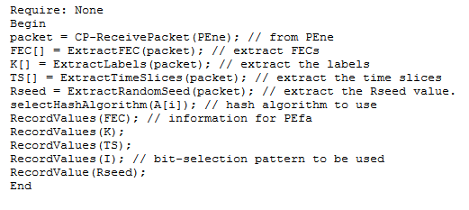
Control plane algorithms for PEfa

Slide 10
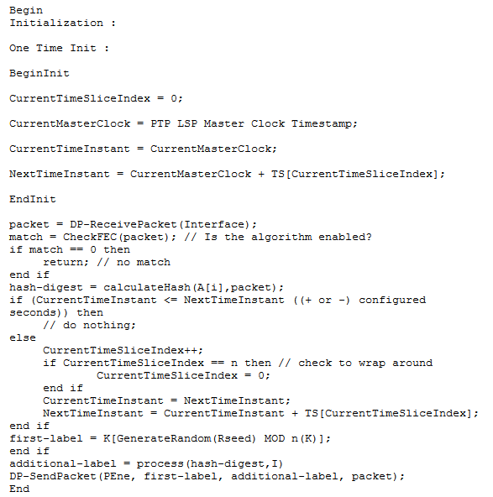
Data Plane Algorithm for PEfa

Slide 11
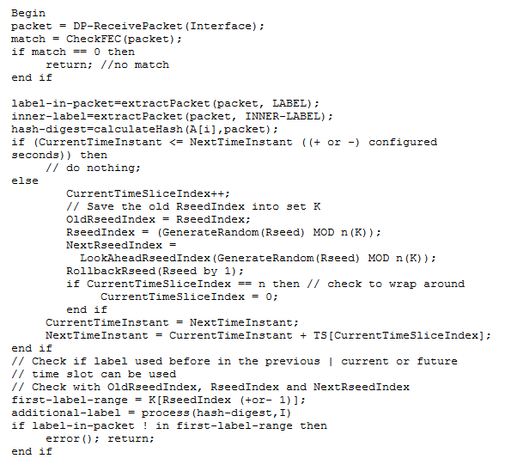
Data Plane Algorithm for PEne

Slide 12
Avoiding replay attacks
Exchange the seed
Use Pseudo Random Number Generation algorithm
Use the Random Number generated to choose the labels at various time slices

Slide 13
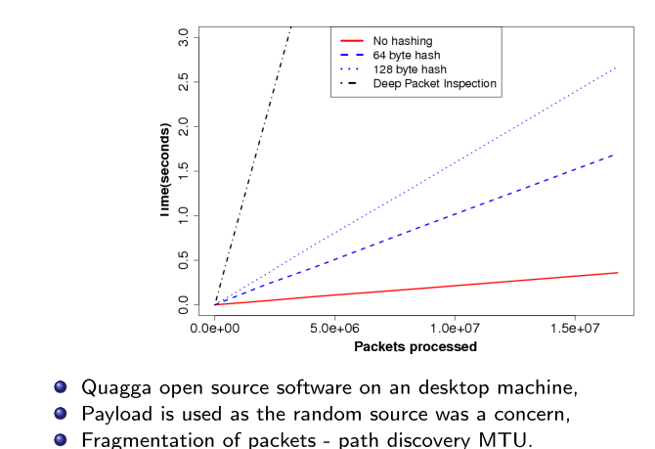
Simulation and Implementation

Slide 14
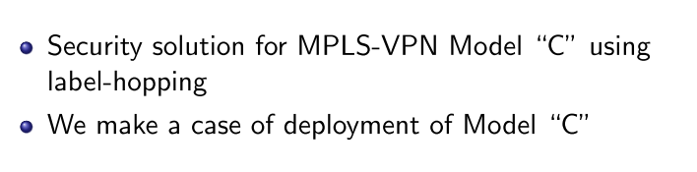
Conclusion

Slide 15
Questions?
Thank you

