Slide 1
Problem Statement: TRILL Active/Active Edge
draft-zhang-trill-aggregation-03.txt
Mingui Zhang
Donald Eastlake

Slide 2
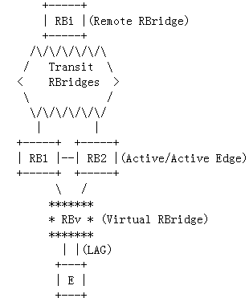
Overview
An MCLAG link is used to connect an edge device to multiple RBridges.
The edge RBridge group is represented by a virtual RBridge RBv
All member RBridges use RBv as the ingress nickname in TRILL data encapsulation to avoid the MAC move issue at the remote RBridges.

Slide 3
Purpose
Provide edge devices with active/active connection to multiple RBridges
Increase the reliability of TRILL edge
Increase the access bandwidth of RBridge campus
It’s different from the Active/Standby connection for LAN links

Slide 4
Frame Processing: Unicast Ingressing
Encapsulate native frames using RBv as their ingress nickname.
Remote RBridges will regard the RBv as the egress RBridge for the edge node.

Slide 5
Frame Processing: Unicast Egressing
Member RBridges should egress TRILL data frames whose egress nickname is RBv.
Discard frames whose ingress nickname is RBv to avoid loops.

Slide 6
Frame Processing: Multicast Ingressing
Member RBridges encapsulate the native frames using RBv as their ingress nickname.
Member RBridges must not share a distribution tree to avoid the Reverse Path Forwarding Check issue.

Slide 7
Frame Processing: Multicast Egressing
Only one member RBridge can egress a data frame. This avoids duplication.
Discard frames whose ingress nickname is RBv to avoid loops.

Slide 8
DRB and Pseudonode
Since there is no HELLO exchanging on the MCLAG link, member RBridges SHOULD have other signaling method to discover each other and elect the DRB.
Each MCLAG link should be allocated with a pseudonode nickname, otherwise, Component Links from Different MCLAG Links Cannot be Distinguished by the same RBridge.

Slide 9
MAC Addresses Sharing
Northbound Sharing
MAC address learnt from the local end node
Southbound Sharing
MAC addresses learnt from remote RBridges
MAC Addresses Sharing helps to reduce the multicast frames.

Slide 10
Failures and Self-healing
The failure of a component link/node of the active/active edge group will be handled by ISIS.
This provides the self-healing characteristic of the edge group.

Slide 11
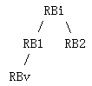
Reverse Path Forwarding Check
According to RFC 6325, RBridges MUST drop multicast frames that fail the RPFC.
For the distribution tree on the left, multicast frames from RBv should only come from the port of RBi connecting to RB1.
If RB2 uses this distribution tree to ingress multicast frame, these frames will be discarded by RBi.

Slide 12
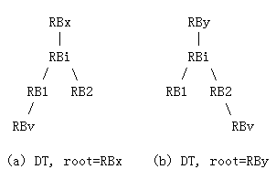
Reverse Path Forwarding Check (cont.)
Leverage the feature that one RBridge can compute multiple Distribution Trees.
Each member RBridge gets an unique distribution tree [CMT].
This avoids the RPFC issue.

Slide 13
Next Step
WG adoption.

Slide 14
Thanks!

