Slide 1

Service Function Dev Kit using FD.io’s VPP

Slide 2
Goals
Writing a high-perf service function is hard:
  Require NSH implementation, DPDK awareness, …
But it should be simple !
Software abstraction for writing a Service Function
Design for high performance
  So ask VPP team for help
Investigate packet injection and reversal

Slide 3
The Team
Dave Dolson (Champion)
Kyle Larose (IETF newcomer)
Pierre Pfister (White knight)
Shwetha Bhandari

Slide 4
Achievements
Make NSH SF development simpler !
  Top-down proof-of-concept application
  VPP may host multiple service functions
In more details:
  Add NSH over Ethernet to VPP
  Create NSH Service Function plugin in VPP
  Load simple SF plugins in VPP
  Add VPP backend support to NSH SF DevKit
100% Open-Source

Slide 5
Hackathon Project Design

Slide 6
Hackathon Project Design
70 LoC
500 LoC
VPP
nsh_sfc
nshsfdev
SF: Packet Counter
SF: Crude Firewall
600 LoC
github.com/dcdolson/nsh-sf-devkit

Slide 7
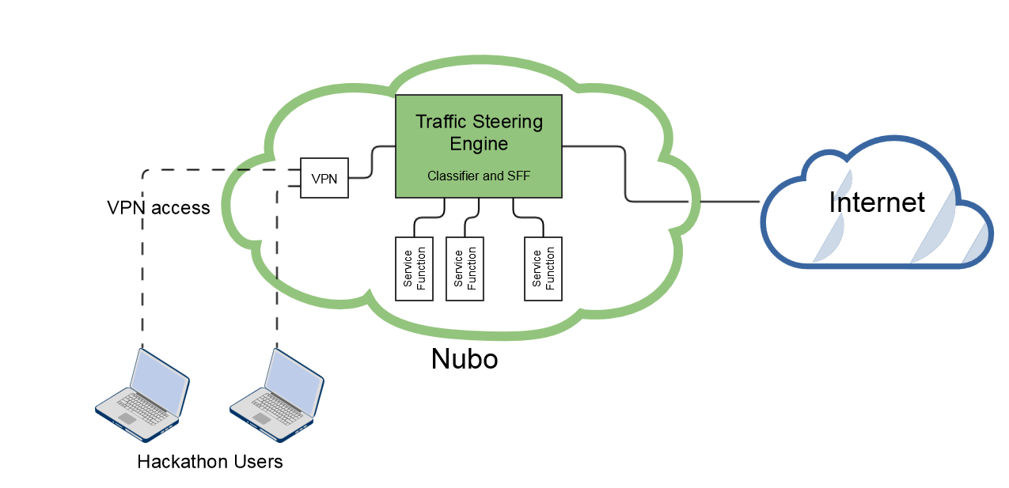
Test Cloud

Slide 8
Protocol Status
Pierre (a first-time reader) found the draft-ietf-sfc-nsh-10 to be well written
Success with algorithmic path reversal
  Documented in an expired draft
Successful interop. between Sandvine’s and FD.io’s NSH.
  Discovered issue with proprietary OAM

