Slide 1
Draft-ietf-supa-generic-policy-info-model-01
John Strassner
strazpdj@gmail.com, john.sc.strassner@huawei.com
Joel Halpern
jmh@joelhalpern.com, joel.halpern@ericsson.com

Slide 2
Draft State
Revision submitted 17-July-2016
Summary of changes
Rewrote parts of the Introduction
Clarified how to extend the GPIM and EPRIM
Redesigned the SUPAPolicyVersionMetadataDef class
Added Fully Qualified Path Names to applicable enumerations
Removed supaPolClauseExecStatus with supaPolClauseDeployStatus

Slide 3
Structural Overview - Reminder
Structure for GPIM and EPRIM has been stable for 2 versions
May continue fine-tuning some attributes
Existing classes and relationships likely will not change for either
Key points
Extensive use of patterns
Policies are containers
Each type of policy defines components that go into a type of container
This enables imperative, declarative, and other types of policies to share this infrastructure (but we are currently restricted to imperative types of policies)
Metadata can be attached to any object
Policy target abstracts managed objects that policy applies to
PolicySource may be useful for security policies needing auditability and deontic logic

Slide 4
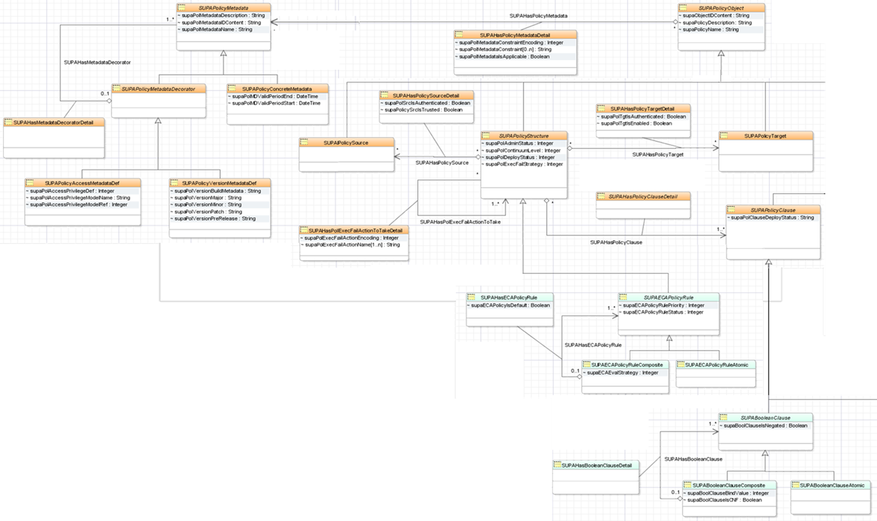
SUPA Generic Policy Information Model (1 of 2)

Slide 5
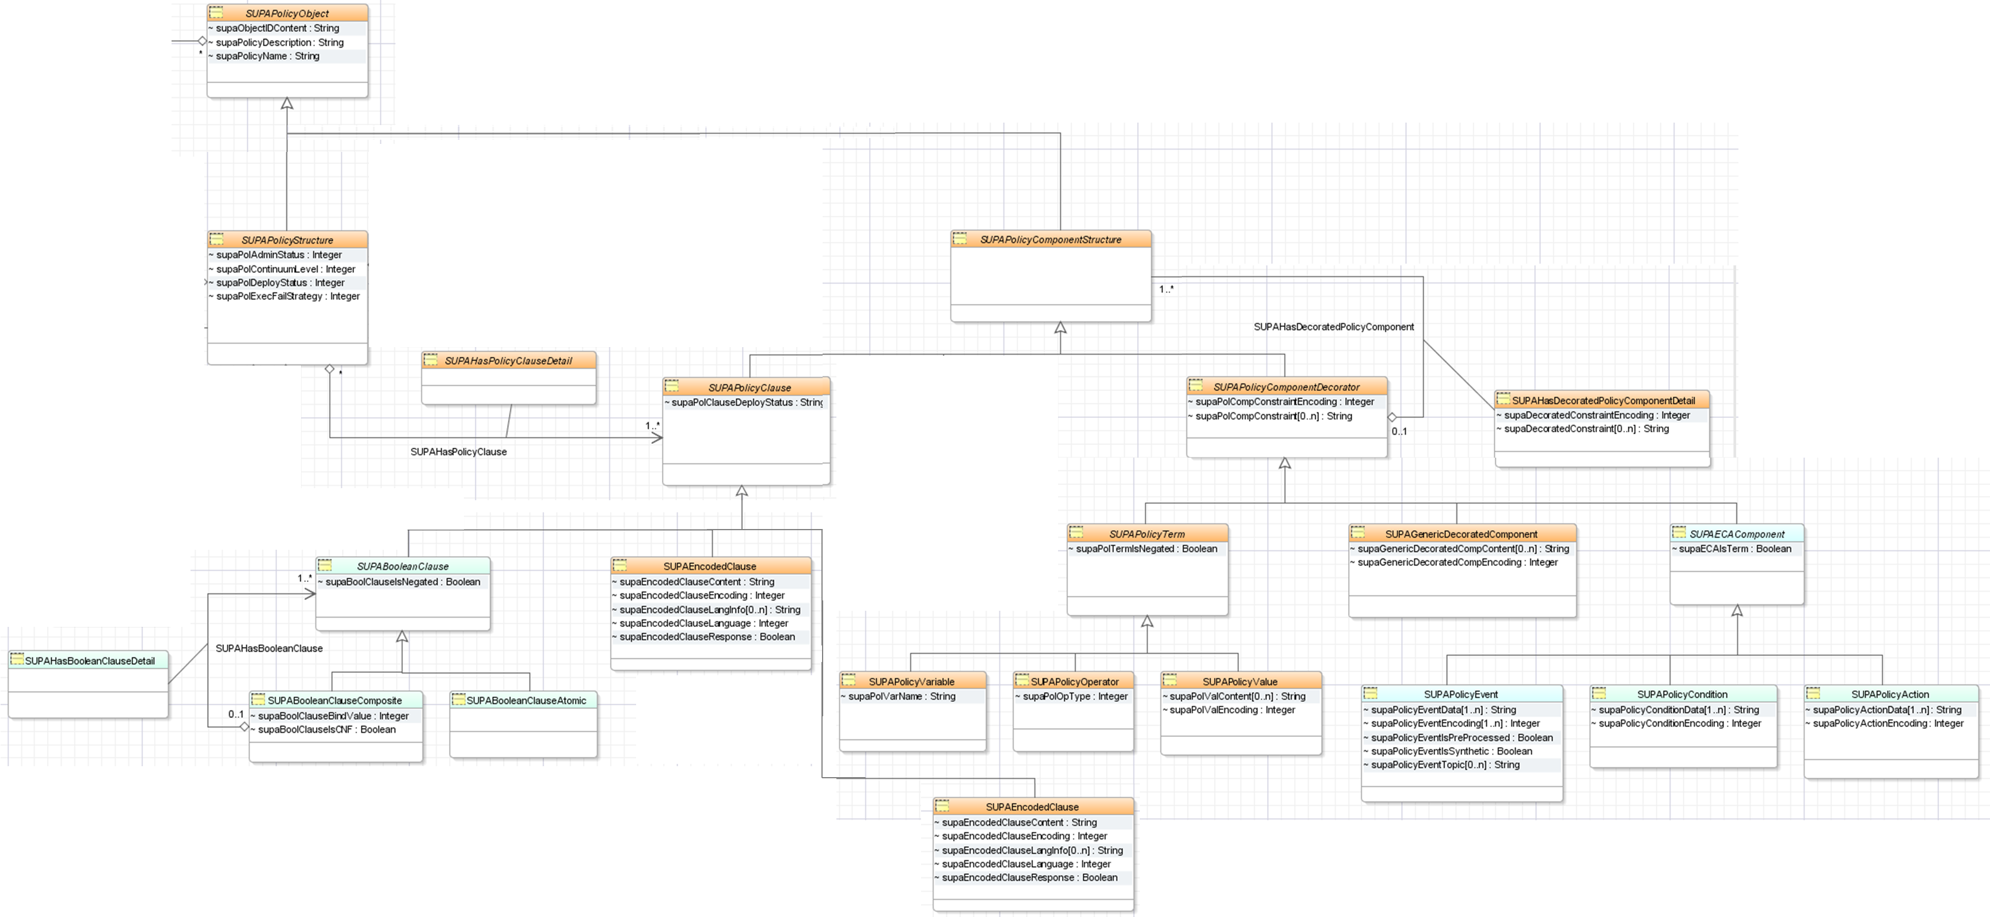
SUPA Generic Policy Information Model (2 of 2)

Slide 6
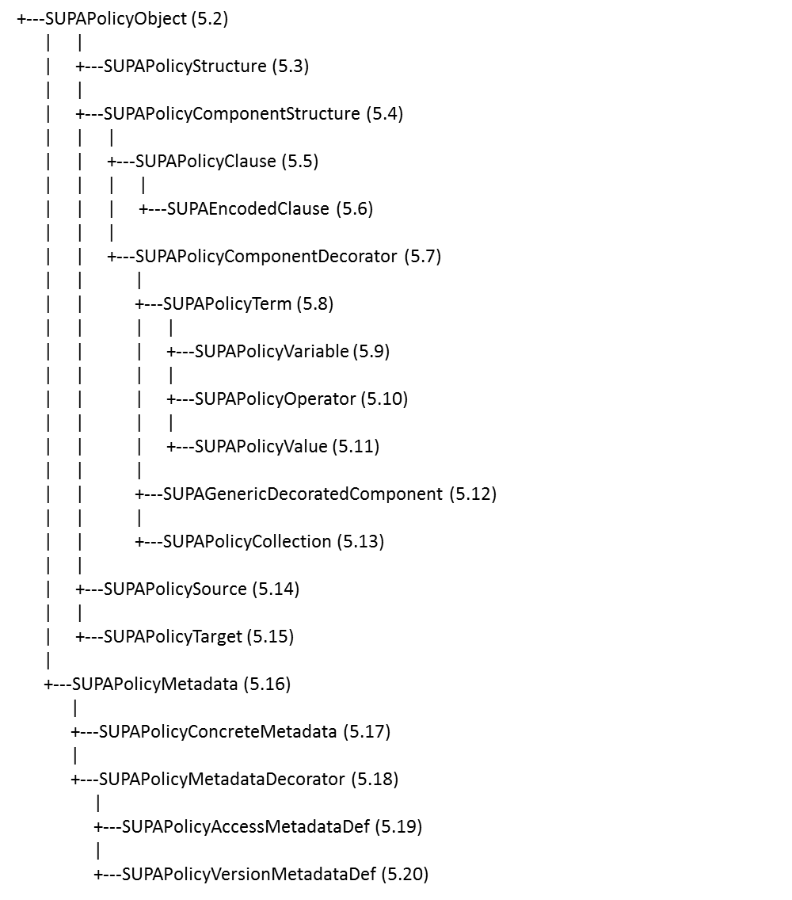
Textual Version of the GPIM

Slide 7
Textual Version of the EPRIM
+---SUPAPolicyObject (5.2)
|
+---SUPAPolicyStructure (5.3)
| |
| +---SUPAECAPolicyRule (6.4)
| |
| +---SUPAECAPolicyRuleAtomic (6.5)
| |
| +---SUPAECAPolicyRuleComposite (6.6)
|
+---SUPAPolicyComponentStructure (5.6)
|
+---SUPAPolicyClause (5.7)
| |
| +---SUPABooleanClause (6.7)
| |
| +---SUPAECAPolicyRuleAtomic (6.8)
| |
| +---SUPAECAPolicyRuleComposite (6.9)
|
+---SUPAPolicyComponentDecorator (5.9)
|
+---SUPAECAComponent(6.10)
|
+---SUPAPolicyEvent (6.11)
|
+---SUPAPolicyCondition (6.12)
|
+---SUPAPolicyAction (6.13)

Slide 8
Pending Actions
Considering adding classes to represent “Unknown Rules” as well as “Unknown PolicyClauses”
Should we do so?
We will add examples
This will be a superset of the examples in the Data Model

