Slide 1
ICN: Baseline Scenarios draft-irtf-icnrg-scenarios-01
K. Pentikousis (Ed.), B. Ohlman, D. Corujo, G. Boggia, G. Tyson, E. Davies, A. Molinaro, and S. Eum
IETF 88 Vancouver, Canada

Slide 2
Draft Goals
Establish a common understanding about a set of scenarios that can be used as a base for ICN evaluation
Provide equal ground for comparison, an agreed framework
Scenarios should be general enough and “technology agnostic”
Scenario detail may vary
Aim to get feedback from implementers, both on the scenario definition and level of detail
All approaches need not implement all scenarios
but all scenarios should end up illustrated in a real demo

Slide 3
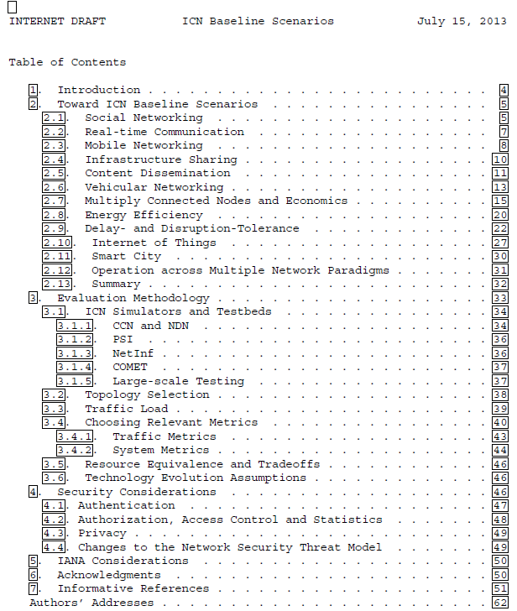
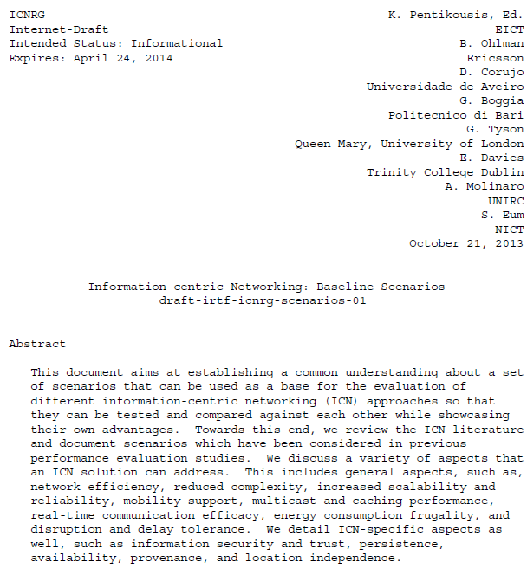
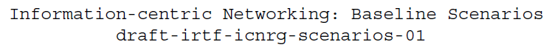
IETF 87: Split and Adopt

Slide 4
Draft Updates
Editorial
Repositioning the draft after the split
Consistency checks and updated summary
Code availability
The TelematicsLab has made sample code implementing the topologies discussed in the draft available to the community
See http://telematics.poliba.it/icn-baseline-scenarios

Slide 5
Community Document
Thanks to Marica Amadeo, Hitoshi Asaeda, Claudia Campolo, Luigi Alfredo Grieco, Myeong-Wuk Jang, Ren Jing, Priya Mahadevan, Will Liu, Ioannis Psaras, Spiros Spirou, Dirk Trossen, Jianping Wang, Yuanzhe Xuan, and Xinwen Zhang for their comments, suggestions, literature pointers and short text contributions.
Please contribute

Slide 6
Next Steps
Identify scenarios that are not included so far
Open to suggestions
Keep in mind that this draft surveys existing literature
Enhance scenario details where applicable
Some sections are quite detailed now
Other sections are not detailed, but point to early-phase peer-reviewed work in a certain direction
Ask for 3 or more committed reviewers to make and post on the list full reviews of the draft

Slide 7
Thank You

