Slide 1
ICN Baseline Scenarios draft-pentikousis-icn-scenarios-04
K. Pentikousis (Ed.), B. Ohlman, D. Corujo, G. Boggia, G. Tyson, E. Davies, P. Mahadevan, S. Spirou,
A. Molinaro, D. Gellert, and S. Eum
IETF 87
Berlin, Germany

Slide 2
Draft Goals
Establish a common understanding about potential experimental setups (testbed and simulation)
Provide equal ground for comparison, an agreed framework
Scenarios should be general enough and “technology agnostic”
Scenario detail may vary
Aim to get feedback from implementers, both on the scenario definition and level of detail
All approaches need not implement all scenarios
but all scenarios should end up illustrated in a real demo

Slide 3
Draft Updates (1/2)
Section 2: Toward Baseline Scenarios
Things that you can do with the host-centric approach today and things you cannot do (well)
ICN should make easy things easy and difficult things possible
Updates since Orlando (-02)
Editorial: Social Networking, Infrastructure Sharing , Smart City
Updated: Real-time A/V Communications, Mobile Networking, Content Dissemination, Multiply Connected Nodes and Economics, Internet of Things
Major updates: Energy Efficiency , Delay and Disruption Tolerance
NEW: Vehicular Networking, Operation across Multiple Network Paradigms, Summary

Slide 4
Draft Updates (2/2)
Section 3: Evaluation Methodology
Survey evaluation tools currently available
Provide suggestions regarding methodology and metrics
Updates since Orlando (-02)
Editorial: Resource Equivalence and Tradeoffs
Updated: Topology Selection, Traffic Load
Major updates: ICN Simulators and Testbeds, Choosing Relevant Metrics
Technology Evolution Assumptions section needs input (?)
Section 4: Security Considerations
NEW since Orlando

Slide 5
Community Document
Thanks to Marica Amadeo, Hitoshi Asaeda, Claudia Campolo, Luigi Alfredo Grieco, Myeong-Wuk Jang, Ren Jing, Will Liu, Ioannis Psaras, Dirk Trossen, Jianping Wang, Yuanzhe Xuan,
and Xinwen Zhang for their comments, suggestions, literature pointers and short text contributions.
Please contribute

Slide 6
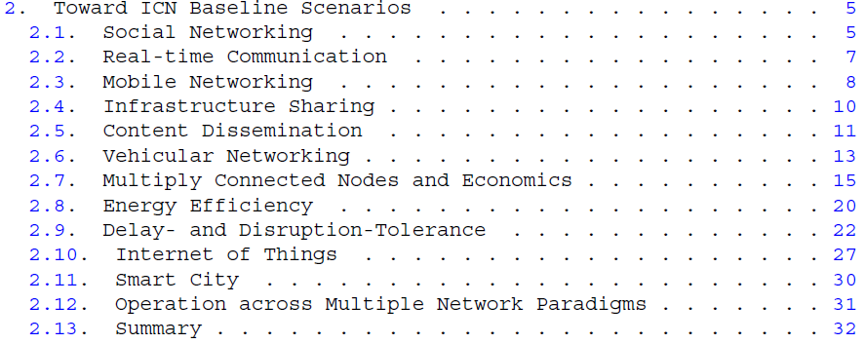
Toward ICN Baseline Scenarios
Comprehensive review of ICN evaluations
First of its kind

Slide 7
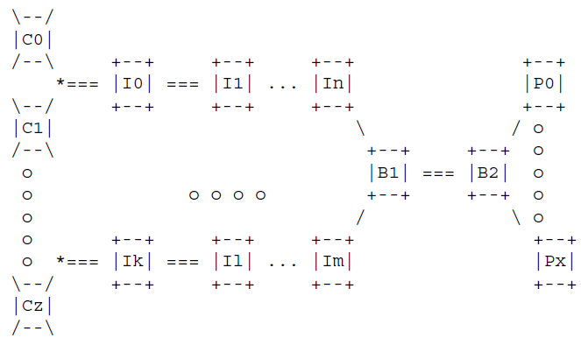
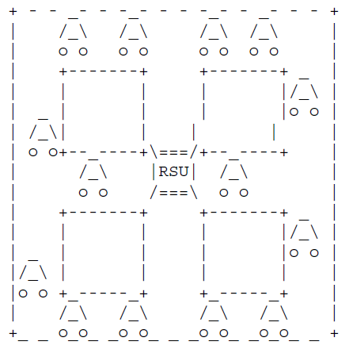
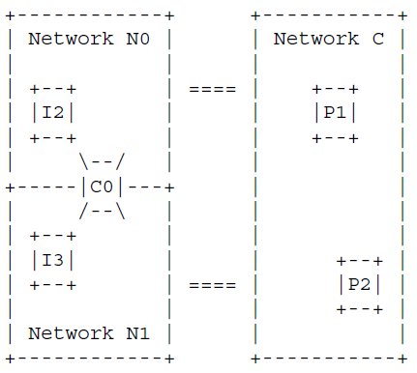
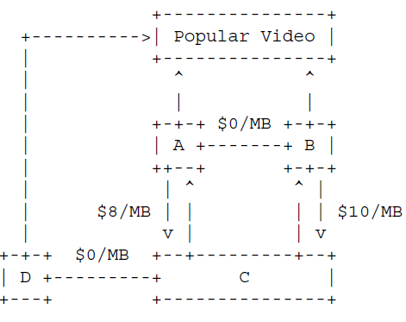
Topologies

Slide 8
Literature Review Summary (1/2)
Scalability
Network, resource and energy efficiency
Operational aspects
Network planning
Manageability
Reduced complexity and overhead
Economics
Design tradeoffs
Communication, Computation, Storage

Slide 9
Literature Review Summary (2/2)
Support for
Multicast
Mobility
Caching
QoS (real-time A/V)
Reliability and Resilience
Migration and coping with different paradigms
New applications
Key to sustained and increasing deployment

Slide 10
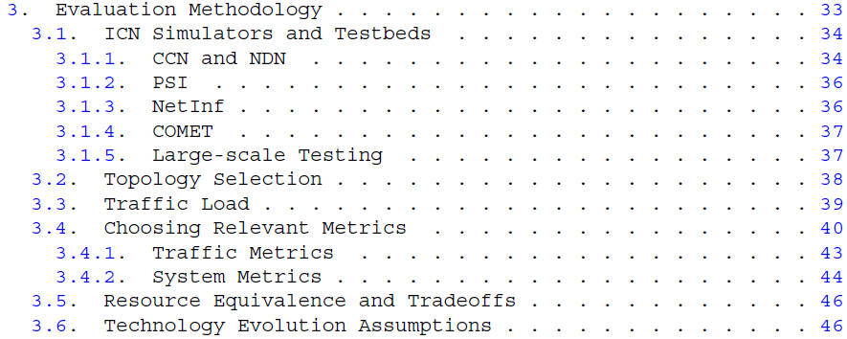
Evaluation Methodology
Survey of evaluation tools, available data sets
Evaluation guidelines, not a benchmark tool

Slide 11
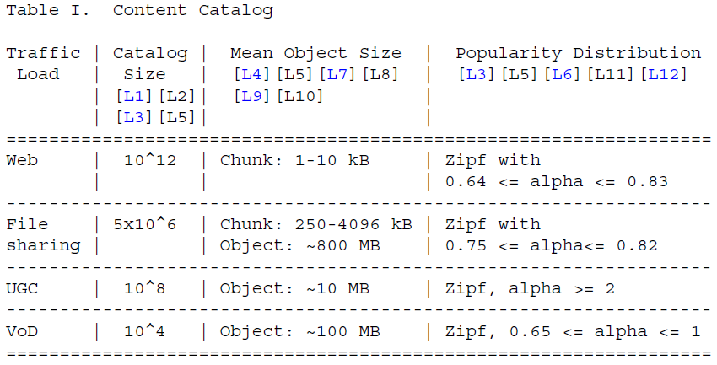
Example Traffic Load (Content Catalog)

Slide 12
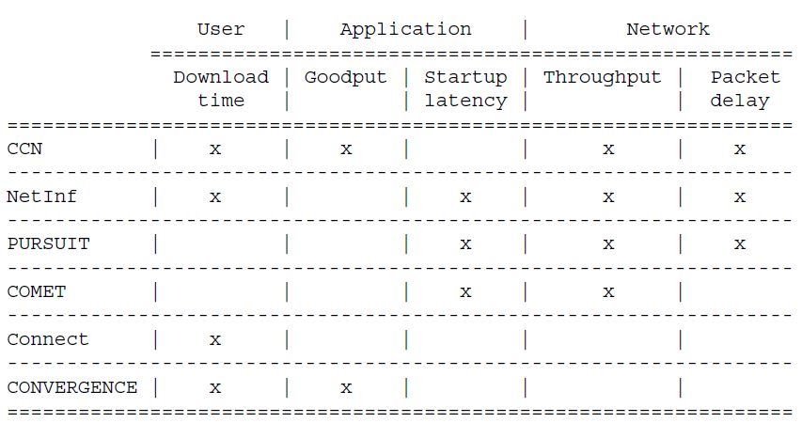
Example: Traffic Metrics

Slide 13
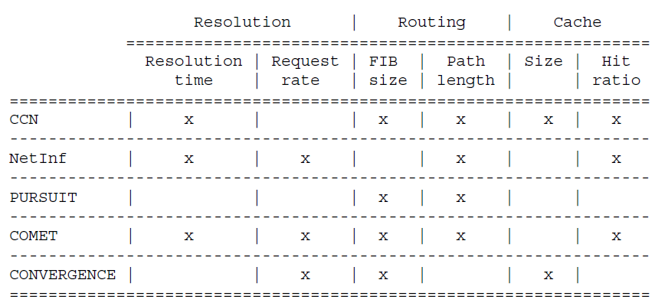
Example: Component Metrics

Slide 14
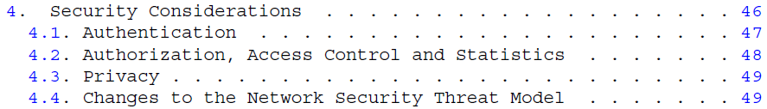
Security Considerations
ICN changes networking as we know it
What is the impact on network security?
Lots of work on content authentication
What about other aspects?
Towards a new/updated threat model?

Slide 15
IEEE Network
Special Issue on
Information-Centric Networking Beyond Baseline Scenarios: Research Advances and Implementation
Large scale scenarios, deployment, and experimentation
Case studies of security attacks and solutions in ICN
ICN development platforms (testbeds, simulators, open-source code) and tools
Evaluation methodology challenges and advances
ICN protocol design challenges in baseline scenarios
ICN practice, including protocol implementation, empirical performance evaluation and enhancements
ICN and Cloud computing
Paper submission deadline: 1 October 2013

Slide 16
Thank You

